Slide 1
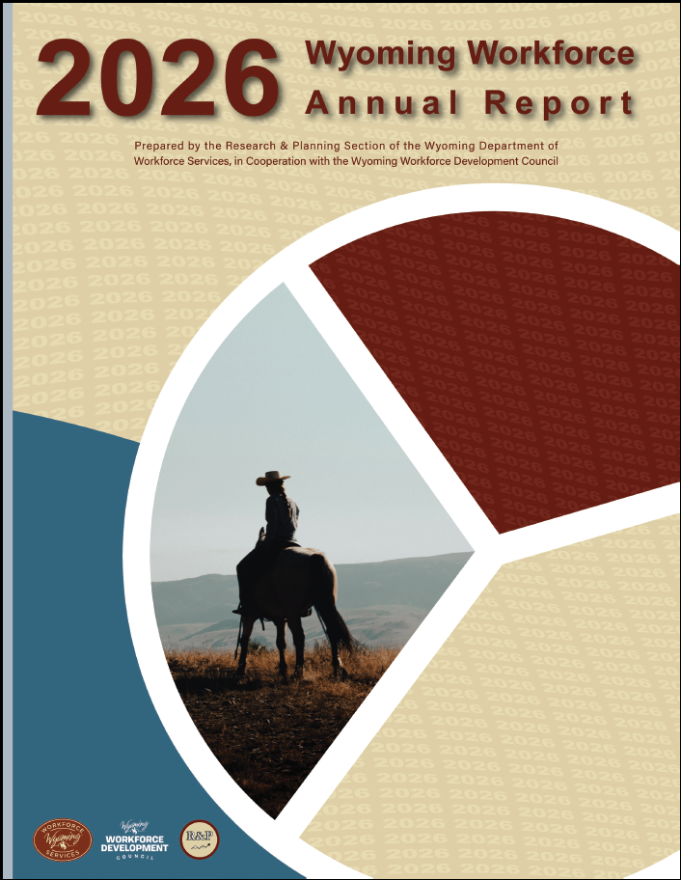
Inside the 2026 Wyoming Workforce Annual Report
Presented to the Wyoming Workforce Development Council by Michael Moore, R&P Research Supervisor, Thursday, September 3, 2026
Notes:
Good morning, my name is Michael Moore and I am the research supervisor for R&P.
I will be covering a couple topics today, beginning with a brief overview of the 2026 Wyoming Workforce Annual Report, and then moving on to a discussion about Wyoming’s leisure & hospitality sector.

Slide 2
2026 Wyoming Workforce Annual Report
About Research & Planning
OUR ORGANIZATION:
R&P is an exclusively statistical entity within DWS.
WHAT WE DO:
R&P collects, analyzes, and publishes timely and
accurate labor market information (LMI)
meeting established statistical standards.
OUR CUSTOMERS:
LMI makes the labor market more efficient by
providing the public and the public’s
representatives with the basis for
informed decision making.
Notes:
Just a little bit about Research & Planning to get us started.
R&P is an exclusively statistical entity within DWS.
We collect, analyze and publish timely labor market information (LMI) data.
We provide this information to the public, legislators, educators, training providers, the media, and more.

Slide 3
2026 Wyoming Workforce Annual Report
2026 Wyoming Workforce Annual Report
https://doe.state.wy.us/annual_report.htm
Annual publication
In conjunction with Wyoming
Workforce Development Council
Overview of all R&P’s work
Notes:
Each year we publish a Wyoming Workforce Annual Report in conjunction with the Wyoming Workforce Development Council.
The 2026 issue was just published in June.
This is a great overview of all the work R&P does during the year.
This publication is available online at the URL on this slide, and there’s also a link at the top of our main page.
This portion of the presentation will serve as a very brief overview to the annual report. I’m sure many of you have read over the report, but if you have not, I encourage you do to do.

Slide 4
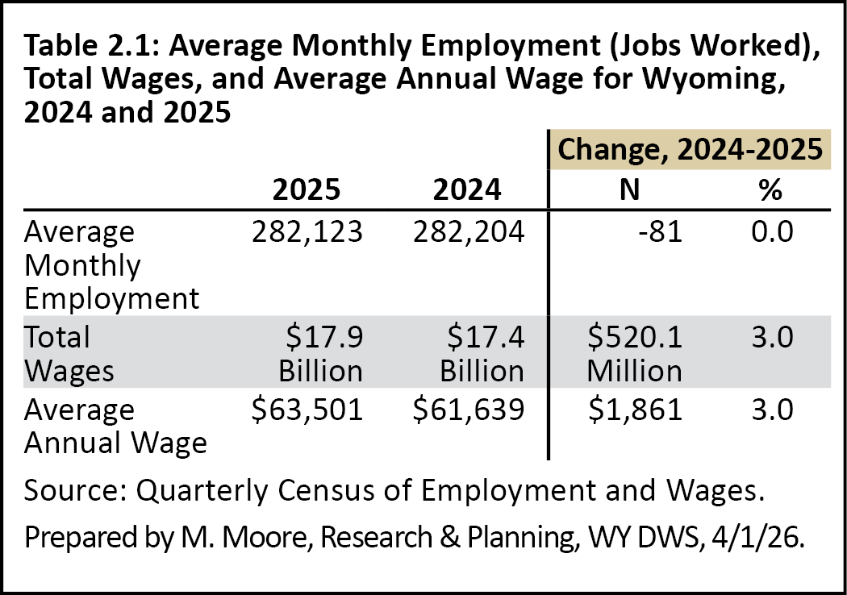
2026 Wyoming Workforce Annual Report
Chapter 2: Quarterly Census of Employment and Wages
Notes:
Chapter 2 looks at annual employment and wages using data from the Quarterly Census of Employment and Wages, or QCEW, and sort of sets the tone for the report.
From 2024-2025:
Wyoming employment was largely unchanged (we lost 81 jobs, a 0.0% change)
Total wages increased by $520.1 million, a 3.0% increase
The state’s average annual wage was $63,501, up 3.0%

Slide 5
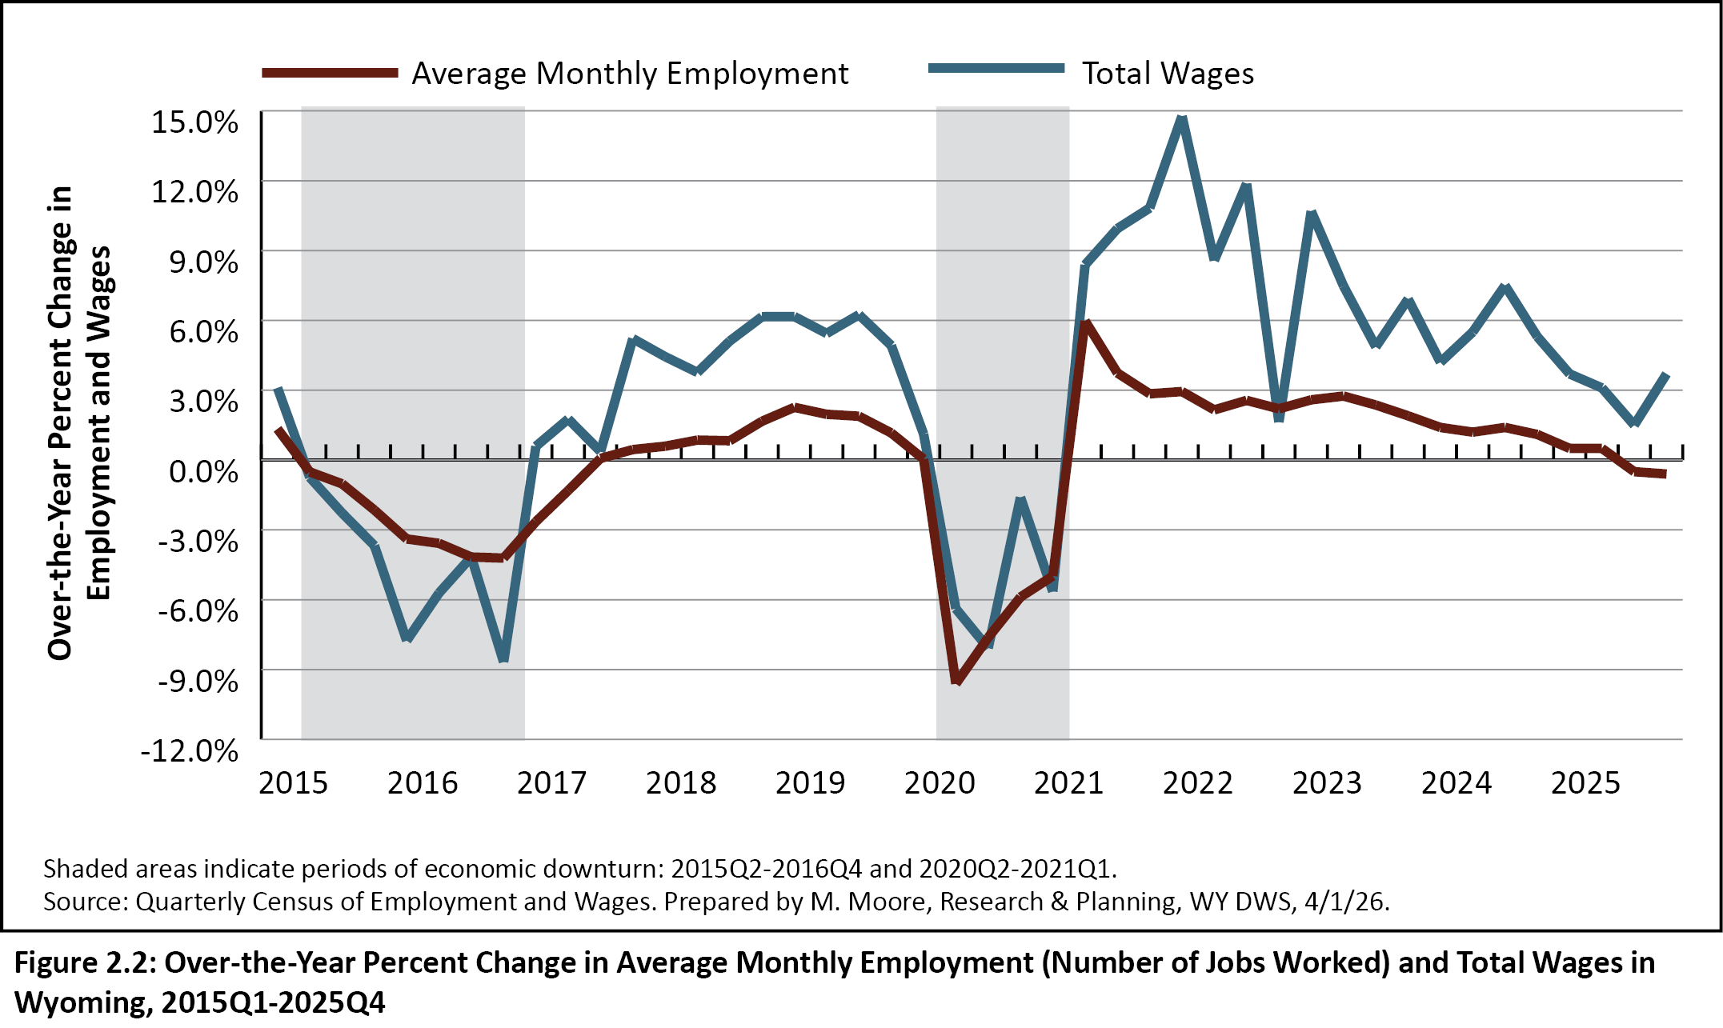
2026 Wyoming Workforce Annual Report
Chapter 2: Quarterly Census of Employment and Wages
Over-the-Year % Change in Employment and Wages, 2015Q1-2025Q4
Notes:
Most notably, Wyoming saw over-the-year job losses in the second half of 2025, but a continued increase in wages.
This figure looks at over-the-year percent change in employment and total wages by quarter from first quarter 2015 to fourth quarter 2025.
At the end of the graph here, you can see the dark red line, which represents employment, dipping below zero. During third and fourth quarter 2025, lost about 1,400 jobs from the prior year, or about half a percent.
There’s discussion in the annual report about economic downturns, which we define as at least two consecutive quarters of over-the-year declines in employment and total wages. You can see the two most recent periods shaded here.
Despite the job losses in the second half of 2025, we don’t think this was the start of another economic downturn.
For one, wages continued to grow.
And secondly, other programs like the Current Employment Statistics program, seem to indicate job growth in 2026.

Slide 6
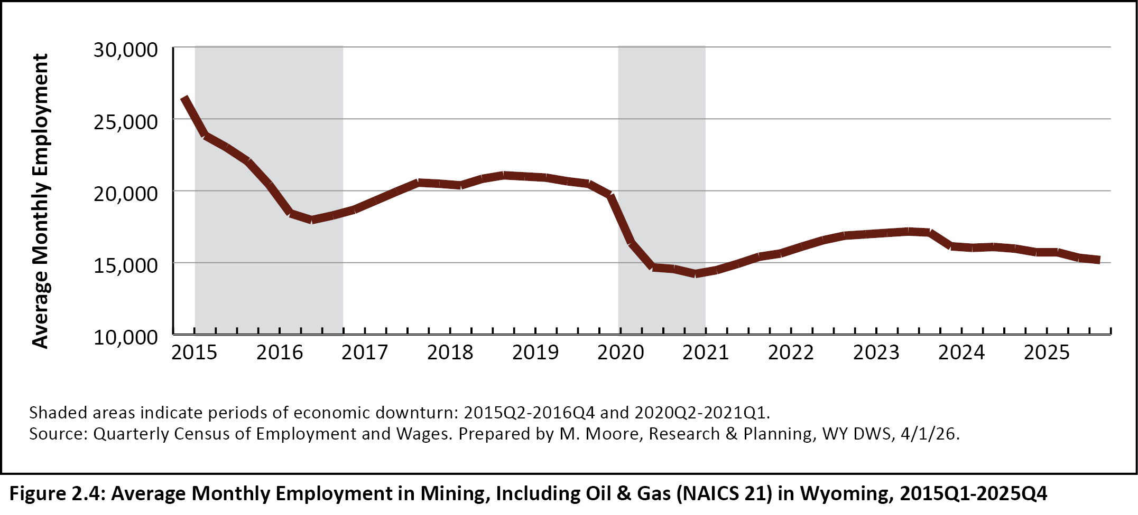
2026 Wyoming Workforce Annual Report
Chapter 2: Quarterly Census of Employment and Wages
Average Monthly Employment in Mining in WY, 2015Q1-2025Q4
Notes:
So why the job losses? There are several reasons, but I’ll touch on two here very briefly.
This figure shows employment in Wyoming’s mining sector from first quarter 2015 to fourth quarter 2025.
We all know how important the mining sector is to Wyoming’s economy, and we’ve continued to see moderate job losses over the last 10 years.

Slide 7
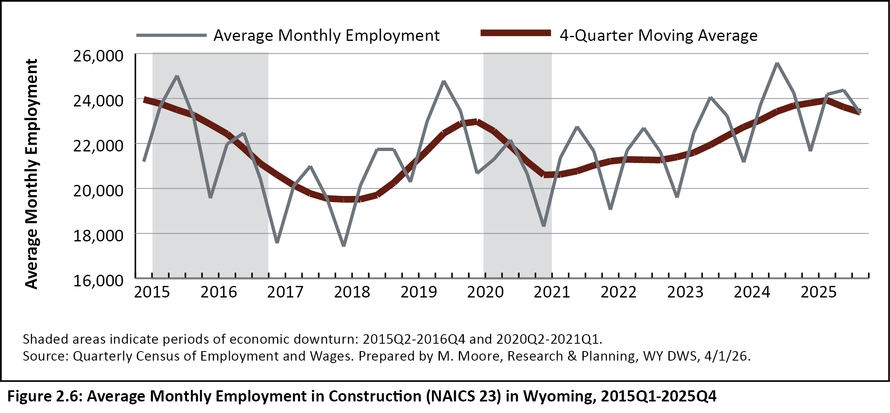
2026 Wyoming Workforce Annual Report
Chapter 2: Quarterly Census of Employment and Wages
Average Monthly Employment in Construction in WY, 2015Q1-2025Q4
Notes:
Another big part of this situation is that since the pandemic, a lot of Wyoming’s job growth has been driven by the construction sector.
This figure shows employment in Wyoming’s construction sector from 2015Q1 to 2025Q4. If you look to the right of the second shaded area, you can see the continued increase until we hit the last two quarters of 2025, and then we see a little bit of a decline.
This job growth was really the result of several large temporary construction projects, like pipelines and windfarms. When those jobs were completed in 2025, those jobs went away, and many of those workers likely went home to another state.
From 2024 to 2025, employment in Wyoming’s construction sector fell by 293 jobs, or 1.2%.

Slide 8
2026 Wyoming Workforce Annual Report
Chapter 2: Quarterly Census of Employment and Wages
Job Growth by Industry
Wholesale trade, transportation, & utilities (376, 1.8%)
Health care & social assistance (247, or 0.9%)
Other services, except public administration (126, or 1.7%)
Notes:
We did see some other industries add jobs from 2024 to 2025.
Wholesale trade, transportation, warehousing, & utilities added 376 jobs, a 1.8% increase.
Health care & social assistance added 247 jobs, a 0.9% increase.
And other services, except public administration added 126 jobs, or 1.7%.

Slide 9
2026 Wyoming Workforce Annual Report
Chapter 4: Local Area Unemployment Statistics
Labor Force: 289,017
Employed: 279,302
Unemployed: 9,715
Unemployment Rate: 3.4%
Notes:
I’ll touch on some other highlights from the annual report fairly quickly, starting with the Local Area Unemployment Statistics program.
Wyoming’s total labor force was 289,017, down about 3,000
The number employed was 279,302, down about 2,700
The number of unemployed individuals was 9,715, up about 600 people
And finally the unemployment rate was 3.4%, up over the last two years

Slide 10
2026 Wyoming Workforce Annual Report
Chapter 5: Unemployment Insurance Statistics
Total UI benefit recipients: 11,753
Exhaustion rate: 17.7%
Average weeks claimed: 10.4
Total benefits paid: $59.4 million
Notes:
In 2025, the number of people receiving Unemployment Insurance benefits was up a little bit over the last couple years, but still historically pretty low.
We had 11,753 UI benefit recipients, up 781 individuals, or 7.1%
17.7% of those recipients exhausted their benefits, which was actually down a little bit
Claimants received 10.4 weeks of benefits on average, up a little bit over the year
And Wyoming paid $59.4 million in benefits, up about $7.8 million, or 15.1%

Slide 11
2026 Wyoming Workforce Annual Report
Chapter 8: Short-Term Employment Projections
Short-Term Projections
2025-2027: More than 6,000 new jobs, or 2.1%
Long-Term Projections
2024-2034: Nearly 28,000 new jobs, or 9.9%
Notes:
The annual report includes a chapter on our short-term projections, which show Wyoming adding more than 6,000 new jobs from 2025 to 2027, a 2.1% increase
Since the report came out, we have published our long-term projections, which show Wyoming adding nearly 28,000 new jobs from 2024 to 2034, a 9.9% increase

Slide 12
2026 Wyoming Workforce Annual Report
Workplace Safety
Chapter 12: Census of Fatal Occupational Injuries
37 occupational fatalities in 2024
  Down from 45 in 2023, which was a 16-year high
Chapter 13: Survey of Occupational Injuries and Illnesses
2,800 nonfatal injuries in 2024
Incidence rate of 2.5 per 100 workers
Notes:
I’ll finish the portion on the annual report talking about two chapters on workplace safety.
In 2024 there were 37 occupational fatalities, down from 45 in 2023. The 45 in 2023 was unusually high, the highest since 2007.
Chapter 13 looks at occupational injuries and illnesses. There were 2,800 nonfatal injuries in 2025, with an incidence rate of 2.5 per 100 workers.
Again, I’ve just briefly touched on some highlights from the annual report. There’s a lot more in the report, so please look it over on our website and feel free to reach out with any questions.

Slide 13
Leisure & Hospitality in Wyoming
Presented to the Wyoming Workforce Development Council by Michael Moore, R&P Research Supervisor, Thursday, September 3, 2026
Notes:
I will move on now to the bulk of the presentation, focusing on Wyoming’s leisure & hospitality sector.

Slide 14
Leisure & Hospitality in Wyoming
How do we Define Leisure & Hospitality?
Arts, Entertainment, & Recreation (NAICS 71)
Performing Arts, Spectator Sports, & Related Industries (NAICS 711)
Museums, Historical Sites, & Similar Institutions (NAICS 712)
Amusement, Gambling, & Recreation Industries (NAICS 713)
About 12% of all jobs in leisure & hospitality
Notes:
I’ll start off by talking about how we define leisure & hospitality.
Leisure & hospitality is comprised of two sectors identified by the North American Industry Classification System, or NAICS
The first of these is arts, entertainment, & recreation, NAICS 71
This is made up of three subsectors:
Performing Arts, Spectator Sports, & Related Industries (NAICS 711)
Museums, Historical Sites, & Similar Institutions (NAICS 712)
Amusement, Gambling, & Recreation Industries (NAICS 713)
This industry accounts for about 12% of all job in leisure & hospitality. In 2025, that’s about 4,500 jobs.

Slide 15
Leisure & Hospitality in Wyoming
How do we Define Leisure & Hospitality?
Accommodation & Food Services (NAICS 72)
Accommodation (NAICS 721)
Food Services & Drinking Places (NAICS 722)
About 88% of all jobs in leisure & hospitality
Notes:
The second sector is accommodation & food services., or NAICS 72
This is made up of two subsectors:
Accommodation (NAICS 721), which includes things like hotels, motels, RV parks, and campgrounds
And food services & drinking places (NAICS 722), which is made up of things like full-service restaurants, fast food restaurants, bars, caterers, and food trucks
This sector makes up the bulk of jobs in leisure & hospitality, accounting for 88%. In 2025, there were 33,742 jobs in accommodation & food services.

Slide 16
Leisure & Hospitality in Wyoming
How do we Define Leisure & Hospitality?
Accommodation & Food Services (NAICS 72)
Arts, Entertainment, & Recreation (NAICS 71)
+
Accommodation & Food Services (NAICS 72)
Leisure & Hospitality
Notes:
So to sum this up, arts, entertainment, & recreation and accommodation & food services are combined to create leisure & hospitality.

Slide 17
Leisure & Hospitality in Wyoming
Employment and Wages
Leisure & Hospitality in 2025
Average Monthly Employment: 38,306 (-31 jobs, -0.1%)
Total Wages: $1.3 Billion (+$34.6 million, +3.2%)
Average Weekly Wage: $568 (+$18, +3.2%)
13.6% of all jobs in Wyoming
6.3% of total wages
Notes:
In 2025, Wyoming’s average monthly employment in leisure & hospitality was 38,306.
That was down just a little bit from 2024, about 31 fewer jobs.
Leisure & hospitality contributed $1.3 billion in total wages, which was up $34.6 million over the year, or 3.2%.
The average weekly wage was $568, up $18, or 3.2%.
That’s obviously quite a bit lower than the total statewide average weekly wage of $1,217.

Slide 18
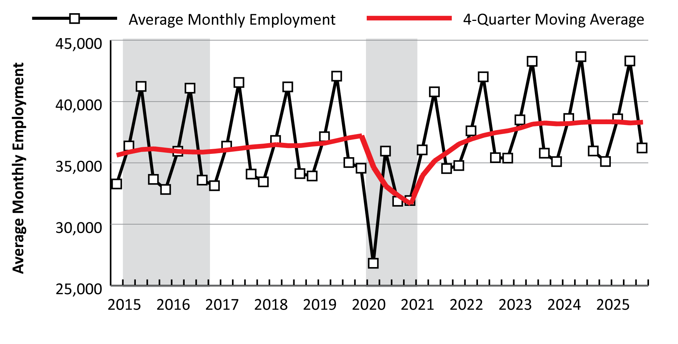
Leisure & Hospitality in Wyoming
Employment and Wages
Average Monthly Employment, 2015Q1-2025Q4
Notes:
This figure shows average monthly employment in leisure & hospitality from first quarter 2015 to fourth quarter 2025. The red line represents a four-quarter moving average that allows us to identify trends.
You can see the seasonal pattern in employment in this industry: employment is lowest in first quarter, picks up in second, and then we see a big surge in third quarter (July-September), and then a big decrease to fourth quarter, and it starts over again.
This first shaded area represents the economic downturn of 2015-2016, and you can see that downturn really didn’t have a lot of impact on leisure & hospitality, as employment was pretty flat. That was more localized in the natural resources & mining sector.
But when we move to the next shaded area, this is the 2020-2021 economic downturn, which was associated with the Covid-19 pandemic. Leisure & hospitality was hit harder than any other industry, and from second quarter 2019 to second quarter 2020 lost about 11,000 jobs, or about 27%.
You can see growth since the pandemic, and in 2023 and 2024 leisure & hospitality hit all-time employment highs. That dropped just a little bit from 2024 to 2025.

Slide 19
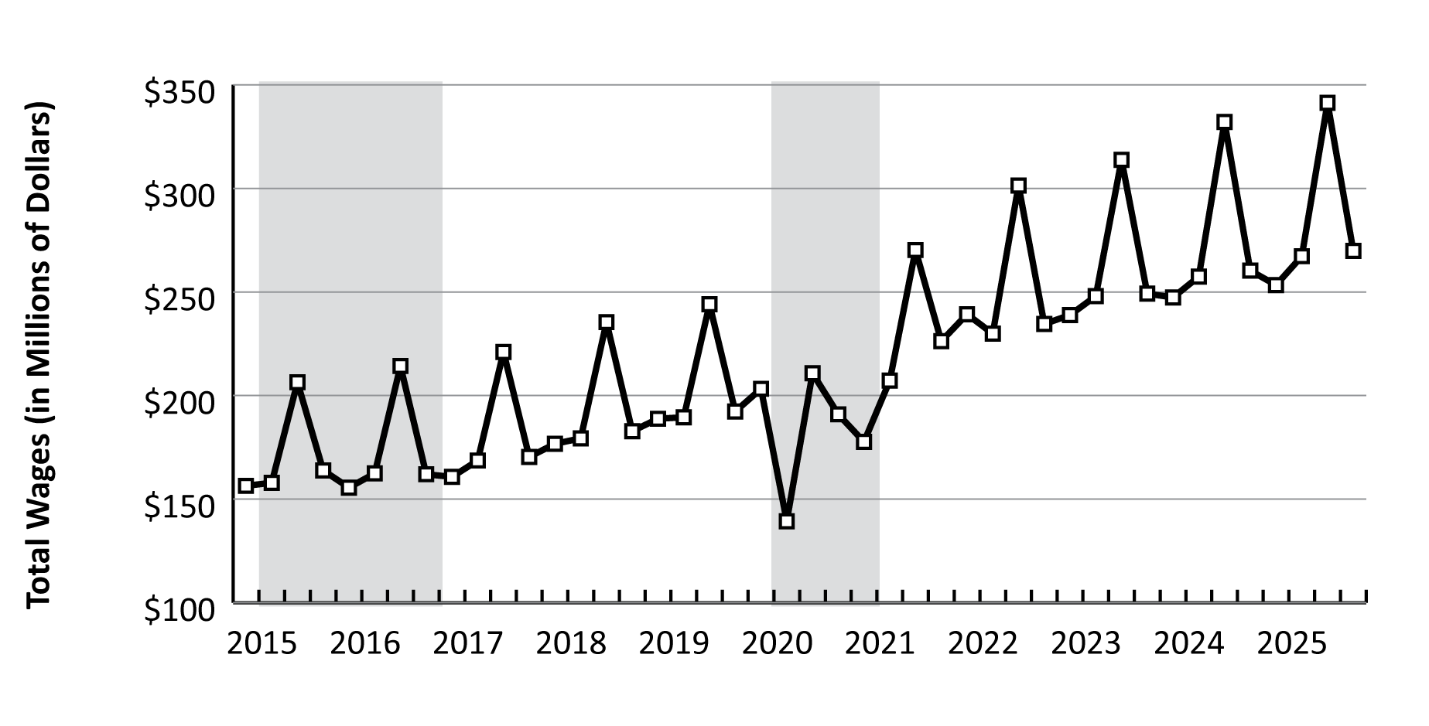
Leisure & Hospitality in Wyoming
Employment and Wages
Total Wages, 2015Q1-2025Q4
Notes:
This figure shows total wages for leisure & hospitality in Wyoming, and you can really see the growth in wages over the last 10 years.
Every third quarter since 2021 we’ve hit a new high, most recently third quarter 2025, when leisure & hospitality had more than $341 million in total wages.
In fact in 2022, leisure & hospitality had its first billion dollar year in terms of total wages, which it has done each year since.

Slide 20
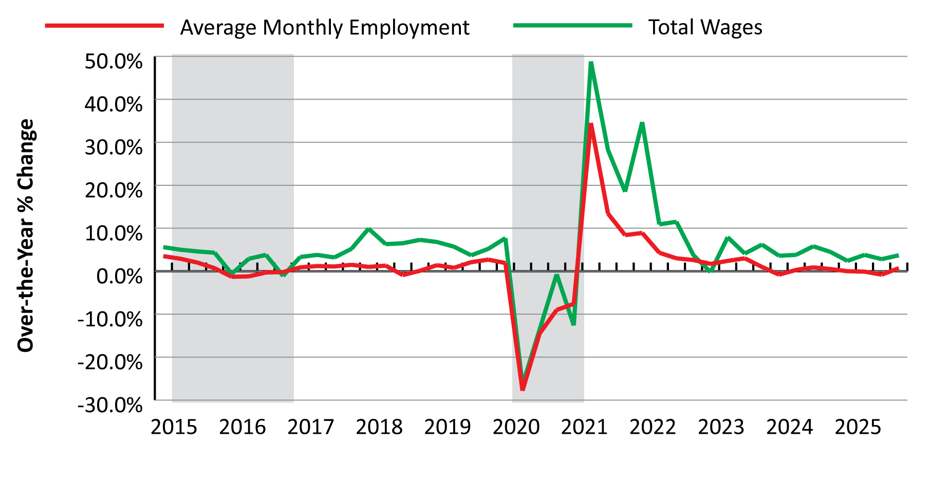
Leisure & Hospitality in Wyoming
Employment and Wages
Over-the-Year Change in Employment and Wages, 2015Q1-2025Q4
Notes:
This figure shows over-the-year changes in average monthly employment and total wages in leisure & hospitality from first quarter 2015 to fourth quarter 2025.
The red line represents employment.
Again you can see that big dip in second quarter 2020, when leisure & hospitality lost about 27% of its jobs from the prior year. You see the big increase again in 2021; we had moderate job growth in 2022 and 2023, but it’s been pretty flat the last couple years.

Slide 21
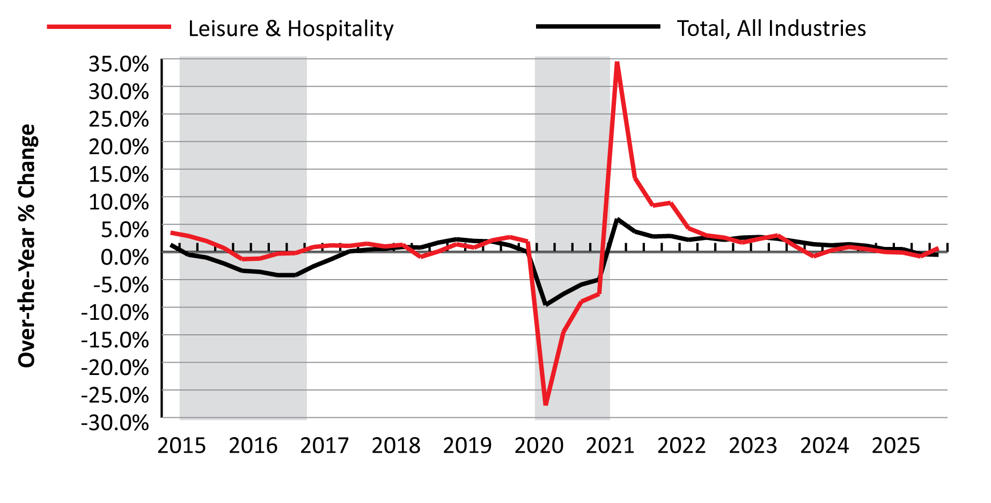
Leisure & Hospitality in Wyoming
Employment and Wages
Over-the-Year Change in Employment in Leisure & Hospitality and
All Industries, 2015Q1-2025Q4
Notes:
This figure shows over-the-year change in average monthly employment in leisure & hospitality compared to the statewide total, which is the black line. You can see how much harder the 2020-2021 downturn hit leisure & hospitality (the red line) than the overall total (the black line). From second quarter 2019 to second quarter 2020, Wyoming lost about 10% of its total jobs, compared to over 27% of jobs in leisure & hospitality.

Slide 22
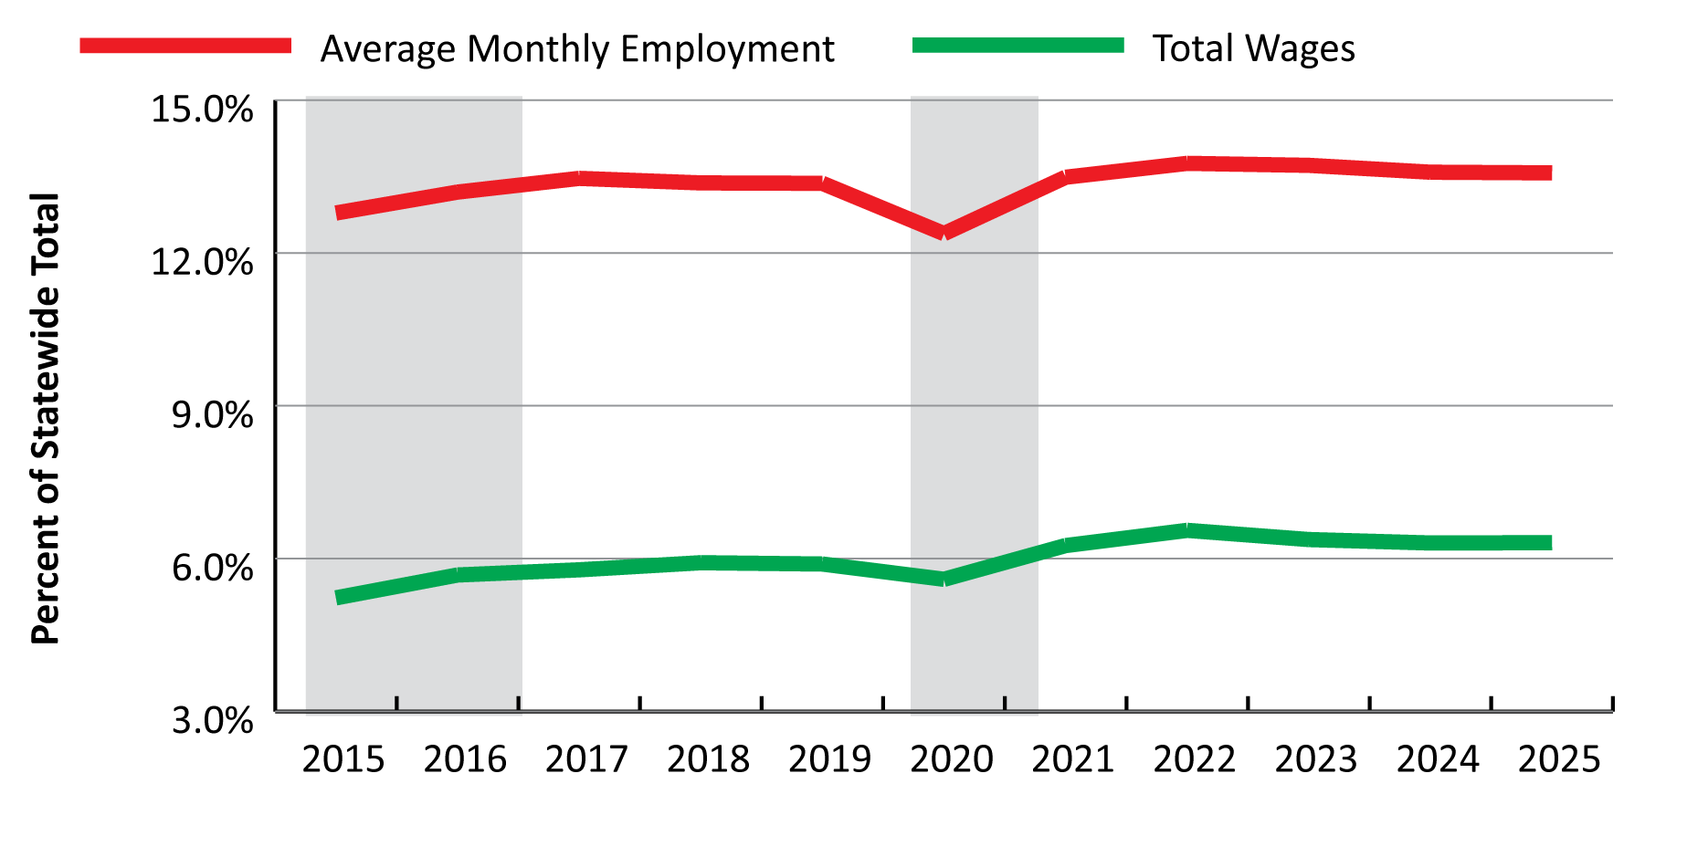
Leisure & Hospitality in Wyoming
Employment and Wages
Leisure & Hospitality as % of Statewide Total Employment
and Wages, 2015-2025
Notes:
This figure shows leisure & hospitality in terms of the statewide total of employment and wages from 2015 to 2025.
Since the pandemic, leisure & hospitality has consistently contributed about 13% of all jobs in the state, and just over 6% of the state’s total wages.

Slide 23
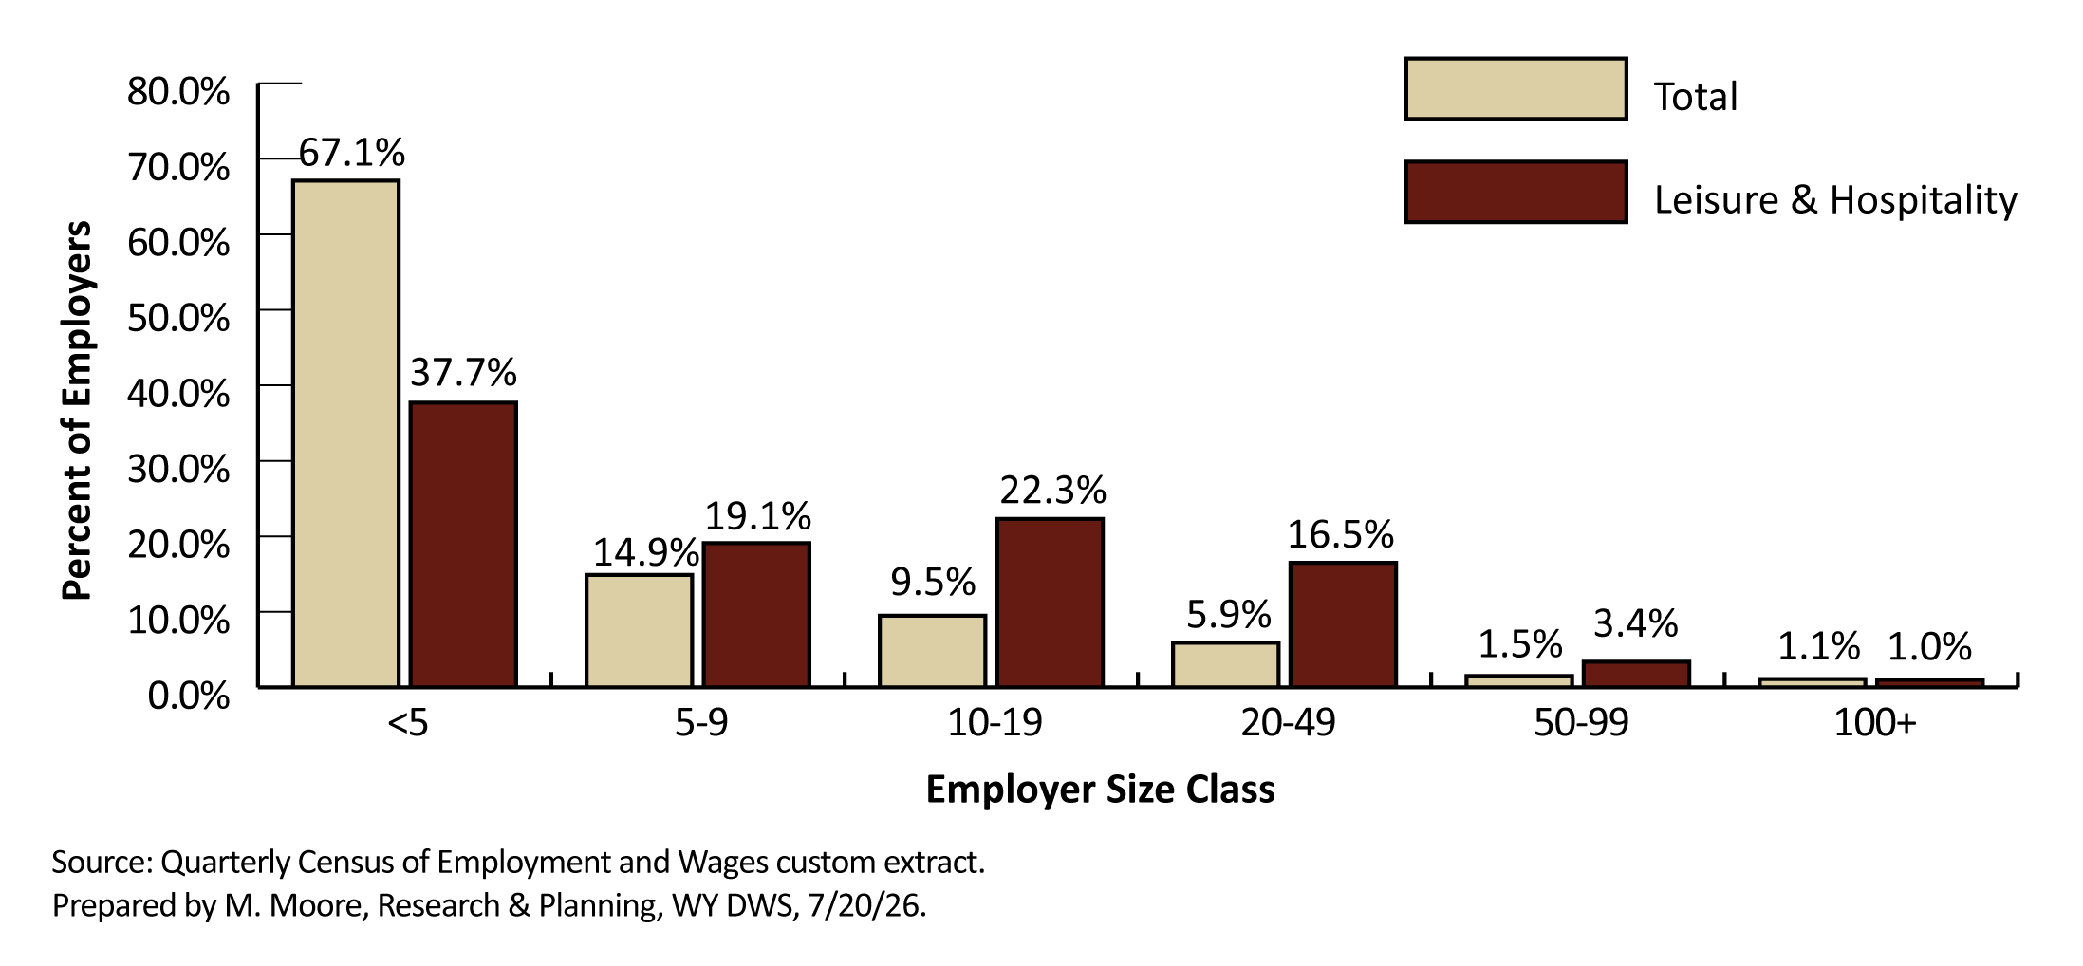
Leisure & Hospitality in Wyoming
Employment and Wages
Percent of Employers by Size Class, 2025
Notes:
This figure shows leisure & hospitality in terms of employer size class, or number of employees.
You can see quite a few differences between leisure & hospitality (the red bars) and the overall total (the tan).
For example, two-third of all employers in Wyoming had fewer than 5 employees in 2025, compared to just 37.7% of leisure & hospitality employers.
We really see a difference in the middle, as employers with 10-19 employees make up 22.3% of employers in leisure & hospitality, compared to 9.5% overall.
We also see a difference in employers with 20-49 employees, with 16.5% of leisure & hospitality employers compared to 5.9% overall.

Slide 24
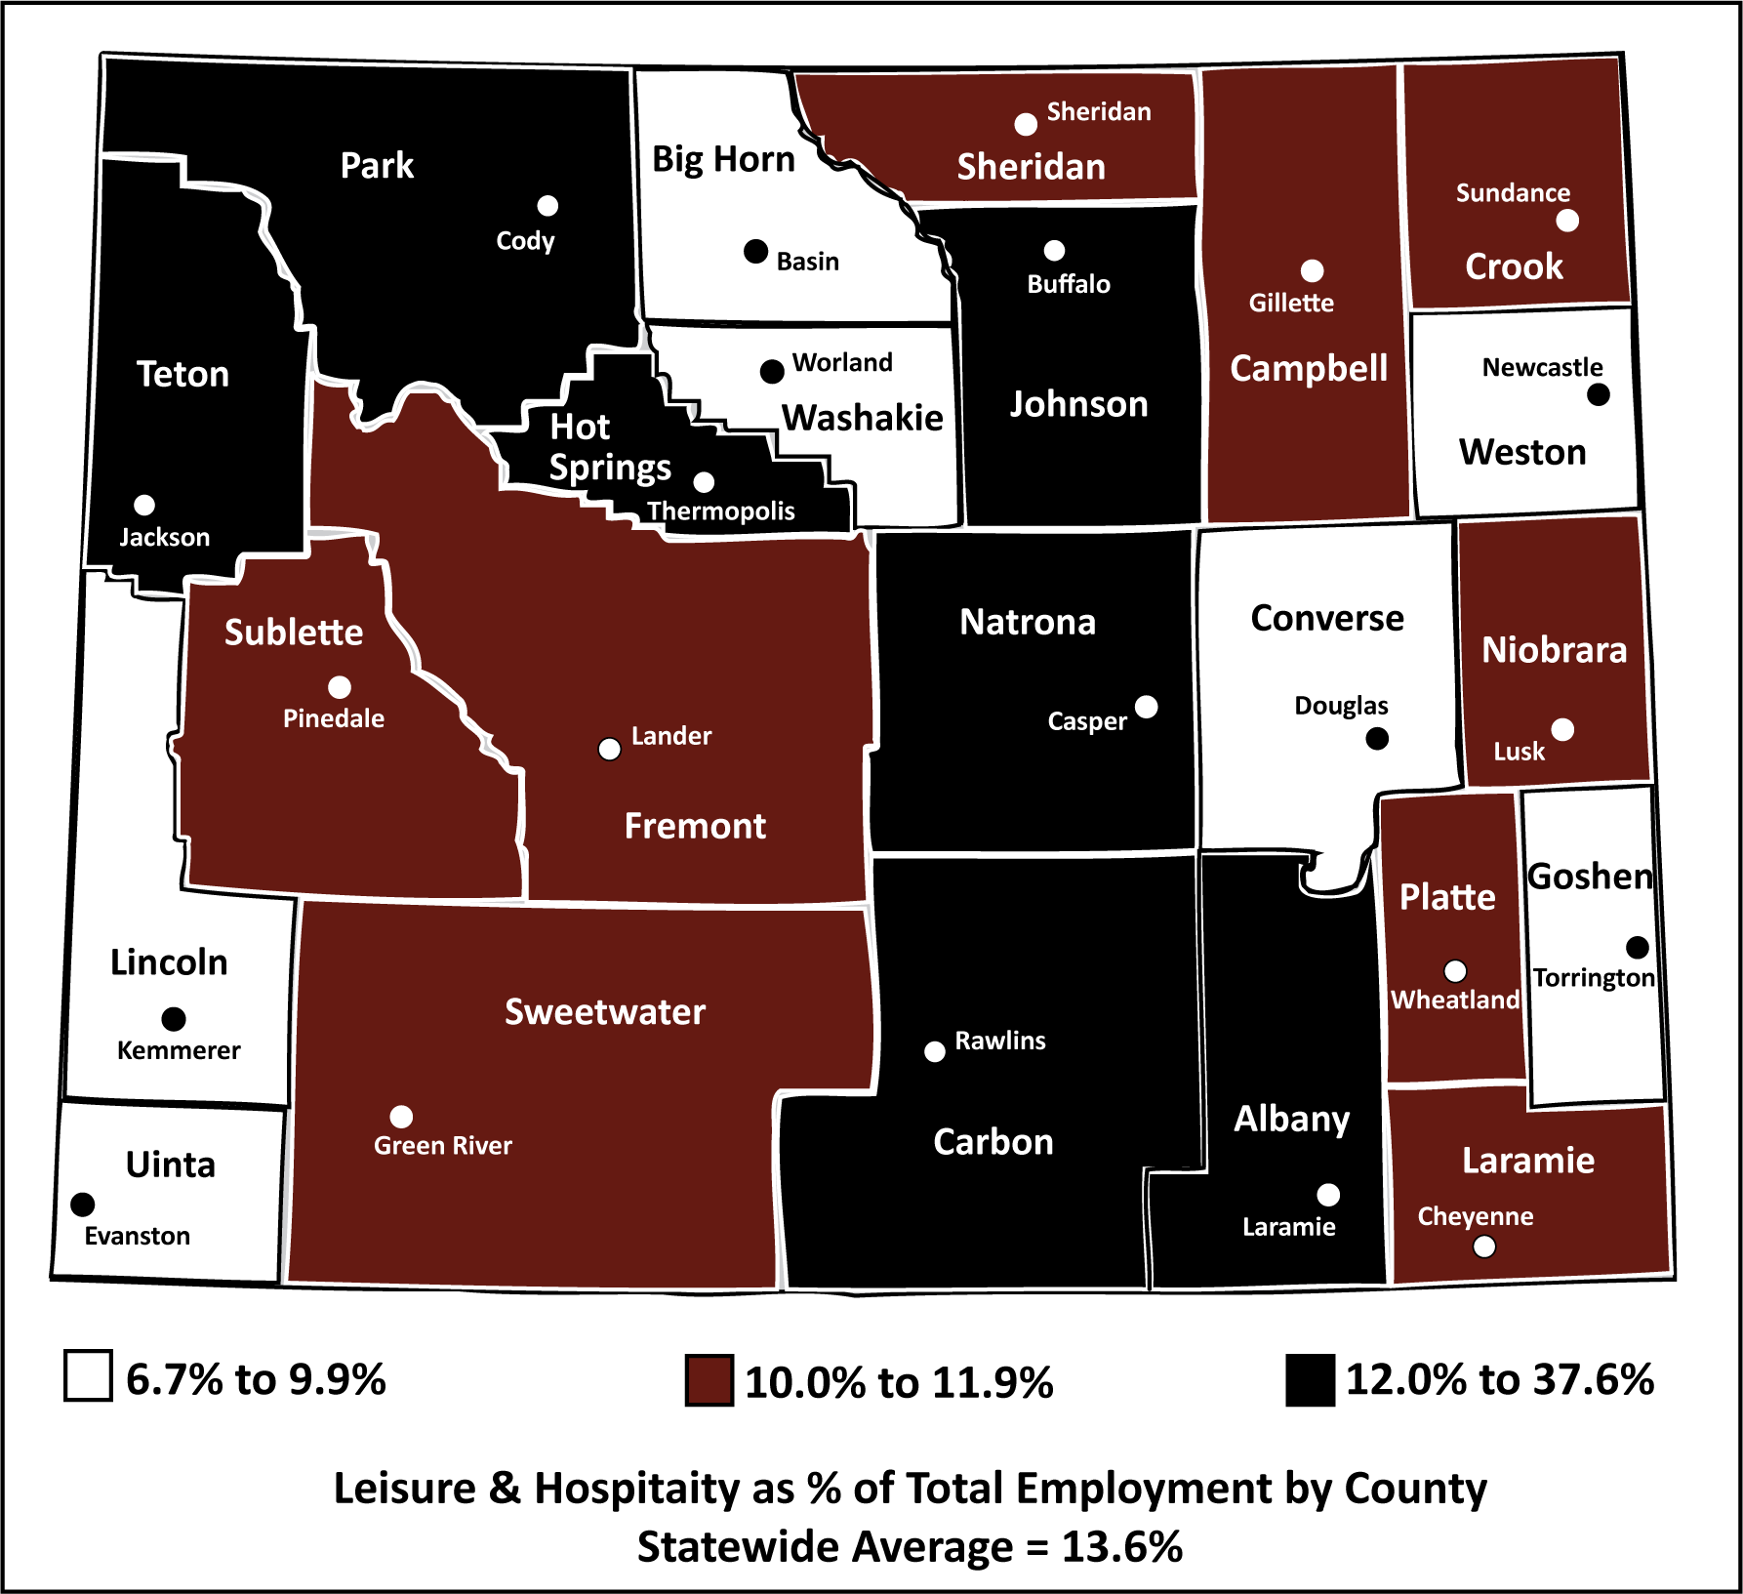
Leisure & Hospitality in Wyoming
Employment and Wages
Leisure & Hospitality as a % of Total Employment by County, 2025
Notes:
This figure shows leisure & hospitality as a percentage of total employment by county in 2025.
Statewide, leisure & hospitality accounted for 13.6% of all jobs.
The white counties are those where leisure & hospitality made up the smallest proportion of jobs, less than 10%.
The red counties are those where leisure & hospitality made up 10-11.9% of all jobs.
And finally, in the black counties, leisure & hospitality made up between 12% and 37.6% of all jobs.
In Teton County, leisure & hospitality made up 37.6% of all jobs. In fact, about one in four leisure & hospitality jobs in Wyoming were located in Teton County.

Slide 25
Leisure & Hospitality in Wyoming
Demographics of the Workforce
Leisure & Hospitality in 2025
Total Persons Working: 57,538
Average Annual Wages: $19,241
Average Quarters Worked: 2.8
Notes:
We’ll take a look at some of the demographics of the workforce, which is accomplished by linking Wage Records with other administrative databases.
While the previous section was a discussion of the jobs, this is more of a discussion on the persons working those jobs.
These numbers include all people working in Wyoming in 2025 at any time during the year, so they may have worked one day or all four quarters.
Overall there were 57,538 people who worked in leisure & hospitality at any time in 2025.
They earned an average annual wage of $19,241, and worked an average of 2.8 quarters.
These numbers are obviously representative of leisure & hospitality, where jobs are often seasonal and hourly pay is often lower.

Slide 26
Leisure & Hospitality in Wyoming
Demographics of the Workforce
Leisure & Hospitality in 2025
Total Persons Working: 57,538 / 351,812
Average Annual Wages: $19,241 / $46,079
Average Quarters Worked: 2.8 / 3.2
Notes:
So when we compare that to the overall numbers of persons working in Wyoming at any time during the year, we see there were 351,812 total persons working.
The overall average annual wage was $46,079, more than twice the wage for leisure & hospitality.
And people working in Wyoming overall worked an average of 3.2 quarters during the year, compared to 2.8 in leisure & hospitality.

Slide 27
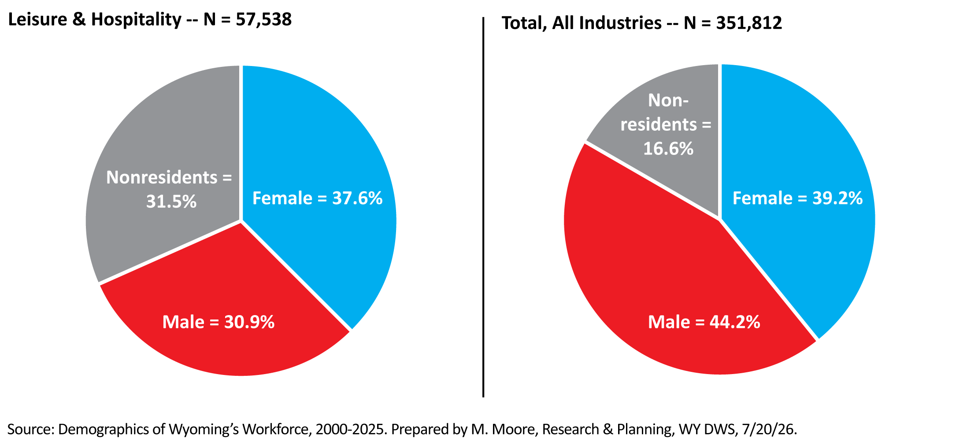
Leisure & Hospitality in Wyoming
Demographics of the Workforce
Persons Working in Wyoming by Sex, 2025
Notes:
These figures look at persons working in Wyoming by sex.
The figure on the left looks at persons working in leisure & hospitality, while the figure on the right represents all industries.
The biggest difference is the gray slice of the pie, which represents nonresidents. In leisure & hospitality, nonresidents made up nearly one-third of all persons working, or 31.5%.
In contrast, nonresidents made up 16.6% of all persons working in Wyoming overall.

Slide 28
Leisure & Hospitality in Wyoming
Demographics of the Workforce
Nonresidents
Persons for whom demographic data are not available
No Wyoming driver’s license
Often come from another state or country for temporary work
Often work in leisure & hospitality and construction
Notes:
Nonresidents is a term we use to describe individuals for whom demographic data are not available.
These are individuals who do not have a Wyoming driver’s license, and often come to Wyoming from another state or country for temporary work.
Nonresidents are often found working in seasonal industries like leisure & hospitality and construction.

Slide 29
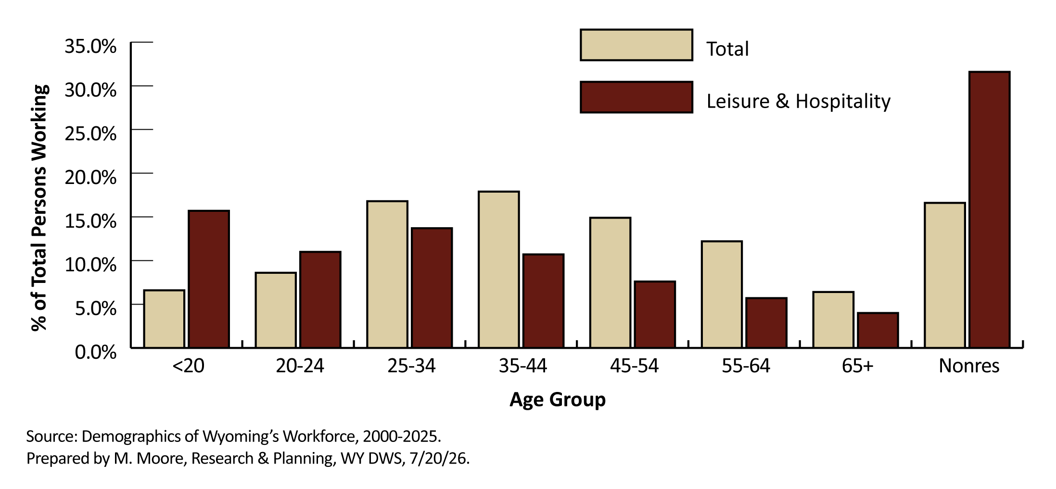
Leisure & Hospitality in Wyoming
Demographics of the Workforce
Persons Working in Wyoming by Age, 2025
Notes:
This figure shows the percentage of persons working in leisure & hospitality and the statewide total by age in 2025.
The tan bar represents the total, while the red bar represents leisure & hospitality.
You can see that leisure & hospitality relies more on younger workers (under 20 and 20-24) and nonresidents than the overall total.
Teens made up 15.7% of persons working in leisure & hospitality in 2025, compared to 6.6% overall.

Slide 30
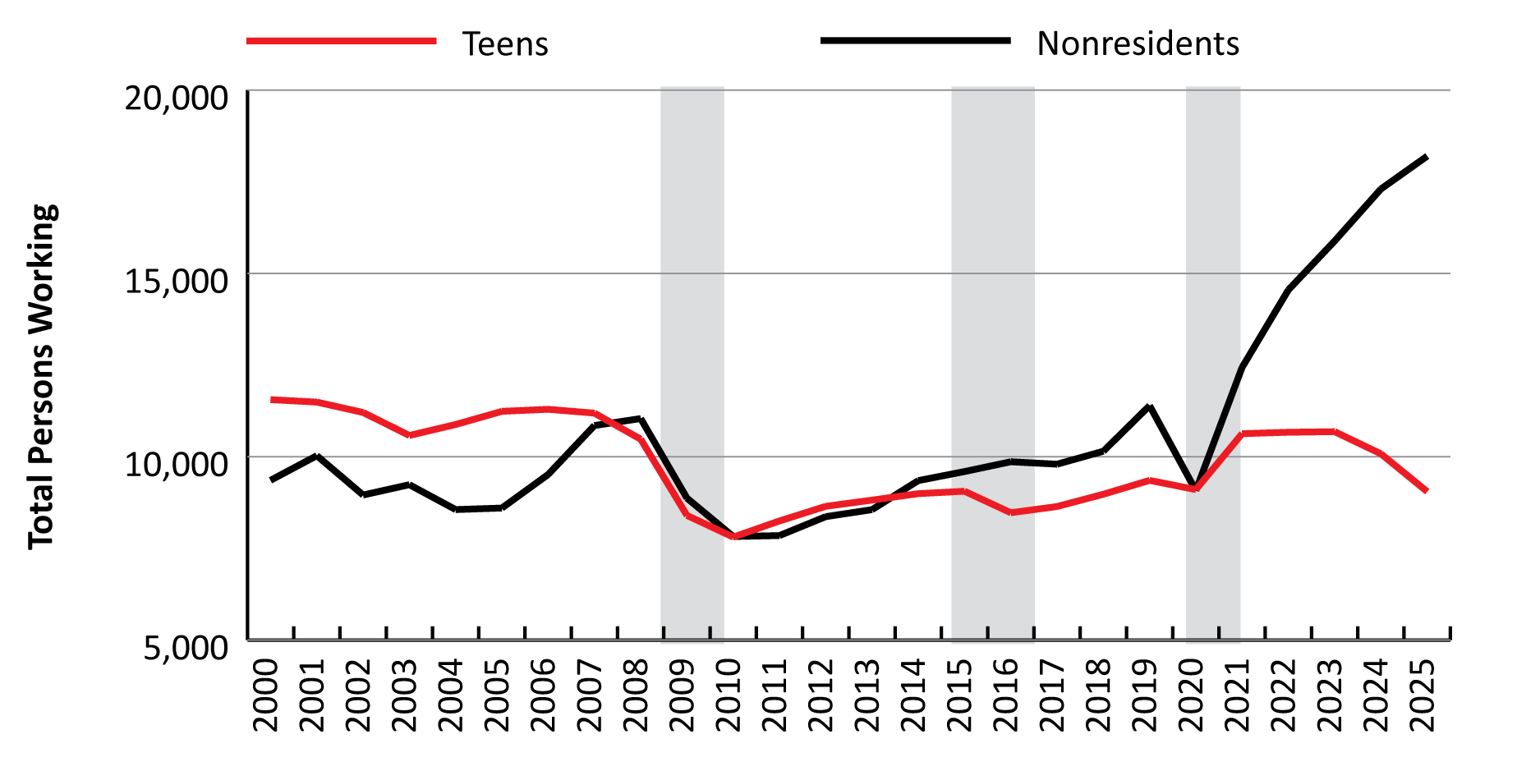
Leisure & Hospitality in Wyoming
Demographics of the Workforce
Teens and Nonresidents Working in Leisure & Hospitality, 2000-2025
Notes:
Over the last 25 years, we have seen quite a change of how youth participate in the labor market, and what that means for employers and nonresidents.
If we go back to the early 2000s, we consistently had more teens (the red line) working in the leisure & hospitality workforce than nonresidents (the black line).
That really changed by the time that first economic downturn hit in 2009, which was the same time as the national Great Recession. From that point on, there just weren’t as many teens working in Wyoming, or in the U.S. as a hole.
Since about 2014, we’ve consistently had more nonresidents working in Wyoming than teens.
Since the pandemic (the third gray bar) we’ve seen a substantial increase in nonresidents working in leisure & hospitality, while teens have trailed off a little bit.
Basically as fewer and fewer young people choose not to participate in Wyoming’s labor market for whatever reason, employers appear to be turning to nonresidents to fill those jobs more and more.
Part of this could also be fewer teens driving. If a teenager who lives in Wyoming doesn’t have a driver’s license, we likely wouldn’t be able to identify them, and they would be counted as a nonresident.

Slide 31
Leisure & Hospitality in Wyoming
Occupations
Top 10 Frequently Occurring Occupations in in Leisure & Hospitality, 2025
SOC Code | Title | Employment | Average Annual Wage
 | Total, All Occupations | 36,201 | $37,916
35-3023 | Fast Food & Counter Workers | 6,381 | $27,021
35-3031 | Waiters & Waitresses | 3,463 | $31,368
35-2014 | Cooks, Restaurant | 2,671 | $37,900
35-3011 | Bartenders | 2,382 | $29,595
35-1012 | First-Line Supervisors of Food Preparation & Serving Workers | 2,166 | $42,140
37-2012 | Maids & Housekeeping Cleaners | 2,076 | $32,214
49-9071 | Maintenance & Repair Workers, General | 1,089 | $42,472
35-9021 | Dishwashers | 986 | $30,868
43-4081 | Hotel, Motel, & Resort Desk Clerks | 936 | $36,161
53-3031 | Driver/Sales Workers | 934 | $25,947
Source: Occupational Employment & Wage Statistics.
Prepared by T. Glover, Research & Planning, WY DWS, 7/1/26.
Notes:
The Occupational Employment and Wage Statistics program allows us to look at employment and wages by occupation within leisure & hospitality.
In 2025, employment was 36,201, with an average annual wage of just under $38,000.
This slide shows the 10 occupations that are most frequently found in leisure & hospitality – things like fast food workers, waiters & waitresses, cooks, housekeeping cleaners, hotel clerks, etc.
These 10 occupations make up about two-thirds of total employment in leisure & hospitality.

Slide 32
Leisure & Hospitality in Wyoming
Unemployment Insurance Claims
Leisure & Hospitality in 2025
11,753 benefit recipients in 2025
  2,103 in leisure & hospitality
$59.5 millions in benefits paid
  $8.6 million in leisure & hospitality
10.4 average weeks claimed
  9.2 in leisure & hospitality
Notes:
These are some statistics in terms of annual Unemployment Insurance claims and benefits paid.
In 2025 Wyoming had a total of 11,753 benefit recipients, and 2,103 were in leisure & hospitality, about 17.9% of the total.
Wyoming paid $59.5 million in benefits, with $8.6 million in leisure & hospitality, 15% of the total.
The average claimant received 10.4 weeks of benefits over all, which was lower in leisure & hospitality with 9.2.

Slide 33
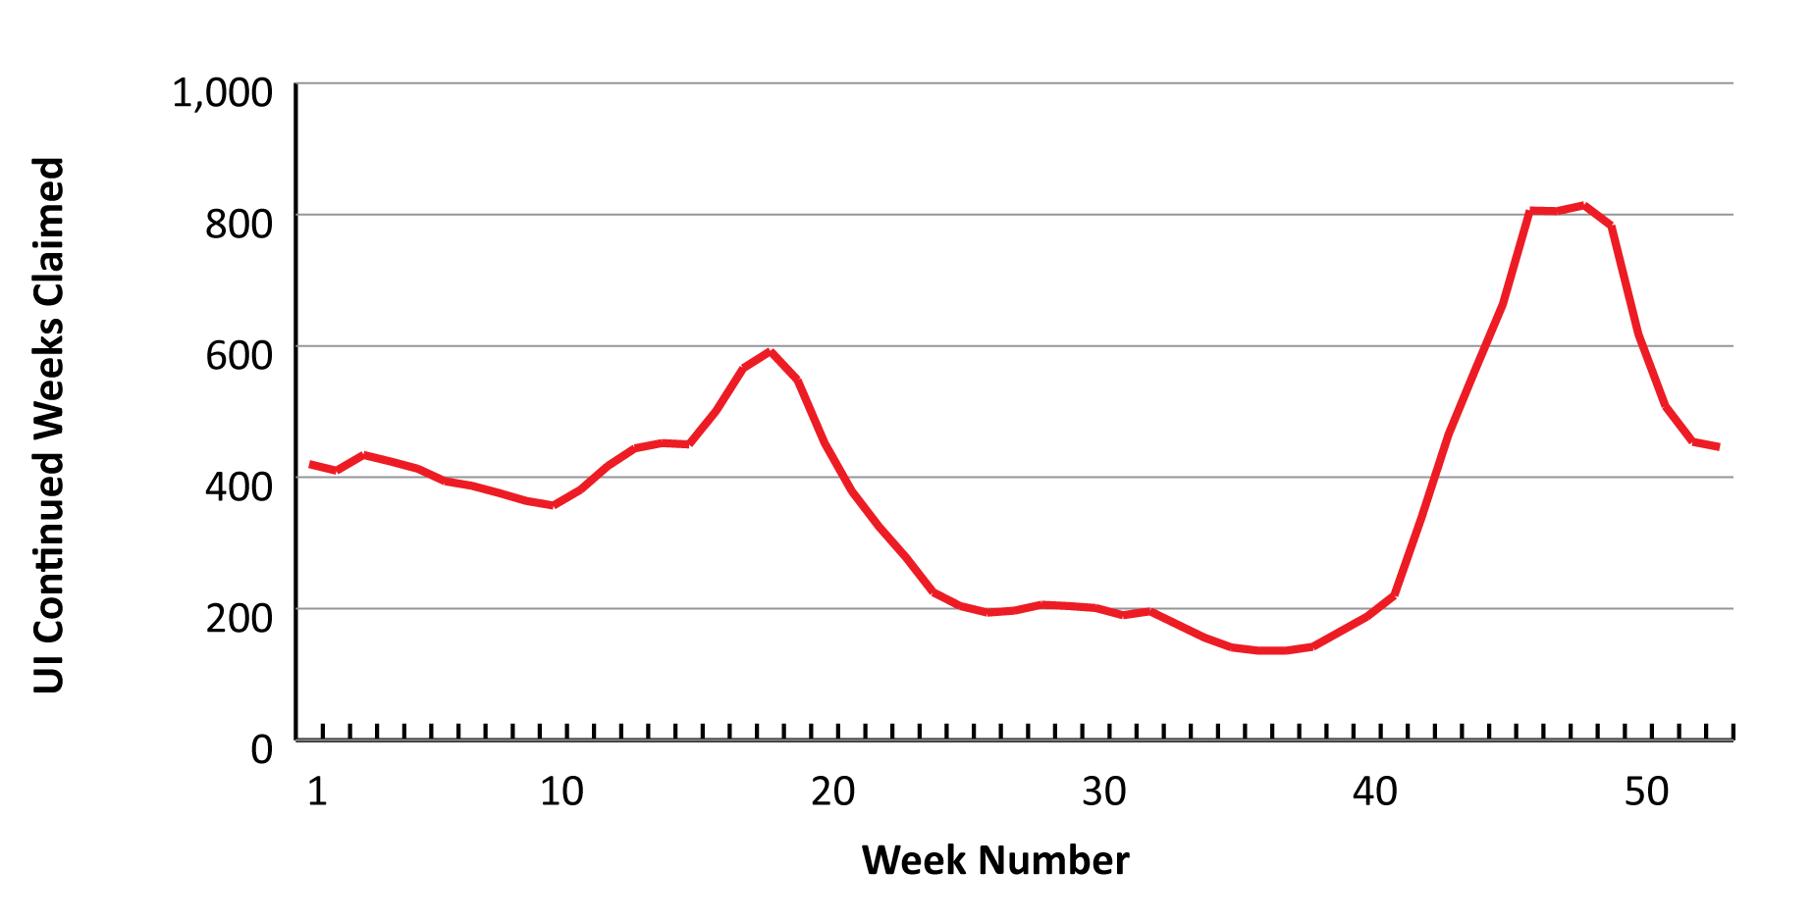
Leisure & Hospitality in Wyoming
Unemployment Insurance Claims
Continued UI Claims by Week in Leisure & Hospitality,
2025 Weeks 1-53
Notes:
This figure shows continued UI claims for leisure & hospitality by week for 2025.
You can see how claims spike a little bit around week 18 in the spring as the winter tourism season ends, and then remain pretty low from about week 25 to 40 in the summer months.
Starting about week 41 we see a big increase as the summer season ends and more people file UI claims.
Claims in leisure & hospitality tend to peak around weeks 46-48 in November, and then drop again and the whole thing starts over again.

Slide 34
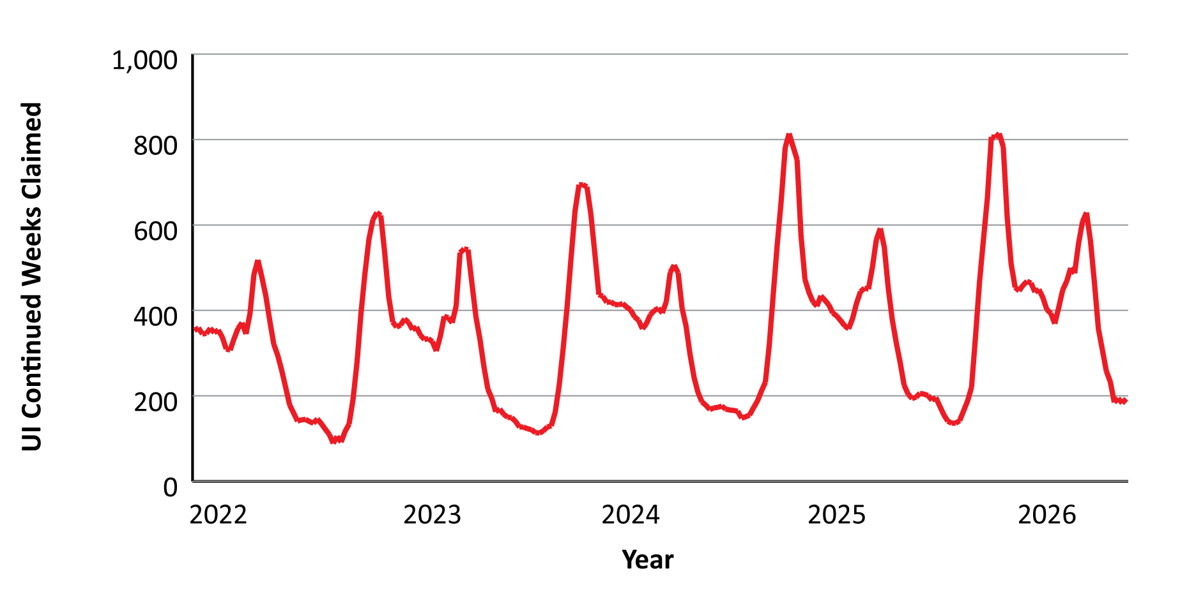
Leisure & Hospitality in Wyoming
Unemployment Insurance Claims
Continued UI Claims by Week in Leisure & Hospitality,
2022 Week 1 to 2026 Week 27
Notes:
If you want to see how consistent this pattern is for continued UI claims in leisure & hospitality, this figure shows weekly claims for 2022 Week 1 through 2026 Week 27.
You see the same thing each year, with an increase in the spring, followed by a period of low claims in the summer, and then that big spike in the fall.

Slide 35
Leisure & Hospitality in Wyoming
Quarterly Turnover
Second Quarter 2025
Turnover: Hires, exits, and both
Continuous: Employed by same employer the previous and subsequent quarter
Turnover + Continuous = Total Employment
Turnover Rate: Turnover/Total
Notes:
I’ll talk briefly about quarterly turnover in leisure & hospitality.
For our purposes, turnover basically refers to anyone who is a hire, exit, or both in a given quarter
Continuous employment refers to individuals who were working for the same employer in the quarter being discussed, the previous quarter, and the subsequent quarter
So in this example, we’re looking at second quarter 2025. Continuous employment would refer to an individual who worked for the same employer in first, second, and third quarter 2025.
Adding turnover and continuous employment gives us total employment for that quarter.
We calculate the turnover rate by dividing the number of turnover (hires, exits, or both in the same quarter) by the total employment.

Slide 36
Leisure & Hospitality in Wyoming
Quarterly Turnover
Second Quarter 2025
Turnover (hires, exits, both): 101,437
Continuous: 227,966
Total: 329,403
Turnover Rate: 101,437/329,403 = 30.8%
WY turnover rate: 30.8%
  Leisure & hospitality turnover rate: 52.8%
Notes:
So in this example for second quarter 2025, there were 101,437 individuals working in Wyoming who we would consider turnover, meaning they were hired, exited their job, or both in that quarter.
Continuous employment was 227,966, meaning those individuals worked for the same employer in quarters 1-3 in 2025.
Our total employment in second quarter 2025 was 329,403.
To calculate the turnover rate, we divide the turnover by the total, and get a rate of 30.8% across all industries. This means that nearly one in three people working in Wyoming in second quarter 2025 were in some form of turnover (hires, exits, or both).
The turnover rate in leisure & hospitality was even higher: 52.8%.

Slide 37
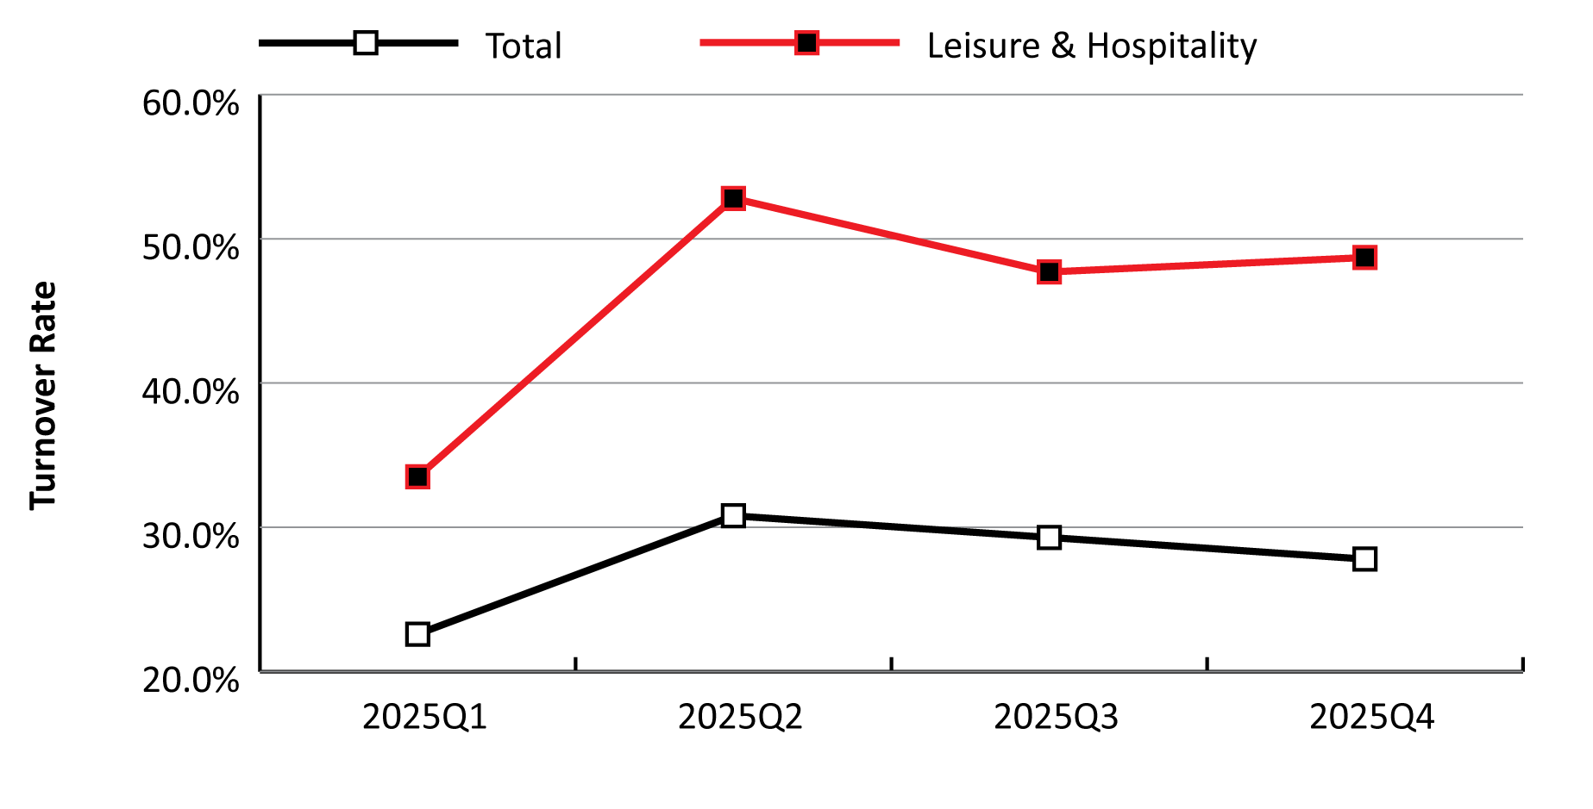
Leisure & Hospitality in Wyoming
Quarterly Turnover
Turnover Rate for Total Industries and Leisure & Hospitality, 2025Q1-Q4
Notes:
Turnover rates tend to follow a pretty predictable pattern in Wyoming, especially in leisure & hospitality. The red line in this graphic is the turnover rate for leisure & hospitality, while the black line represents the overall turnover rate from first quarter 2025 to fourth quarter 2025.
You can see the turnover rate is considerably higher in leisure & hospitality, which is not surprising given the seasonal nature of many of the jobs.
You can see in leisure & hospitality that turnover peaks during the second quarter, when a lot of people are getting hired for jobs or exit jobs, and then stays pretty high during the third and fourth quarters, and is lowest in the first quarter with less activity going on.

Slide 38
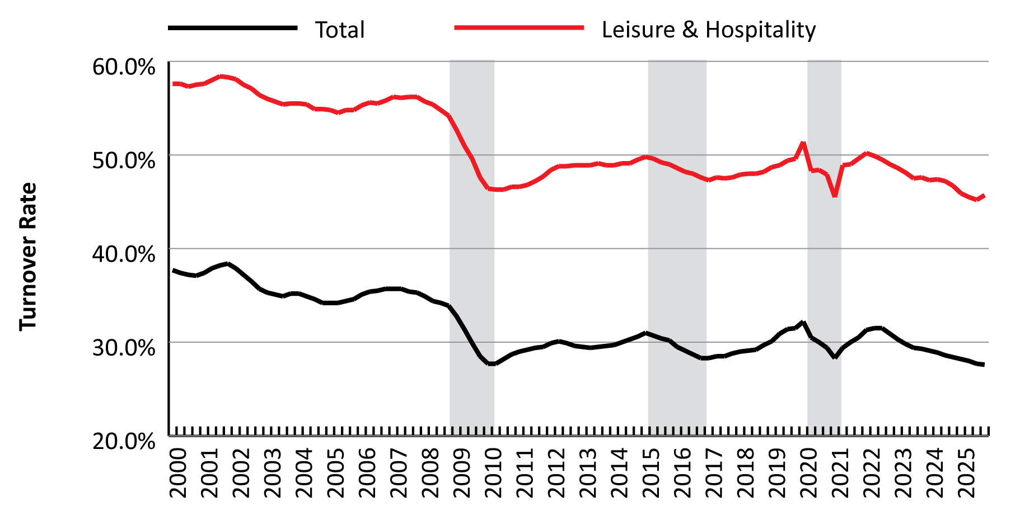
Leisure & Hospitality in Wyoming
Quarterly Turnover
Turnover Rate for Total Industries and Leisure & Hospitality, 2000-2025
Notes:
This figure shows the turnover rate for leisure & hospitality (the red line) and the overall total (the black line) from first quarter 2000 to fourth quarter 2025 using a 4-quarter moving average.
The turnover rate tends to be highest during periods of economic growth, as there are more job opportunities and more incentive for people to change jobs, which we can see on the left hand side of the figure in the early 2000s, when Wyoming was in a period of rapid economic growth.
During those periods of downturn (the gray bars in this graphic) the turnover rate drops, as there are fewer job opportunities and people are less likely to change jobs.
During the downturn of 2009-10 and the national Great Recession, you can see the really prolonged decrease in the turnover rate for both the total and especially leisure & hospitality.
When we look at the most recent downturn that’s associated with the Covid-19 pandemic, we see a pretty quick drop in the turnover rate and then a recovery, although the turnover rate has been consistently declining since 2022.

Slide 39

Leisure & Hospitality in Wyoming
Contact Us
Michael Moore, Research Supervisor
(307) 473-3814
Michael.Moore@wyo.gov
444 W. Collins Drive
Suite 3100
Casper, WY 82601
https://doe.state.wy.us/LMI
Notes:
With that I will go ahead and wrap up the presentation.
Thank you for inviting me to speak here today. Hopefully I’ve given you plenty to think about with regard to Wyoming’s leisure & hospitality sector.
If you have any questions or need any assistance finding particular data, please feel free to reach out to me. My phone number and email address are provided on this slide, along with our physical address and website.

