Slide 1
Economic and Workforce Analyses
Research & Planning’s Contributions to the WIOA State Plan Revisions for 2026
Presented to the Wyoming Workforce Development Council by Michael Moore, R&P Research Supervisor, Thursday, May 14, 2026
Notes:
Good afternoon, my name is Michael Moore and I am the research supervisor for R&P.
Thank you for giving me the time today to talk to you a little bit about R&P’s part in the WIOA state plan two-year revisions. Just as a reminder, WIOA stands for Workforce Innovation and Opportunity Act.
Please keep in mind that at the time we put this plan together, much of the most recent data we had was through 2024.
The 2026 Wyoming Workforce Annual Report is being reviewed by our editorial committee right now and will be sent to the council for reviews within the next week. That report will have more current data through 2025 and into early 2026.
The annual report will be published in June, and I will be back here in the fall to provide the council with an overview.

Slide 2
WIOA State Plan Revisions: 2026
About Research & Planning
OUR ORGANIZATION:
R&P is an exclusively statistical entity within DWS.
WHAT WE DO:
R&P collects, analyzes, and publishes timely and
accurate labor market information (LMI)
meeting established statistical standards.
OUR CUSTOMERS:
LMI makes the labor market more efficient by
providing the public and the public’s
representatives with the basis for
informed decision making.
2
Notes:
Just a little bit about Research & Planning to get us started.
R&P is an exclusively statistical entity within DWS.
We collect, analyze and publish timely labor market information (LMI) data.
We provide this information to the public, legislators, educators, training providers, the media, and more.

Slide 3
WIOA State Plan Revisions: 2026
WIOA Background Slide
Economic Analysis
Workforce Analysis
https://tinyurl.com/wywioa
https://tinyurl.com/wywioafigures
3
Notes:
R&P is responsible for providing the narrative to the WIOA state plan revisions and sort of setting the table in order to provide an idea of current trends in Wyoming’s economy and labor market.
There are two parts of the plan for which we are responsible. The first is an economic analysis, and the second is a workforce analysis.
For this presentation I’ll touch on some of the highlights. There is a lot more in the plan than what we have time for today, so I encourage you to look at the full plan online.
You can find a draft of the state plan in its entirety at the first URL listed on this slide.
The second URL will take you to R&P’s tables and figures that are mentioned in the plan.

Slide 4
WIOA State Plan Revisions: 2026
Part 1: Economic Analysis
4
Notes:
I’ll start off with some data from the first part of the plan, an economic analysis.

Slide 5
WIOA State Plan Revisions: 2026
Part 1: Economic Analysis
16 consecutive quarters of over-the-year job growth as of 2025Q2
Job growth slowed in 2025
Job losses in 2025Q3 and 2025Q4
Source: Quarterly Census of Employment and Wages (QCEW).
5
Notes:
Since the end of the Covid-19 pandemic and the associated economic downturn, Wyoming saw 16 consecutive quarters of job growth from second quarter 2021 to second quarter 2025, based on data from the Quarterly Census of Employment and Wages, or QCEW.
That’s four years of job growth.
However, job growth began to slow during the first two quarters of 2025. During first and second quarter 2025, Wyoming employment grew at a rate of just 0.4% over the year during each quarter. Employers added right around 1,050 jobs each quarter.
In addition, data from the QCEW indicate that Wyoming lost 1,300 jobs over the year in third quarter 2025, which is a 0.5% decrease, and 1,800 jobs in fourth quarter 2025, a 0.6% decrease. This marked the first over-the-year job losses in Wyoming since first quarter 2021 during the pandemic.

Slide 6
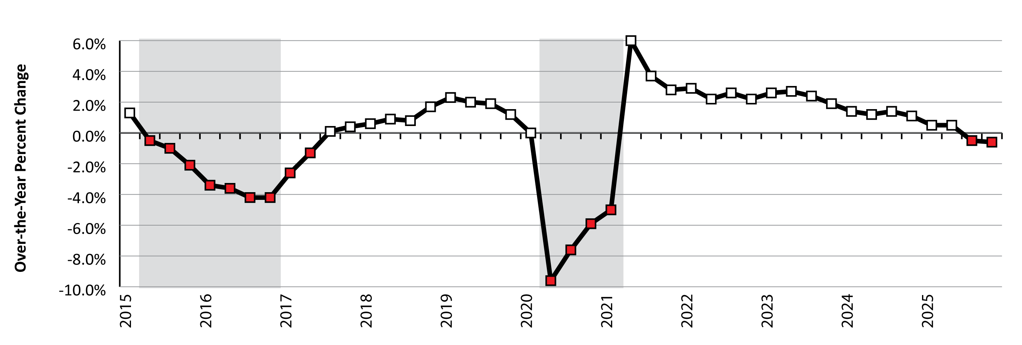
WIOA State Plan Revisions: 2026
Part 1: Economic Analysis
Over-the-Year Percent Change in Employment in Wyoming, 2015Q1-2025Q4
Source: Quarterly Census of Employment and Wages (QCEW).
6
Notes:
This figure presents a visualization of what I was just talking about, and shows over-the-year percent change in Wyoming employment from first quarter 2015 to fourth quarter 2025. You can see how job growth slowed during the last several quarters.
Each red square indicates a quarter of over-the-year job losses.
The two shaded boxes represent periods of economic downturn: 2015Q2 to 2016Q4 and 2020Q2 to 2021Q1. We define an economic downturn as a period of at least two consecutive quarters of over-the-year declines in both average monthly employment and total wages based on data from the QCEW.
At the very end of this graph you can see two consecutive quarters of over-the-year job losses during third and fourth quarter 2025. These were relatively small job losses at .5% and .6%, and we wouldn’t consider this an economic downturn because total wages actually increased during those two quarters. However, this is definitely something to keep an eye on.

Slide 7
WIOA State Plan Revisions: 2026
Part 1: Economic Analysis
Industries
Construction (363, 1.5%)
Wholesale trade, transportation, & utilities (338, 1.7%)
Other services, except public administration (197, 2.6%)
Health care & social assistance (166, 0.6%)
Mining (-317, -2.0%)
Source: Quarterly Census of Employment and Wages (QCEW).
7
Notes:
For this part of the WIOA plan we used data from second quarter 2024 to second quarter 2025, as they were the most current data at the time.
Construction added the greatest number of jobs with 363, a 1.5% over-the-year increase.
Wholesale trade, transportation, & utilities added 338 (1.7%)
Other services, except public administration added 197 (2.6%)
And health care & social assistance added 166 (0.6%)
But perhaps the thing that stood out the most was mining, which lost 317 jobs, a 2% over-the-year decline.

Slide 8
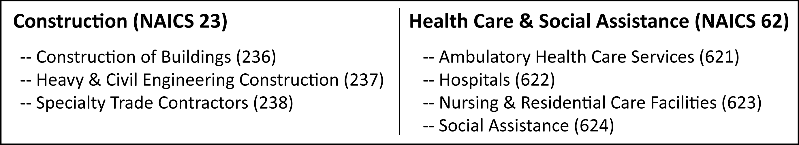
WIOA State Plan Revisions: 2026
Part 1: Economic Analysis
North American Industry Classification System (NAICS)
Source: North American Industry Classification System.
8
Notes:
The WIOA plan requires us to identify existing and emerging industries.
To do this, we looked at more detailed industry subsectors.
Just to quickly explain, industry sectors are given a 2-digit code from North American Industry Classification System, or NAICS. Within each 2-digit sector are several more detailed 3-digit subsectors.
For example, construction is given the NAICS code 23, which you can see on the left. Within construction are three subsectors: construction of buildings (NAICS 236), heavy & civil engineering construction (237), and specialty trade contractors (238).
Also, health care & social assistance is given the NAICS code 62, which you can see on the right. There are four subsectors within health care & social assistance, including ambulatory health care services (NAICS 621), hospitals (622), nursing & residential care facilities (623), and social assistance (624).

Slide 9
WIOA State Plan Revisions: 2026
Part 1: Economic Analysis
Existing Demand Industries
Specialty trade contractors
Support activities for transportation
Warehousing & storage
Food manufacturing
Source: Wyoming Growing and Declining Industries Report, 2025Q2.
9
Notes:
To identify existing demand industries as required by the WIOA plan, we looked at our latest growing and declining industries report from second quarter 2025.
We define a growing industry subsector as one that has seen an over-the-year increase of at least 5% for two consecutive quarters, based on data from the QCEW. In addition, we limit these to industries with employment of at least 100.
In second quarter 2025, we had 8 subsectors that met these criteria.
Some of the subsectors with the greatest job gains in second quarter 2025 included specialty trade contractors, support activities for transportation, warehousing & storage, and food manufacturing.
For example, specialty trade contractors added an average of 671 jobs per quarter from the prior year in 2025Q2 and 2025Q1, an average increase of 5.6%.

Slide 10
WIOA State Plan Revisions: 2026
Part 1: Economic Analysis
Emerging Demand Industries
Specialty trade contractors (2,714, or 22.9%)
Heavy & civil engineering construction (752, or 15.3%)
Support activities for mining (641, or 9.9%)
Construction of buildings (502, or 11.3%)
Chemical manufacturing (402, or 23.5%)
Source: Wyoming Long-Term Industry Projections, 2022-2032.
10
Notes:
To identify emerging demand industries as required by the WIOA plan, we found the 10 industry subsectors with the greatest projected growth from 2022 to 2032, based on our most recent long-term industry projections.
This slide shows the top 5 industry subsectors with the greatest projected growth from 2022 to 2032.
These include specialty trade contractors with 2,714 new openings during the 10-year period, an increase of 22.9%
Heavy & civil engineering construction with 752 new jobs, or 15.3%
And support activities for mining, with 641 new jobs, or 9.9%
Also I just thought I would mention that we will have new long-term projections for 2024 to 2034 available this summer.

Slide 11
WIOA State Plan Revisions: 2026
Part 1: Economic Analysis
Demand Occupations
WWDC’s In-Demand Occupations List
At least 50 annual openings, 2022-2032
Average hourly wage of at least $25.00
62 occupations met these criteria
Source: Wyoming Workforce Development Council’s In-Demand Occupations List, 2025.
11
Notes:
As part of the WIOA plan we were also tasked with identifying demand occupations.
For that we used the in-demand occupations list that the Wyoming Workforce Development Council approved last year.
As an reminder, occupations on this list had at least 50 projected total openings from 2022-2032, and an average hourly wage of at least $25.00.
There were 62 occupations that met these criteria.

Slide 12
WIOA State Plan Revisions: 2026
Part 1: Economic Analysis
Demand Occupations
Heavy & tractor-trailer truck drivers (862, $29.15)
General & operations managers (741, $56.87)
Operating engineers … (361, $30.68)
Registered nurses (354, $40.82)
Carpenters (342, $26.79)
Source: Wyoming Workforce Development Council’s In-Demand Occupations List, 2025.
12
Notes:
There were a wide variety of occupations that met these criteria. The top 5 were:
Heavy & tractor-trailer truck drivers, with 862 total projected openings and an average hourly wage of $29.15
General & operations managers, 741 and $56.87
Operating Engineers & Other Construction Equipment Operators, 361 and $30.68
Registered nurses, 354, $40.82
Carpenters, 342, $26.79

Slide 13
WIOA State Plan Revisions: 2026
Part 2: Workforce Analysis
13
Notes:
The second part of R&P’s narrative for the WIOA state plan focused on a workforce analysis.

Slide 14
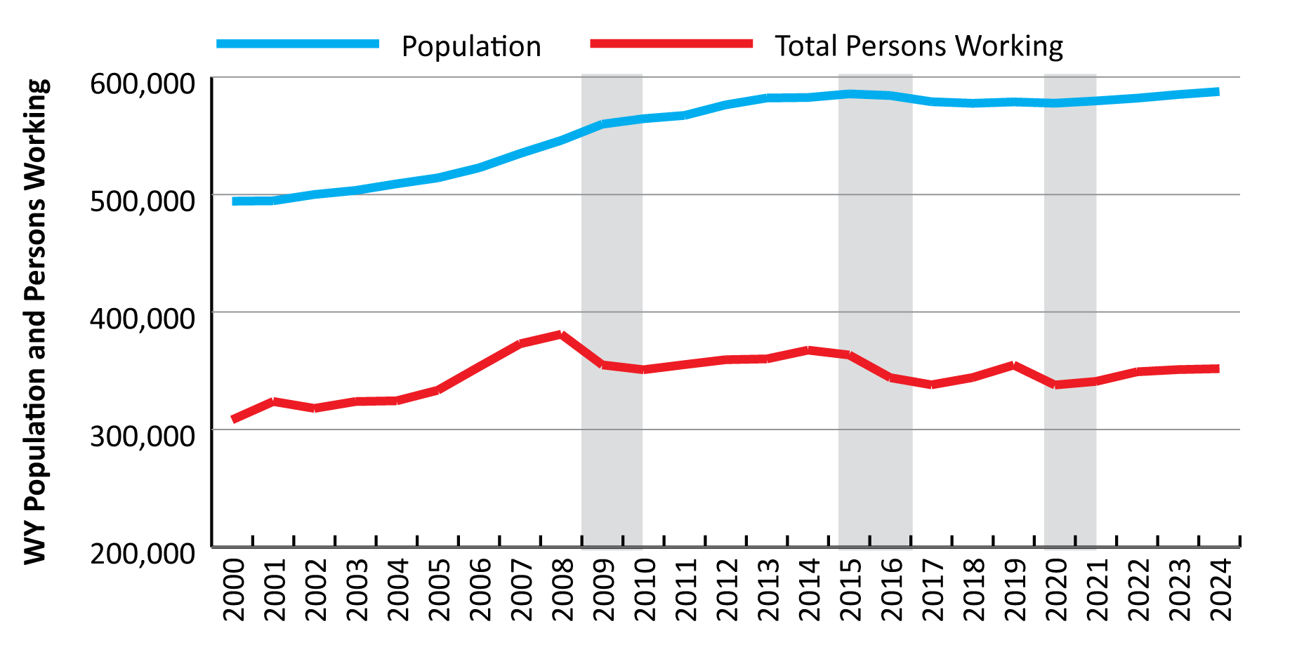
WIOA State Plan Revisions: 2026
Part 2: Workforce Analysis
Population and Number of Persons Working in Wyoming, 2000-2024
Sources: U.S. Census Bureau Population Estimates and Research & Planning Wage Records.
14
Notes:
This figure shows Wyoming’s population and the number of persons working in Wyoming from 2000 to 2024.
Population peaked at 587,618 in 2024, which you can see in the blue line.
Persons working was highest at 381,090 in 2008, which is re red line.
The three shaded areas again represent periods of economic downturn.
You can see the ups and downs, especially with regard to the number of persons working.
Since the pandemic, we’ve seen slow, steady growth in both population and the number of persons working.

Slide 15
WIOA State Plan Revisions: 2026
Part 2: Workforce Analysis
Individuals with Barriers to Employment
Poverty
American Indian
Disability
English Proficiency
Youth
15
Notes:
Using data from the U.S. Census Bureau’s American Community Survey, we looked at individuals with barriers to employment.
These include things like individuals living in poverty, American Indians, individuals with a disability, English proficiency, youth, and more.

Slide 16
WIOA State Plan Revisions: 2026
Part 2: Workforce Analysis
Individuals Living at or Below Poverty Line
2025 Poverty Threshold: $15,650 individual, $32,150 family of 4
100%, 130%, 160%
Sex and age
Source: American Community Survey, U.S. Census Bureau.
16
Notes:
To begin with when talking about individuals with barriers to employment, we’ll start with individuals living in poverty.
In 2025, the poverty threshold for an individual living in Wyoming was $15,650, or $32,150 for a family of four.
The ACS provides data at the 100%, 130%, and 160% of the poverty level.
Our tables also include sex and age.

Slide 17
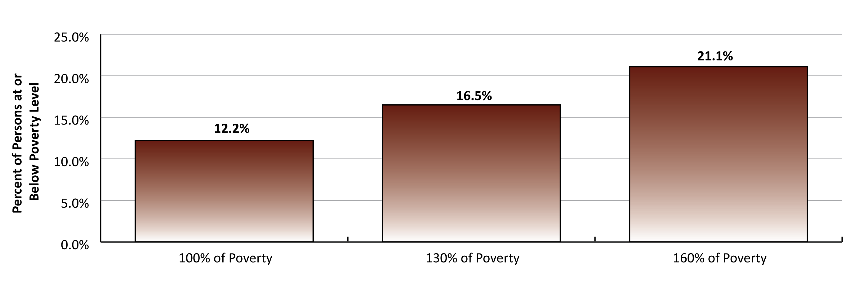
WIOA State Plan Revisions: 2026
Part 2: Workforce Analysis
Individuals Living At or Below Poverty Level, 2023
Source: American Community Survey, U.S. Census Bureau.
17
Notes:
In 2023, 70,618 people in Wyoming were at or below the poverty level, or 12.2% of the population
95,434 (or 16.5%) were at or below 130% of the poverty level
And 122,216 (or 21.1%) were at or below 160% of the poverty level

Slide 18
WIOA State Plan Revisions: 2026
Part 2: Workforce Analysis
American Indian or Alaska Native
12,397 in Wyoming, 2.4% of population
31.2% younger than 18
1 in 5 (20.9%) in Fremont County
Of those 16+, 41.3% not in the labor force
Source: American Community Survey, U.S. Census Bureau.
18
Notes:
Looking at American Indian or Alaska Natives, there were 12,397 of those individuals in Wyoming in 2023, 2.4% of the state’s total population
Almost one in three (31.2%) were younger than 18
1 in 5 of those were in Fremont County
And of those ages 16 or older, 41.3% were not in the labor force in 2023

Slide 19

WIOA State Plan Revisions: 2026
Part 2: Workforce Analysis
Veterans
Source: American Community Survey, U.S. Census Bureau.
19
Notes:
In 2023, Wyoming had an estimated 40,913 veterans living in the state.
The U.S. Census Bureau defines veterans as individuals who served in any branch of the United States military during a time of war or peace, for any length of time, at home or abroad. This includes active duty individuals.
Nearly half of those were age 65+.
16.9% were 55-64, and it kind of goes down from there. 14.3% of veterans were ages 45-54, 10.1% were ages 35-44, and 8.2% were ages 25-34.
The small blue slice at the top represents individuals younger than 25, who made up just 1.2% of all veterans in Wyoming.
The WIOA report also includes some discussion about veterans with different levels of disability, and 26.8% of all veterans had some level of disability.

Slide 20
WIOA State Plan Revisions: 2026
Part 2: Workforce Analysis
English Proficiency
93.4% speak only English
1.2% (6,810) speak English, not well
0.5% (2,779) don’t speak English
Source: American Community Survey, U.S. Census Bureau.
20
Notes:
The WIOA plan includes discussion on English proficiency in Wyoming in 2023.
93.4% of all persons spoke only English.
1.2% (or 6,810) said they spoke English, but not well.
And 0.5% (or 2,779) said they didn’t speak English.

Slide 21
WIOA State Plan Revisions: 2026
Part 2: Workforce Analysis
Disability Status
84,069 people with disability
15.3% of the population
Percent with disability increases with age
More than one-third of those 65+ had a disability
Source: American Community Survey, U.S. Census Bureau.
21
Notes:
We looked at individuals with a disability.
According to the ACS, more than 84,000 people in Wyoming had some sort of disability in 2023.
That’s 15.3% of the entire population.
The percent of the population with a disability increased with age.
For example, more than one-third (35.1%) of those 65 and older had a disability.
Among individuals younger than 45, less than 10% had a disability.

Slide 22
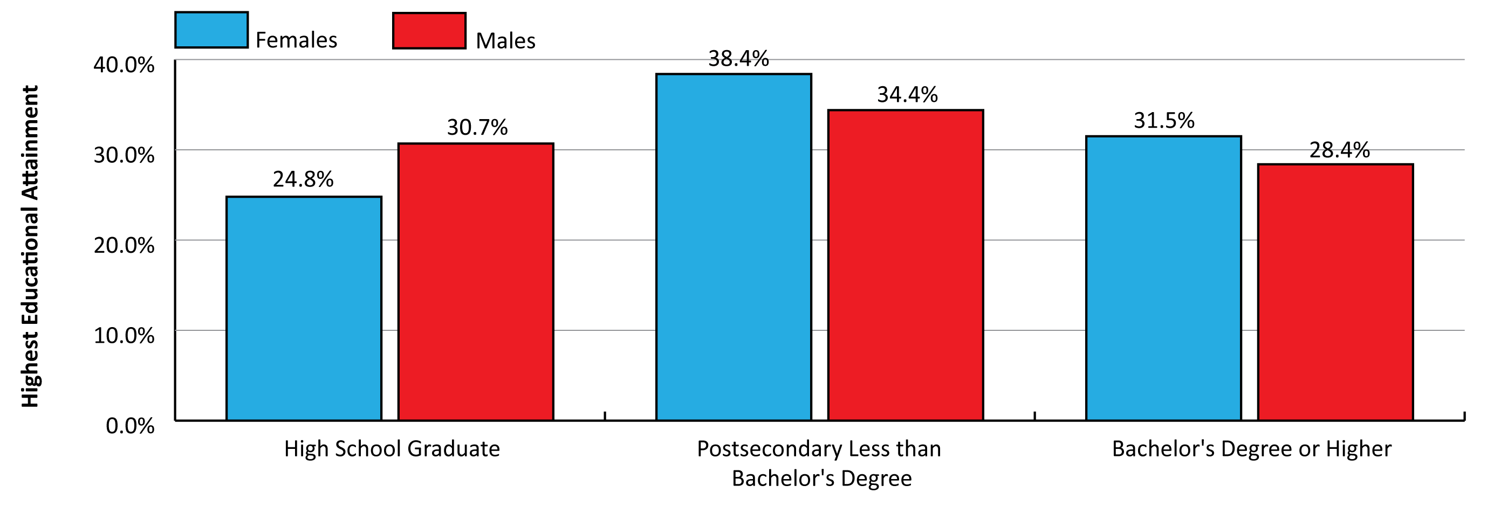
WIOA State Plan Revisions: 2026
Part 2: Workforce Analysis
Highest Completed Education by Sex in Wyoming, 2023
Source: American Community Survey, U.S. Census Bureau.
22
Notes:
This figure shows the highest completed education by sex for Wyoming’s population.
24.8% of all females had a high school diploma (or equivalent) as their highest level of education, compared to 30.7% of males.
38.4% of females had an associate’s degree or some college, no degree, compared to 34.4% for males.
Finally, 31.5% of all females had a bachelor’s degree or higher, compared to 28.4% of males.
In general, females in Wyoming tended to have a higher level of education than males.

Slide 23
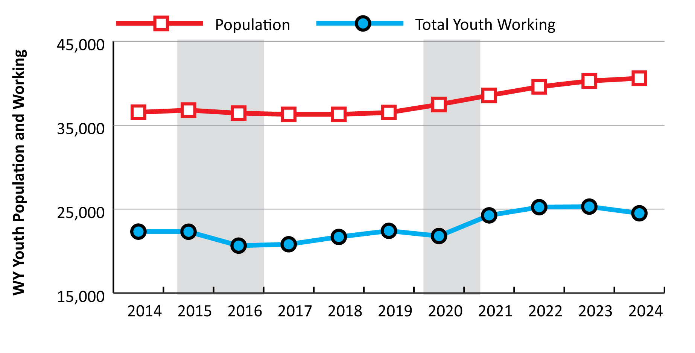
WIOA State Plan Revisions: 2026
Part 2: Workforce Analysis
Youth Population and Number of Persons Working in Wyoming, 2014-2024
Sources: U.S. Census Bureau Population Estimates and Research & Planning Wage Records.
23
Notes:
Part of our focus for the WIOA plan was on youth ages 15-19.
This figure shows the youth population and the number of those working in Wyoming from 2014 to 2024.
You can see in the red line that our youth population consistently increased after the pandemic, and was 40,590 in 2024. That was an increase of over 4,000 from 2019 to 2024.
The number of youth working in Wyoming, the blue line, also increased consistently but at a lower rate from 2019 to 2024. In 2024 we had 23,100 youth working in Wyoming, up almost 700, or 3.1%, compared to 2019.

Slide 24
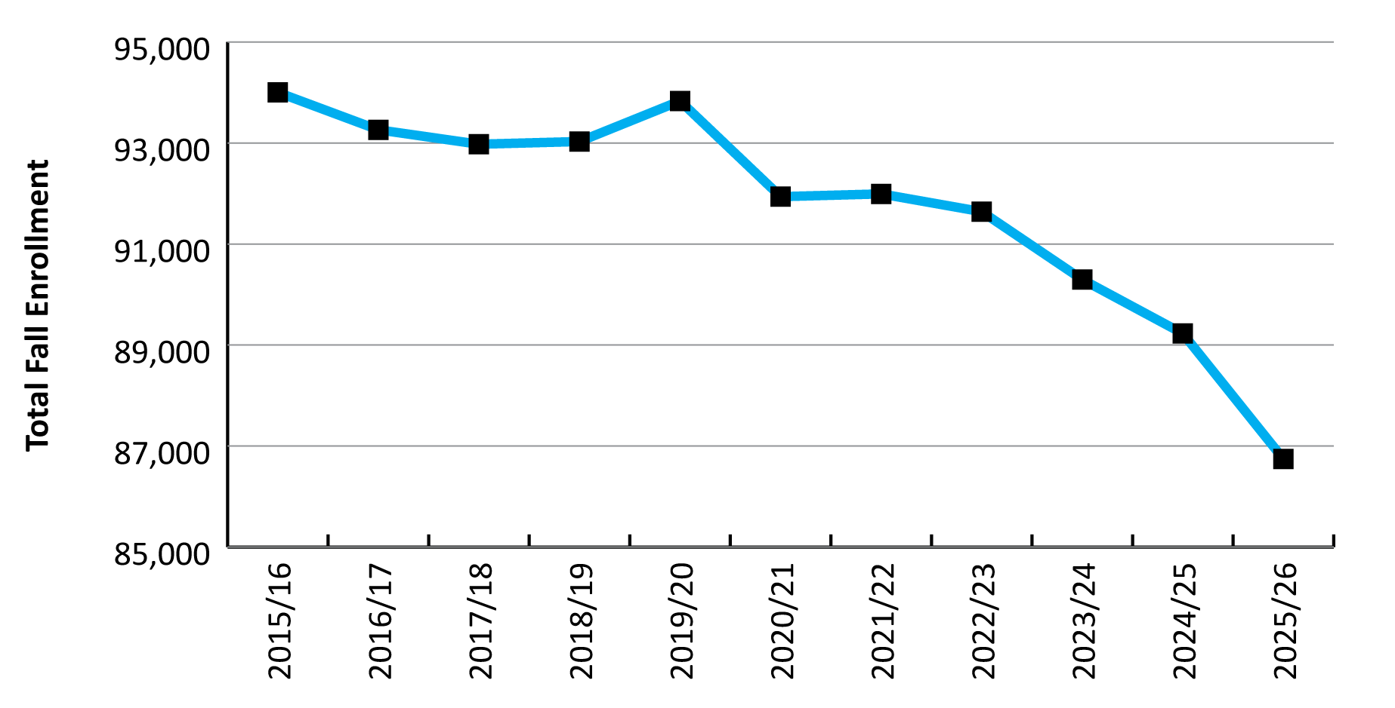
WIOA State Plan Revisions: 2026
Part 2: Workforce Analysis
Total Fall Enrollment for Wyoming Public Schools, Grades K-12
Source: Wyoming Department of Education.
24
Notes:
This figure shows total fall enrollment for Wyoming public schools for the 2015/16 to 2025/26 school years.
The data used to create this graphic came from the Wyoming Department of Education.
You can see a noticeable decline in fall enrollment in Wyoming’s public schools, especially after 2022/23.
In 2025/26, fall enrollment fell below 87,000 students.

Slide 25
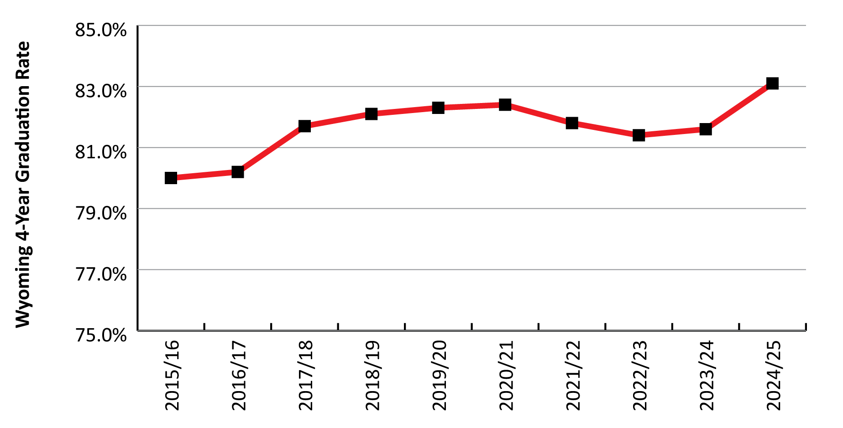
WIOA State Plan Revisions: 2026
Part 2: Workforce Analysis
Wyoming 4-Year High School Graduation Rates, 2015/16 to 2024/25
Source: Wyoming Department of Education.
25
Notes:
We also looked at high school graduation rates for Wyoming, and this figure shows the 4-year (or on-time) graduation rate for Wyoming public schools for the 2015/16 to 2024/25 school years, again based on data from the Wyoming Department of Education.
You can see that the state’s 4-year graduation rate hovered right around 82% from 2017/18 to 2020/21, then dipped a little bit for three years.
In 2024, we saw a pretty noticeable increase to 83.1%, the highest of the last 10 years.

Slide 26
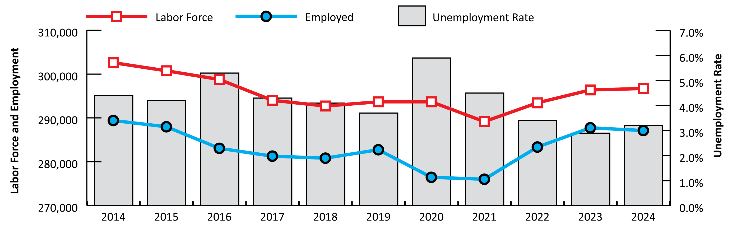
WIOA State Plan Revisions: 2026
Part 2: Workforce Analysis
Local Area Unemployment Statistics for Wyoming, 2014-2024
Source: Local Area Unemployment Statistics.
26
Notes:
The Local Area Unemployment Statistics Program, or LAUS, provides the number of persons employed and unemployed in Wyoming.
The red line in this figure represents the total labor force, which is the sum of employed and unemployed persons. You can see that it’s gradually increased since 2021, but was kind of flat from 2023 to 2024.
The blue line represents the number of employed, and you can see that declined a little bit from 2023 to 2024.
And finally the gray boxes in the background represent the unemployment rate. The unemployment rate for 2024 was 3.2%, up from 2.9% in 2023, but well below the 6.1% rate in 2020 during the pandemic.

Slide 27
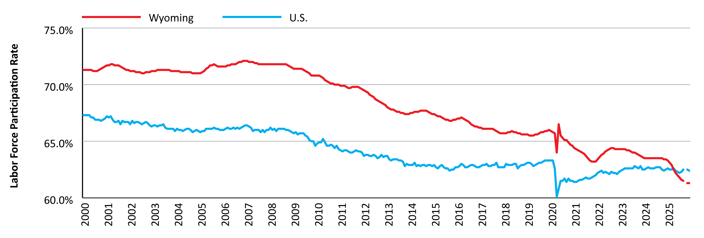
WIOA State Plan Revisions: 2026
Part 2: Workforce Analysis
Labor Force Participation Rates for Wyoming and the U.S., January 2000 to December 2025
Source: Local Area Unemployment Statistics.
27
Notes:
This figure shows the labor force participation rate in Wyoming (the red line) and the U.S. (the blue line) from 2000 to 2025.
You can see that Wyoming has historically had a higher labor force participation rate, and that goes all the way back to 1976, when these metrics were first measured.
But if you look at the right hand side of the graph, you can see that for the first time in 2025, the labor force participation rate for Wyoming dipped below that of the U.S. That has never happened before.
At the very end you’ll also see a small break in the data; that’s because we don’t have data for October 2025 due to the federal government shutdown during that time.

Slide 28
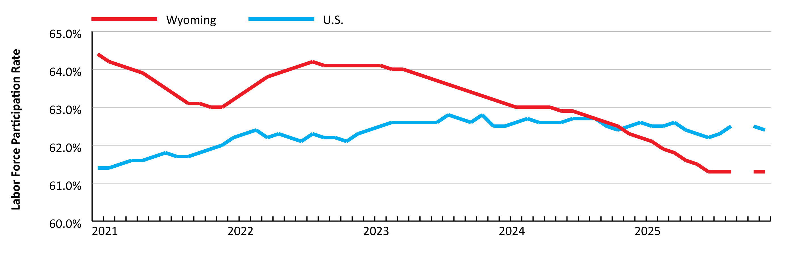
WIOA State Plan Revisions: 2026
Part 2: Workforce Analysis
Labor Force Participation Rates for Wyoming and the U.S., January 2021 to December 2025
Source: Local Area Unemployment Statistics.
28
Notes:
This figure zooms in on the period from 2021 to 2025 from the previous figure.
You can get a better look of how Wyoming’s labor force participation rate fell below the national average in 2025.
Again, that break in the lines represents October 2025, which we don’t have because of the federal government shutdown.

Slide 29
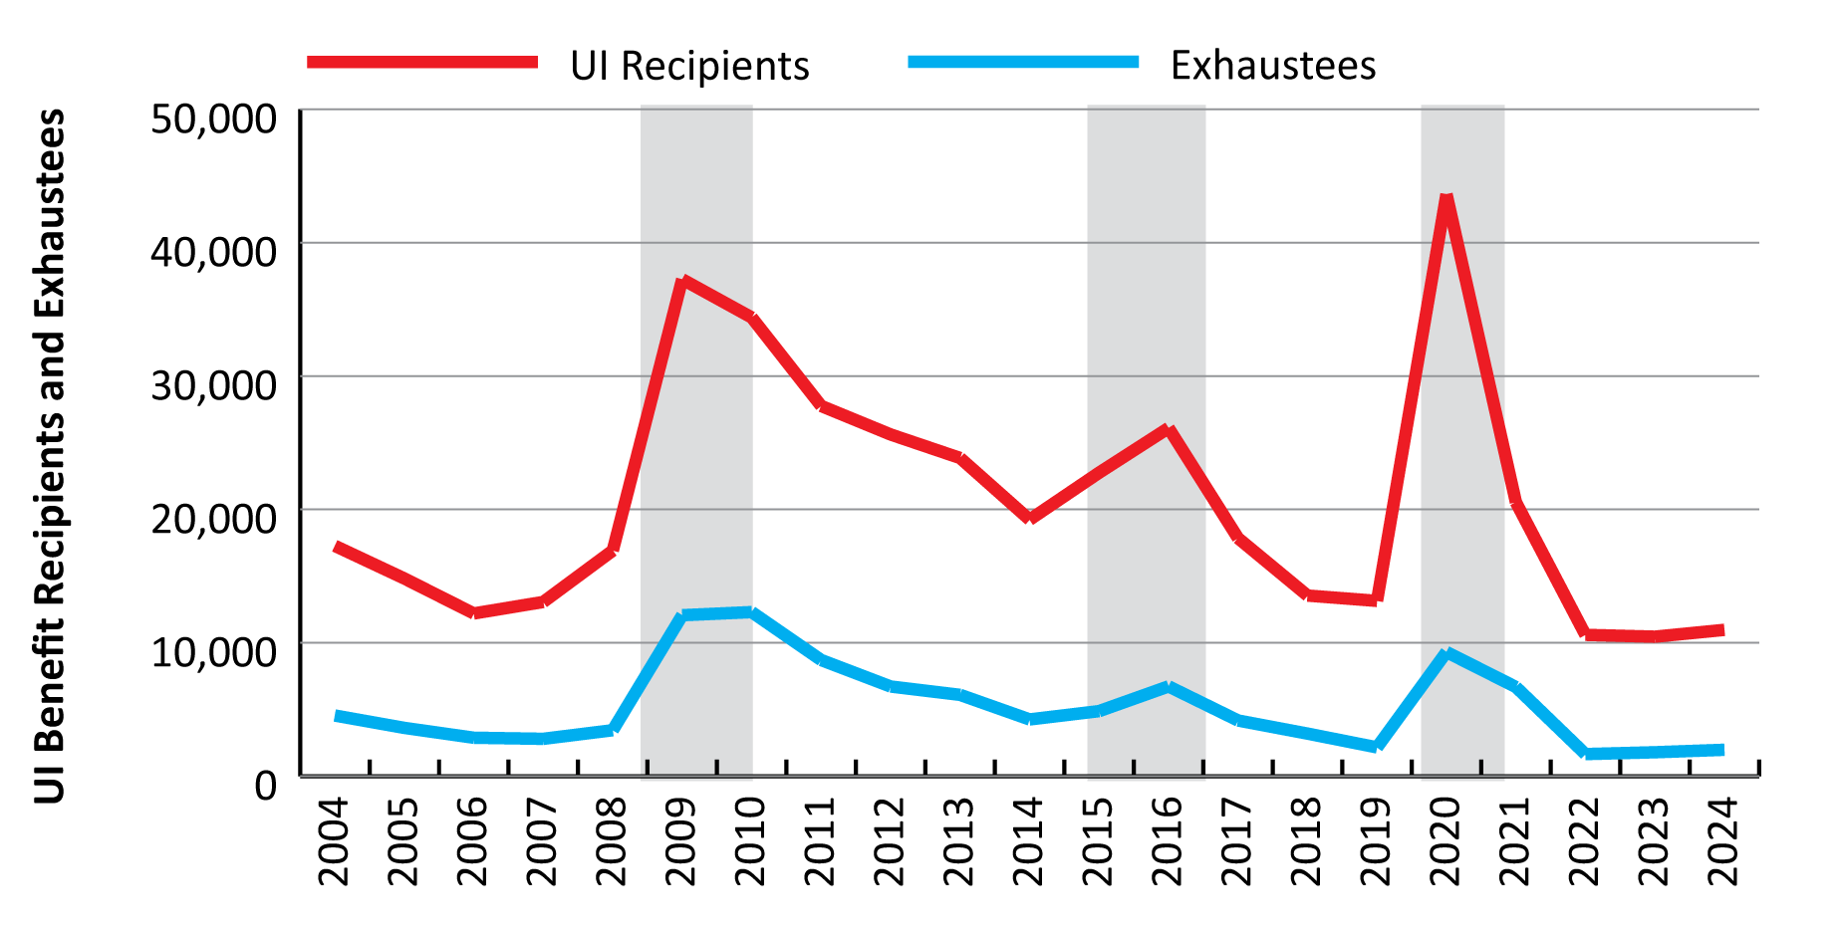
WIOA State Plan Revisions: 2026
Part 2: Workforce Analysis
UI Benefit Recipients and Exhaustees in Wyoming, 2005-2025
Source: Wyoming Unemployment Insurance claims data.
29
Notes:
We also looked at individuals receiving Unemployment Insurance (or UI) benefits.
The number of UI benefit recipients the (red line) increased from 10,460 in 2023 to 10,972 in 2024 (an increase of 512, or 4.9%).
You can see the number of benefit recipients spike during those periods of economic downturn, which are marked with the shaded gray boxes.
The blue line represents those who exhausted their UI benefits. You can see the spikes in benefit exhaustees during those economic downturns as well.
However you can see that from 2022 to 2024, the number of UI benefit recipients remained lower compared to historical levels.
Again, we were up slightly from 2023 to 2024, but still lower than at any point over the last 20 years.

Slide 30
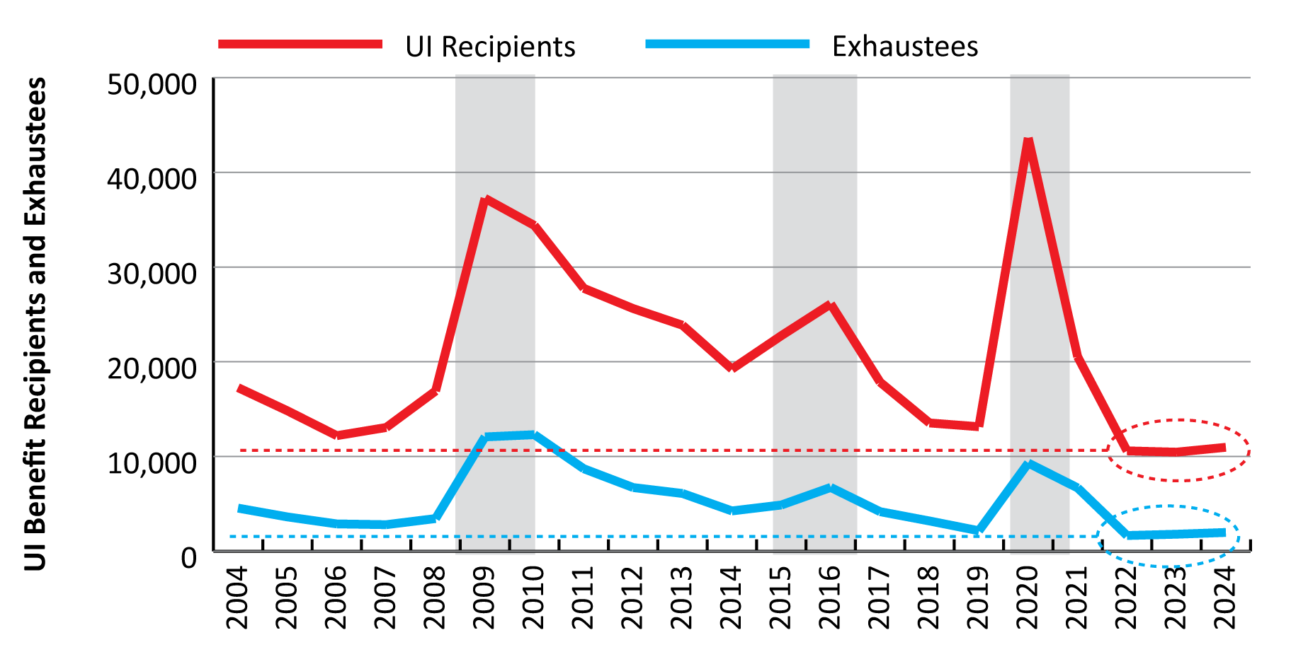
WIOA State Plan Revisions: 2026
Part 2: Workforce Analysis
UI Benefit Recipients and Exhaustees in Wyoming, 2005-2025
Source: Wyoming Unemployment Insurance claims data.
30
Notes:
We saw a little bit of an increase in UI benefit recipients and exhaustees from 2023 to 2024.
However if you follow the dotted lines, you can see that from 2022 to 2024, the number of UI benefit recipients and exhaustees remained lower compared to historical levels of the last 20 years.
So even though we’ve seen some increases over the last couple years, we’re still below any other period over the last 20 years.

Slide 31
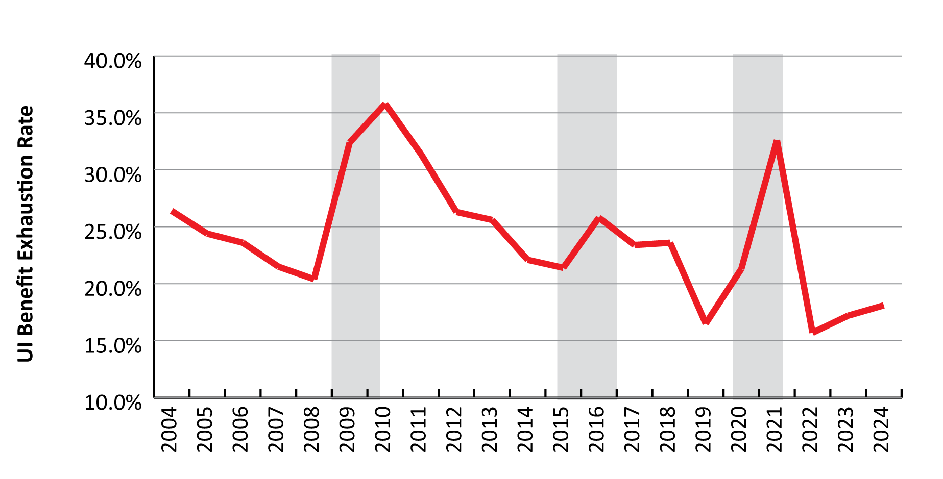
WIOA State Plan Revisions: 2026
Part 2: Workforce Analysis
UI Benefit Recipients Exhaustion Rate in Wyoming, 2004-2024
Source: Wyoming Unemployment Insurance claims data.
31
Notes:
This figure provides another way to look at benefit exhaustees by showing the benefit exhaustion rate in Wyoming.
In 2024, 18.1% of individuals who received UI benefits exhausted those benefits. That was up slightly from 2023, but again, pretty low compared to the last 20 years.
You can also see here how benefit exhaustion rates spike during those economic downturns, with the highest being 35.8% in 2010.

Slide 32
WIOA State Plan Revisions: 2026
Part 2: Workforce Analysis
Other UI Benefit Statistics
Older workers more likely to exhaust benefits
More males receive benefits
Females more likely to exhaust benefits
13.5% of claimants eligible for maximum 26 weeks
Source: Wyoming Unemployment Insurance claims data.
32
Notes:
There are a lot of other statistics on UI benefit recipients in the WIOA state plan, I’ll just touch on a few.
Older workers are more likely to exhaust their benefit than younger workers. For example, 34.2% of those 65+ exhausted their benefits in 2024, compared to 12.0% of those 25-34.
A larger number of males receive UI benefits than females each year, but females are more likely to exhaust those benefits.
Of the almost 11,000 UI benefit recipients in 2024, 13.5% were eligible for the maximum 26 weeks of benefits.

Slide 33
WIOA State Plan Revisions: 2026
Part 2: Workforce Analysis – Labor Market Trends
33
Notes:
As a part of the workforce analysis portion of the WIOA state plan, we also looked at labor market trends.
We focused on six industries: mining, construction, retail trade, professional & business services, health care & social assistance, and leisure & hospitality.
We chose these six industries because they generally contribute the largest number of jobs in Wyoming.

Slide 34
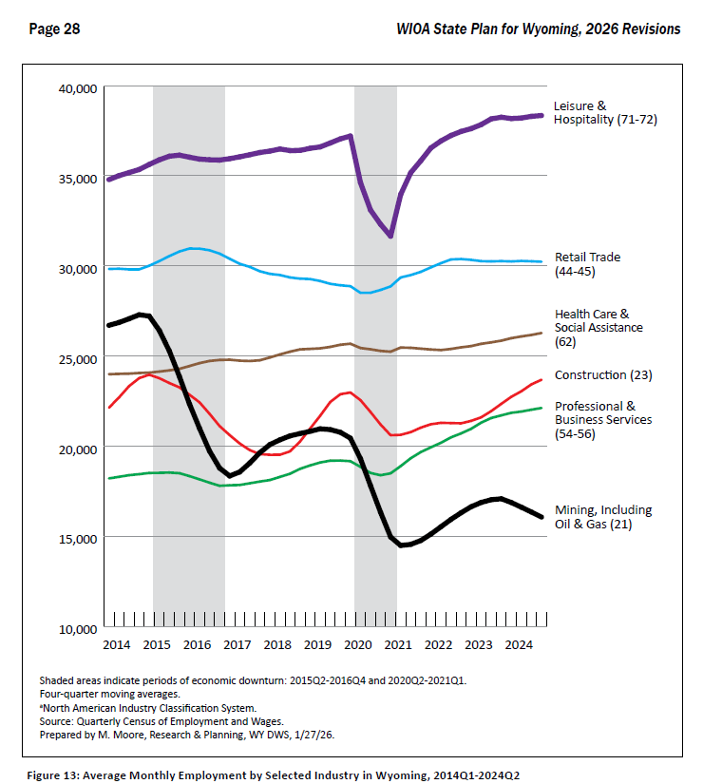
WIOA State Plan Revisions: 2026
Part 2: Workforce Analysis – Labor Market Trends
Source: Wyoming Unemployment Insurance claims data.
34
Notes:
I’ll provide you with a closer look at each of those six industries, but I thought I’d share this figure from page 28 of the tables and figures for the WIOA report, which shows employment for all six industries.
It’s a little difficult to present in this space, but here’s a brief look at it.
You can see the largest number of jobs were in leisure & hospitality (the purple line up top), followed by retail trade (blue line) and health care & social assistance (brown line).

Slide 35
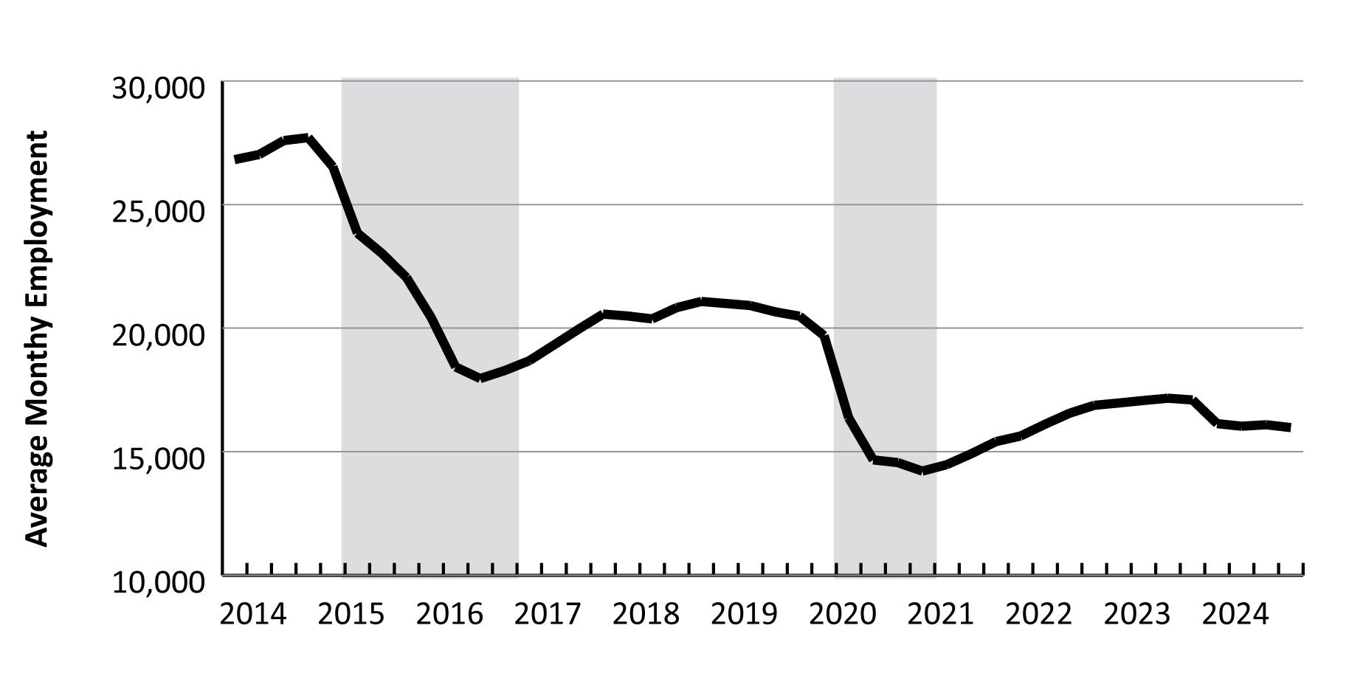
WIOA State Plan Revisions: 2026
Part 2: Workforce Analysis – Labor Market Trends
Average Monthly Employment in Mining in WY, 2014Q1-2024Q4
Source: Quarterly Census of Employment and Wages.
35
Notes:
We’ll start of with mining, including oil & gas. We all know the importance of this sector to Wyoming’s economy.
In 2024, mining’s $1.7 billion in total wages made up 9.8% of the statewide total, and the 16,059 jobs in mining accounted for 5.7% of all jobs.
As you can see in this figure, employment in mining has consistently declined over the last 10 years.
You can see that mining lost a large number of jobs during each economic downturn, and never really returned to those levels.

Slide 36
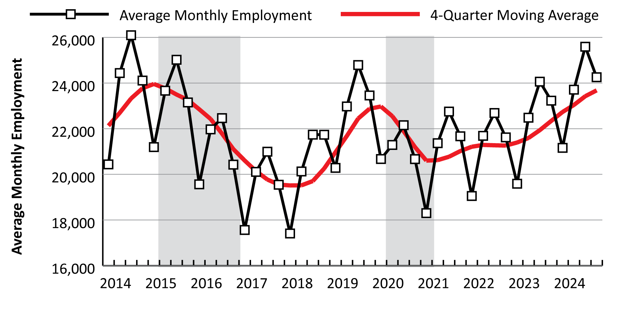
WIOA State Plan Revisions: 2026
Part 2: Workforce Analysis – Labor Market Trends
Average Monthly Employment in Construction in WY, 2014Q1-2024Q4
Source: Quarterly Census of Employment and Wages.
36
Notes:
Construction.
In 2024, construction accounted for 8.4% of Wyoming’s total employment with 23,679 jobs and 9.7% of the state’s total wages, with $1.7 billion.
The black line represents average monthly employment, and you can really see the seasonal trend of construction employment. Employment peaks in third quarter each year.
The red line is a 4-quarter moving average in order to identify employment trends.
We’ve seen consistent growth in construction jobs since the pandemic.

Slide 37
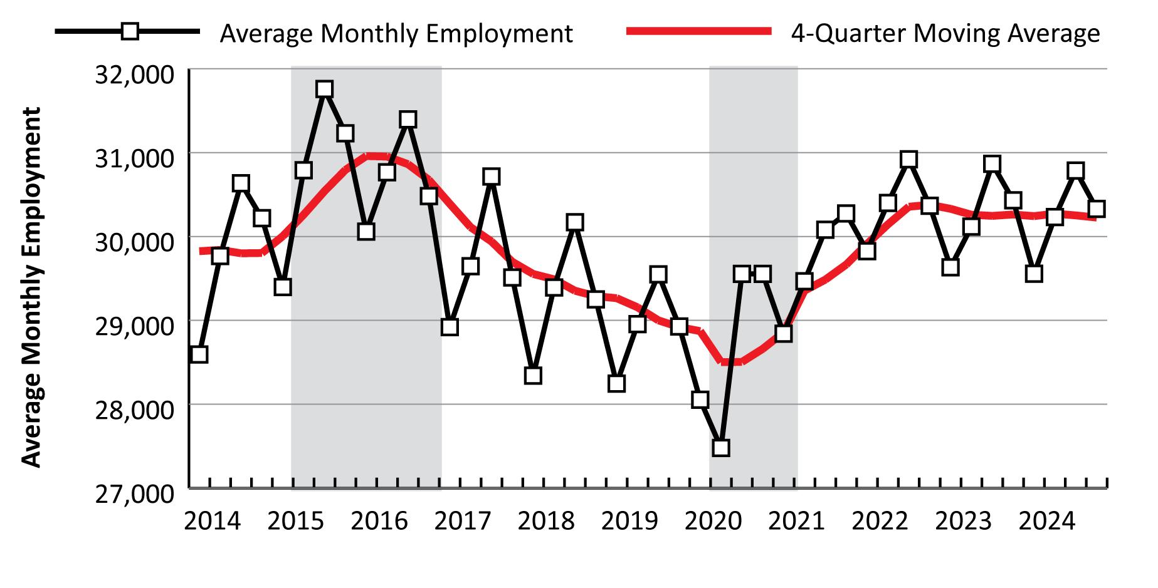
WIOA State Plan Revisions: 2026
Part 2: Workforce Analysis – Labor Market Trends
Average Monthly Employment in Retail Trade in WY, 2014Q1-2024Q4
Source: Quarterly Census of Employment and Wages.
37
Notes:
Retail trade.
The 30,225 jobs in Wyoming’s retail trade sector in 2024 represented 10.7% of the state’s total employment.
You can see that same seasonal pattern that we also saw in construction, with employment peaking in the third quarter each year.
Retail trade contributed $1.1 billion in total wages, 6.6% of the statewide total.
You can see the downward trend in employment in retail trade for several years from 2015 to 2020, and then we really saw an upturn during and after the pandemic.
Since about 2022, employment in retail trade has been pretty flat.

Slide 38
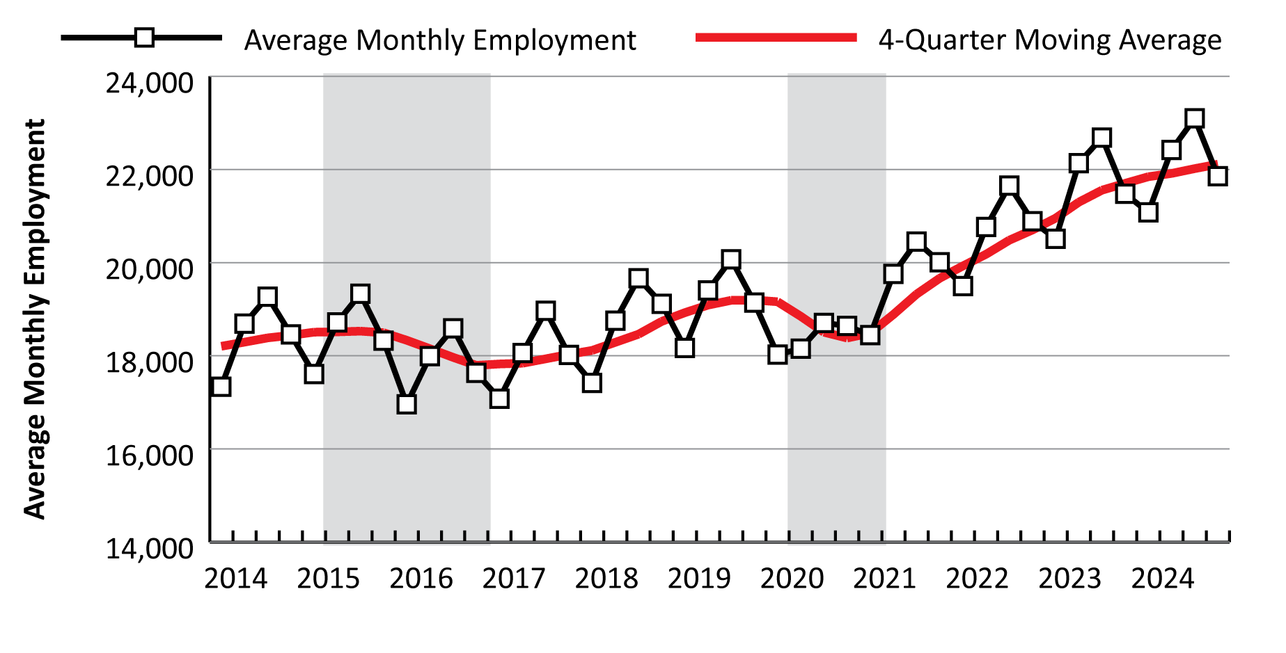
WIOA State Plan Revisions: 2026
Part 2: Workforce Analysis – Labor Market Trends
Average Monthly Employment in Pro. & Business Svcs. in WY, 2014Q1-2024Q4
Source: Quarterly Census of Employment and Wages.
38
Notes:
Professional & business services.
This slide looks at professional & business services, which is a supersector comprising three sectors: professional & technical services, management of companies & enterprises, and administrative & waste services.
In 2024, the 22,112 jobs in professional & business services accounted for 7.8% of Wyoming’s average monthly employment, and this supersector contributed $1.9 billion in total wages, 10.9% of the total.
You can see the really strong, consistent job growth in this industry since the pandemic.
The greatest growth has been seen in detailed industries like computer systems design & related services, management & technical consulting services, architectural & engineering services, and office administrative services.

Slide 39
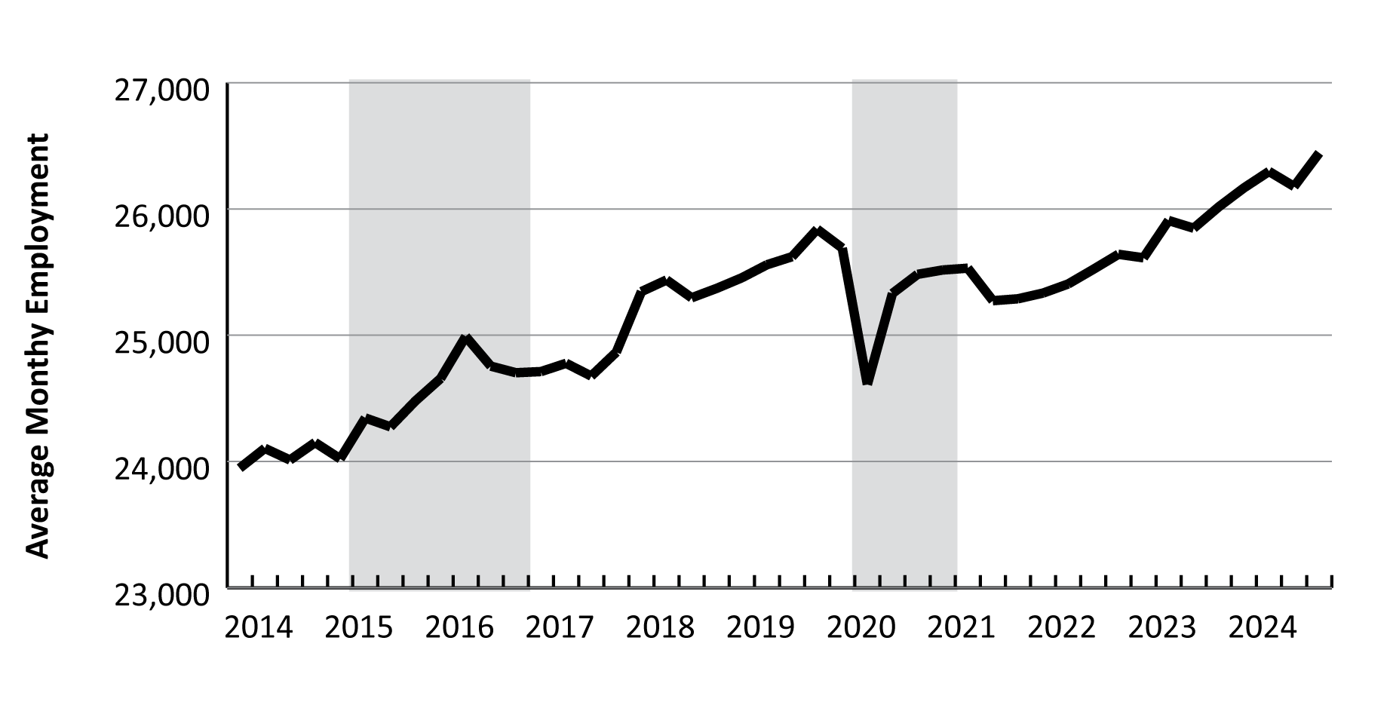
WIOA State Plan Revisions: 2026
Part 2: Workforce Analysis – Labor Market Trends
Average Monthly Employment in Health Care & Social Assistance in WY, 2014Q1-2024Q4
Source: Quarterly Census of Employment and Wages.
39
Notes:
Health care & social assistance.
In 2024, Wyoming had 26,272 jobs in health care & social assistance, or 9.3% of all jobs in the state. The $1.4 billion in total wages accounted for 8.1% of the state’s total.
You can see in this graph how health care & social assistance doesn’t follow the same seasonal patterns of several other industries.
This is another industry where we’ve seen consistent growth since the pandemic.

Slide 40
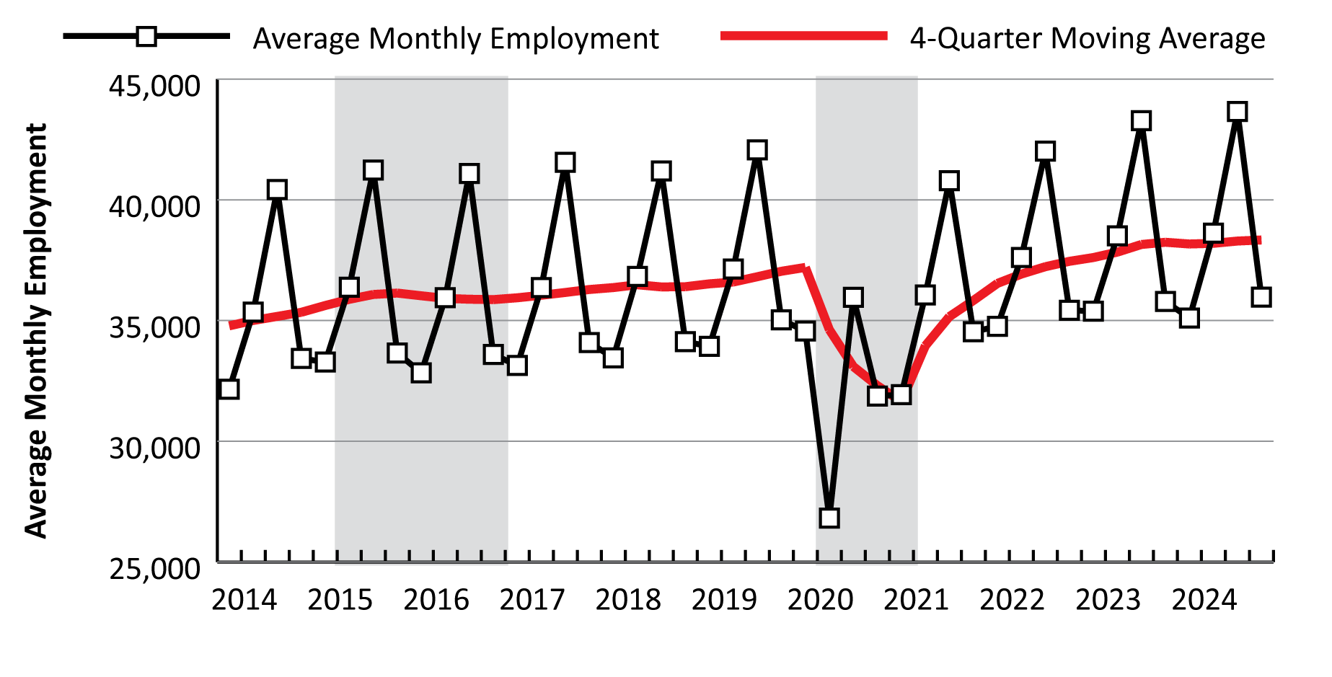
WIOA State Plan Revisions: 2026
Part 2: Workforce Analysis – Labor Market Trends
Average Monthly Employment in Leisure & Hospitality in WY, 2014Q1-2024Q4
Source: Quarterly Census of Employment and Wages.
40
Notes:
And finally, we’ll look at leisure & hospitality.
Wyoming’s leisure & hospitality sector provides more jobs than any other industry. In 2024, the 38,337 jobs accounted for 13.6% of total employment in the state. The $1.1 billion in total wages accounted for 6.3% of the statewide total.
There’s that seasonal pattern again, peaking in the third quarter.
Leisure & hospitality lost more jobs during the pandemic than any other sector, but it did recover and over the last several years, employment has reached an all-time high.

Slide 41

WIOA State Plan Revisions: 2026
Contact Us
Michael Moore, Research Supervisor
(307) 473-3814
Michael.Moore@wyo.gov
444 W. Collins Drive
Suite 3100
Casper, WY 82601
https://doe.state.wy.us/LMI
41
Notes:
With that I will go ahead and wrap up the presentation.
There is a lot more information in the WIOA state plan. I encourage you to read the narrative and check out the tables and figures; the links to those items are on slide 3 in this presentation.
As I previously mentioned, we’re wrapping up our 2026 Wyoming Workforce Annual Report, so I’ll be back with another presentation of updated data in the fall.
Thank you again, and if you have any questions or need any assistance finding particular data, please feel free to reach out to me. My phone number and email address are provided on this slide, along with our physical address and website.

