Slide 1
Getting to Know Wyoming’s Workforce
Presented at the Wyoming Department of Workforce Services Annual Meeting on October 30, 2024, by Michael Moore, R&P Research Supervisor
Notes:
Good afternoon, my name is Michael Moore and I am the research supervisor for the Research & Planning section of the Wyoming Department of Workforce Services.
Today I am going to be presenting a discussion called, “Getting to Know Wyoming’s Workforce.”
This presentation provides an overview of the demographics of Wyoming’s population and labor market, including gender, age, generations in the workforce, and more.

Slide 2
Getting to Know Wyoming’s Workforce
About Research & Planning
OUR ORGANIZATION:
R&P is an exclusively statistical entity within DWS.
WHAT WE DO:
R&P collects, analyzes, and publishes timely and
accurate labor market information (LMI)
meeting established statistical standards.
OUR CUSTOMERS:
LMI makes the labor market more efficient by
providing the public and the public’s
representatives with the basis for
informed decision making.
Notes:
Just a little bit about Research & Planning to get us started.
R&P is an exclusively statistical entity within DWS.
We collect, analyze, and publish timely labor market information (LMI) data.
We provide this information to the public, legislators, educators, training providers, the media, and more.

Slide 3
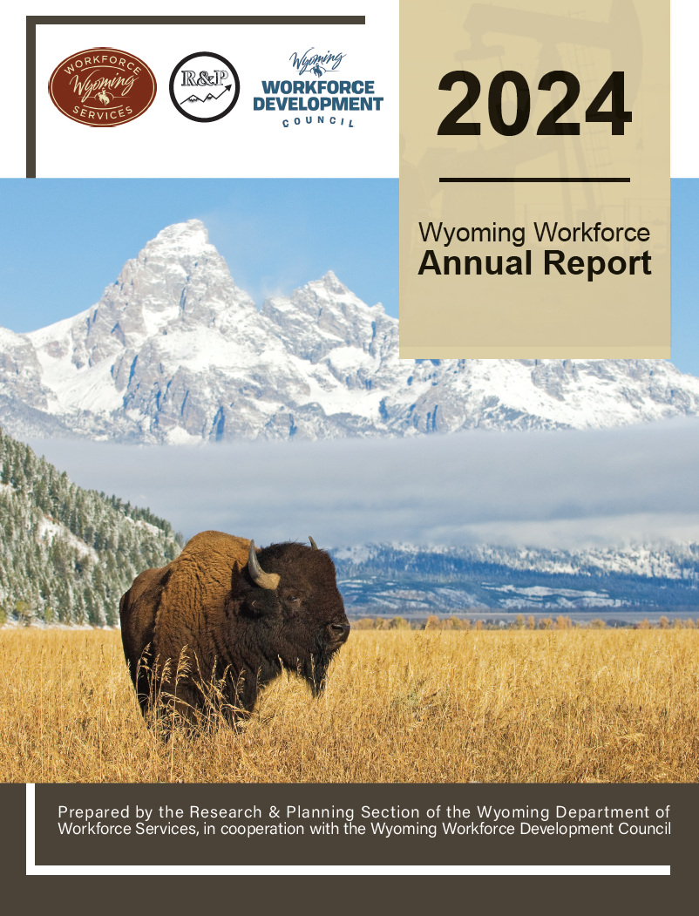
Getting to Know Wyoming’s Workforce
2024 Wyoming Workforce Annual Report
Notes:
Before we start talking about our state’s workforce, I just want to make you aware of a couple of our products that are great resources.
The 2024 Wyoming Workforce Annual Report is prepared each June in partnership with the Wyoming Workforce Development Council.
This is available on our website, and I do have a limited number of print copies available, so if you would like one, please feel free to send me an email, and I’ll get one sent out to you.

Slide 4
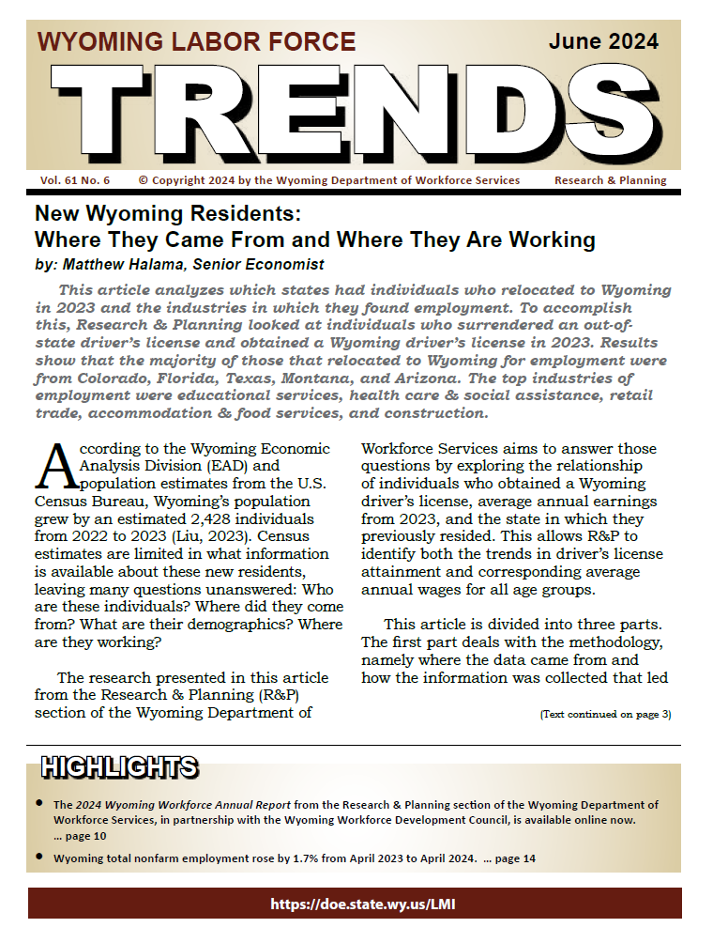
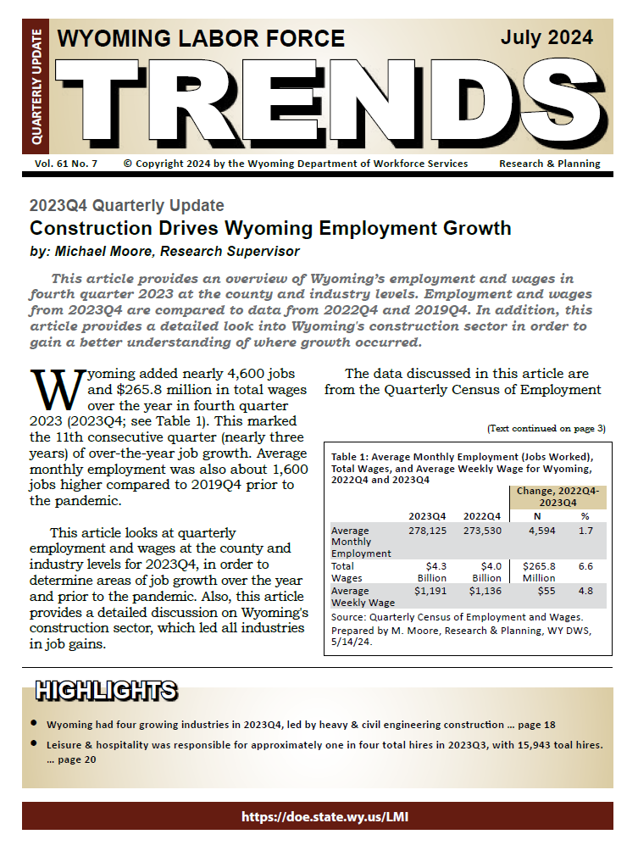
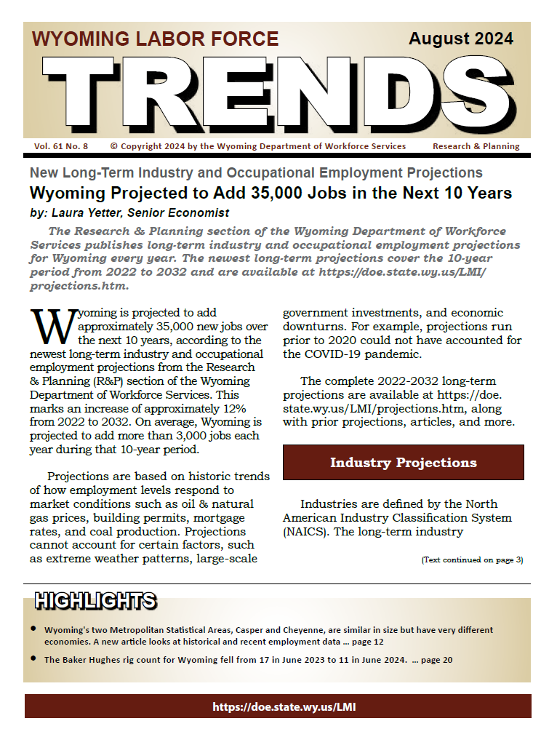
Getting to Know Wyoming’s Workforce
Wyoming Labor Force Trends
https://doe.state.wy.us/LMI
Notes:
Our monthly publication is Wyoming Labor Force Trends, which is published electronically each month.
Each issue has articles, data, tables, and figures on Wyoming’s labor market. If you would like to subscribe, just shoot me an email. My address is at the end of this publication.
All of our products, datasets, publications, presentations and more are available at the link shown on this slide.

Slide 5
Getting to Know Wyoming’s Workforce
Various Data Sources
U.S. Census Bureau
Local Area Unemployment Statistics (LAUS)
American Community Survey (ACS)
Wyoming Wage Records
Linked to other administrative databases
Notes:
There are several data sources that provide insight to Wyoming’s population and workforce.
The U.S. Census Bureau publishes annual population estimates.
The American Community Survey, a product of the Census Bureau, provides us with all sorts of survey-based data, such as age, gender, race, educational attainment, veteran status, and more
R&P links Wyoming Wage Records to the Wyoming driver’s license file and other administrative data sets.
Linking Wage Records to these other administrative databases provides us with all sorts data on those working on Wyoming at ay time during the year:
Gender, age, industry of employment, work history, commuting data, turnover data, and more

Slide 6
Getting to Know Wyoming’s Workforce
U.S. Census Bureau: Population Estimates for Wyoming
Notes:
We’ll start with some discussion on Wyoming’s population estimates from the U.S. Census Bureau

Slide 7
Getting to Know Wyoming’s Workforce
Population Estimates
Wyoming 2023 Population: 584,057
Up 2,428 (0.4%) over the year
Up 5,298 (0.9%) since 2019
Up 1,935 (0.3%) since 2013
Notes:
According to estimates from the U.S. Census Bureau, Wyoming’s population in 2023 was 584,057
This was up by about 2,400 over the year, or 0.4%
It was up even higher compared to 2019, about 5,300, or 0.9%
And over the last 10 years, Wyoming’s population has increased by about 1,900 residents, or 0.3%

Slide 8
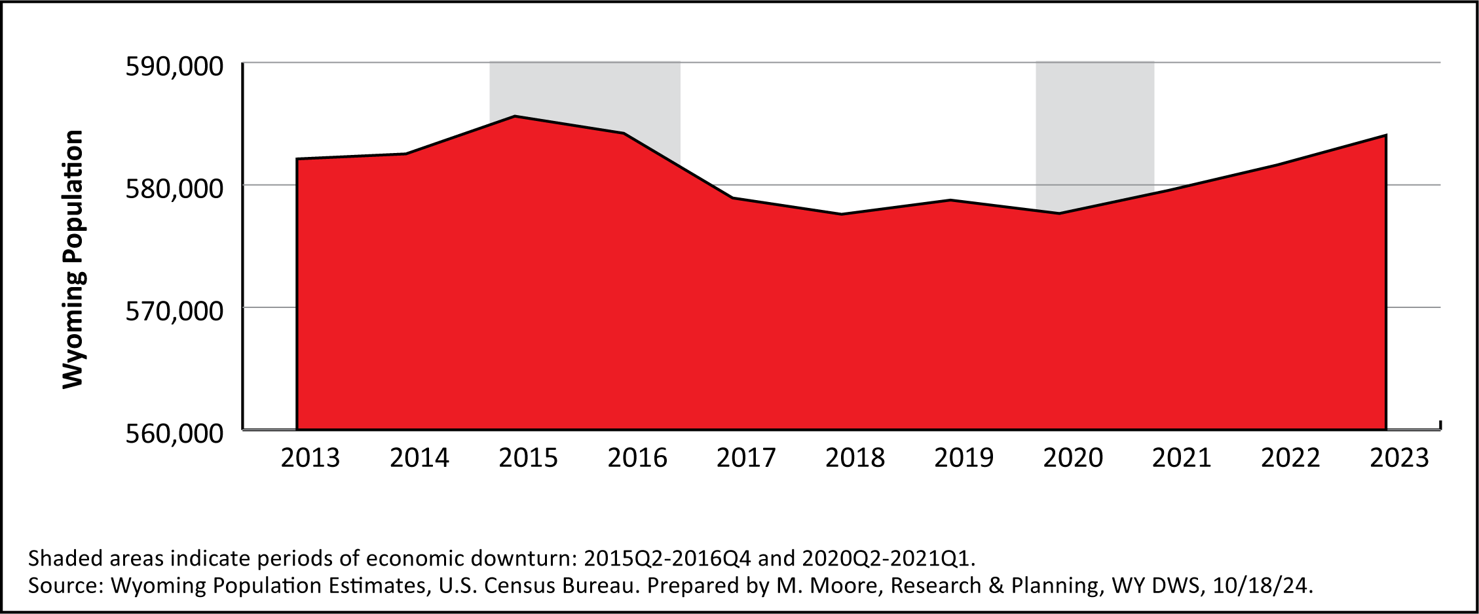
Getting to Know Wyoming’s Workforce
Wyoming Population, 2013-2023
Notes:
You can see Wyoming’s population decreased during the previous economic downturn of 2015-2016 and remained pretty flat through 2020.
Since the pandemic, Wyoming has seen steady over-the-year population growth each year.

Slide 9
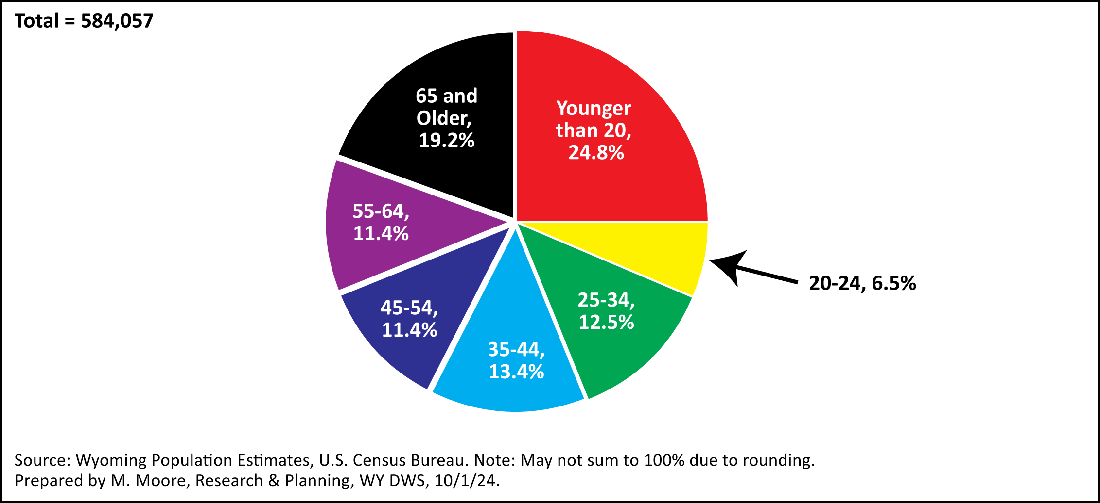
Getting to Know Wyoming’s Workforce
Population Estimates by Age, 2023
Notes:
This pie chart shows the age distribution of Wyoming’s population in 2023.
Individuals younger than 20 made up the largest portion of the population (24.8%, or about 1 in 4)
This was followed by individuals ages 65 and older at 19.2%, or about 1 in every 5
Combined, these two groups made up nearly half (44.0%) of Wyoming’s population in 2023.

Slide 10
Getting to Know Wyoming’s Workforce
Wyoming Population by Generation, 2023
Table: Estimated Wyoming Population by Generation, 2023
 |  |  | Population
Generation | Birth Years | Ages in 2023 | N | %
Baby Boomers | 1946-1964 | 59-77 | 129,283 | 22.1
Generation X | 1965-1980 | 43-58 | 107,016 | 18.3
Millennials | 1981-1996 | 27-42 | 121,821 | 20.9
Generation Z | 1997-2012 | 11-26 | 123,201 | 21.1
Other |  |  | 102,736 | 17.6
Total |  |  | 584,057 | 100.0
Source: Wyoming Population Estimates, U.S. Census Bureau.
Generation source: Pew Research Center.
Other includes population younger than gen z and older than baby boomers.
Prepared by M. Moore, Research & Planning, WY DWS, 10/1/24.
Notes:
Another way to look at Wyoming’s population is to look at it by generation, as defined by the Pew Research Center.
In 2023, baby boomers made up the large proportion of Wyoming’s population, with 129,283, or 22.1%.
Baby boomers are those individuals born between 1946 and 1964. Baby boomers were between the ages of 59-77 in 2023.
Millennials (born 1981-1996) and Generation Z (born 1997-2012) made up similar proportions of the workforce: 20.9% and 21.1%, respectively.
It is worth noting that most of our surrounding states had more millennials and Gen Z each than baby boomers.

Slide 11
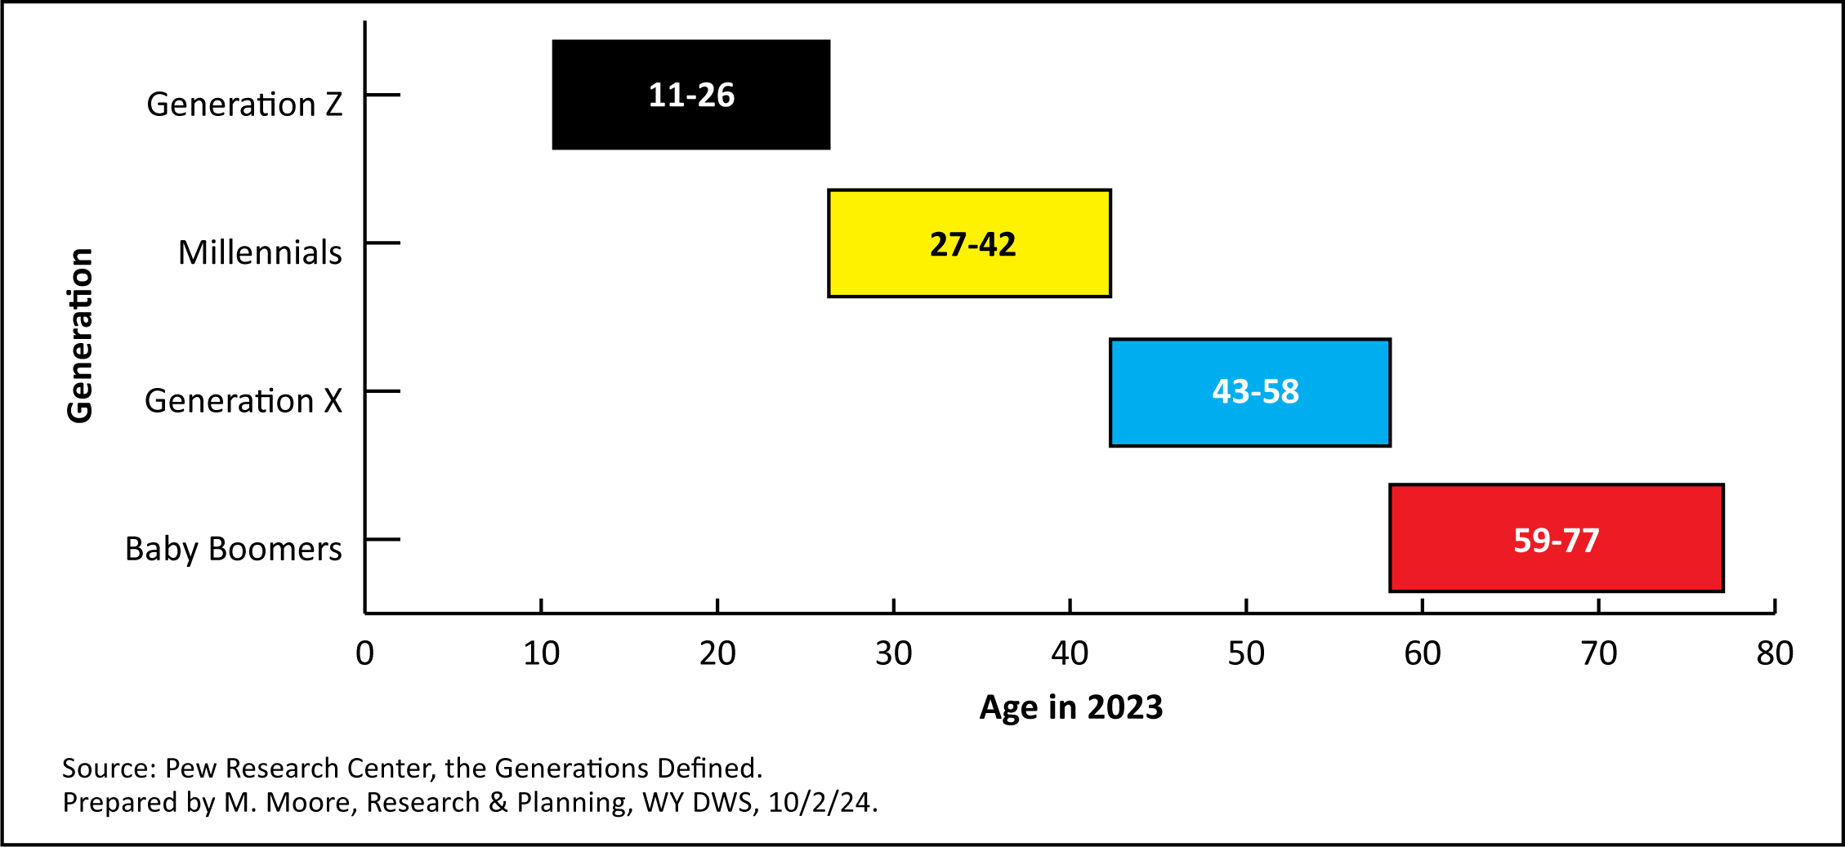
Getting to Know Wyoming’s Workforce
Wyoming Population by Generation, 2023
Notes:
Here is a way to visualize the previous table, specifically the ages of each generation in 2024.
Gen z were between the ages of 11-26.
Millennials were ages 27-42.
Gen x were 43-58.
And baby boomers were 59-77.

Slide 12
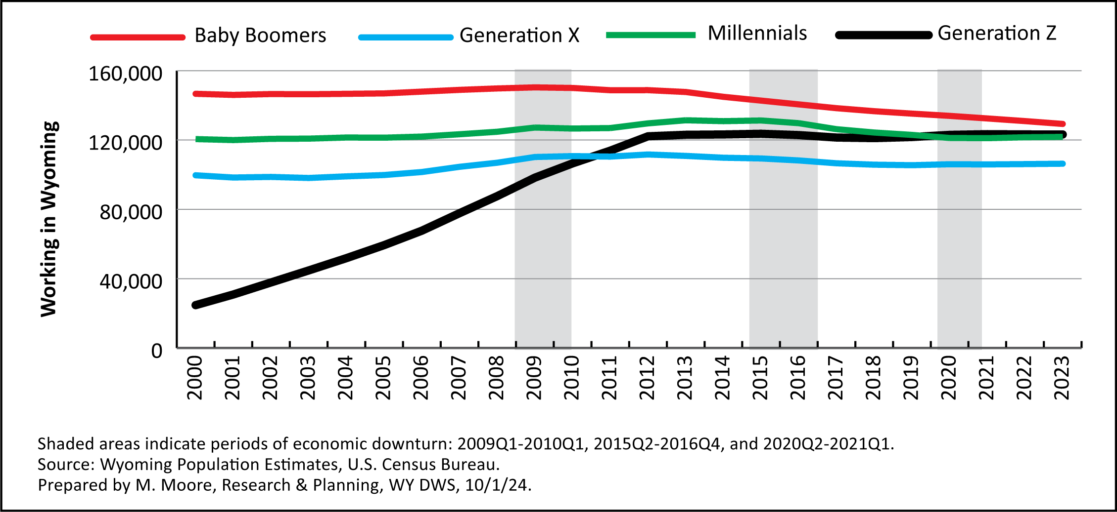
Getting to Know Wyoming’s Workforce
Wyoming Population by Generation, 2000-2023
Notes:
This figure shows Wyoming’s estimated population by generation from 2000 to 2023.
You can see that baby boomers have made up the greatest proportion of our population since 2000. However, the number of resident baby boomers has steadily declined each year since around 2012.
Our millennial population decreased each year from about 2016 to 2020, and has been flat since.
Our gen z population has also been relatively flat over the last three years.

Slide 13
Getting to Know Wyoming’s Workforce
Local Area Unemployment Statistics (LAUS)
Notes:
I want to move on to the Local Area Unemployment Statistics program, or LAUS.

Slide 14
Getting to Know Wyoming’s Workforce
Local Area Unemployment Statistics
Wyoming in 2023
Labor force: 295,207
Employed: 286,669
Unemployed: 8,538
Unemployment rate: 2.9%
U.S. unemployment rate: 3.6%
Notes:
This slide discusses data from the Local Area Unemployment Statistics Program, or LAUS.
Wyoming’s labor force in 2023 was 295,207, the highest it has been in 7 years
The labor force is the sum of employed individuals and unemployed individuals
Unemployed individuals are those who are not currently working but are seeking employment and are available to work
As you can see here, Wyoming had 286,669 employed and 8,538 unemployed in 2023
The average annual unemployment rate for 2023 was 2.9%
By comparison, the unemployment rate for the U.S. in 2023 was 3.6%

Slide 15
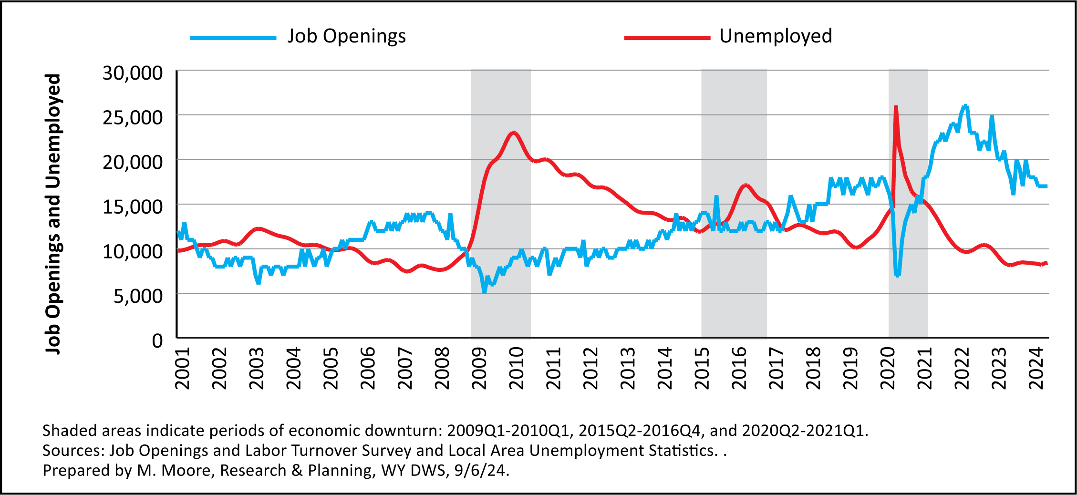
Getting to Know Wyoming’s Workforce
Unemployment and Job Openings
Notes:
One thing I want to touch on briefly is the tightening of the labor market. For the last couple years, Wyoming has had approximately two jobs for every unemployed individuals.
In August 2024 (which is the most recent month for which data are available), Wyoming had an estimated 17,000 job openings
Also in August, Wyoming had 8,975 unemployed individuals
This graph shows the number of job openings in blue and the number of unemployed individuals in Wyoming each month from January 2001 to June 2024.
The blue line shows the number of job openings, as measured by the U.S. Bureau of Labor Statistics’ Job Openings and Labor Turnover Survey, or JOLTS.
The red line shows the number of unemployed people in Wyoming from January 2001 to June 2024 by month.
As you can see at the end of this graph, Wyoming is in pretty uncharted territory.
Wyoming has had periods with more job openings than unemployed people, notably during the boom from 2006 to 2008 and a during period of large construction projections in 2018 and 2019, but never to this extent.
You can see from 2009 through about 2012, Wyoming had substantially more unemployed people than job openings

Slide 16
Getting to Know Wyoming’s Workforce
Wyoming Wage Records:
Individuals Working in Wyoming at Any Time During the Year
Notes:
Wyoming wage records research allows us to identify rich details of those working in Wyoming:
Gender
Age
Industry and county of employment
Number of quarters worked

Slide 17
Getting to Know Wyoming’s Workforce
Wyoming Wage Records
What are Wage Records?
Based on employers’ quarterly wage and employment reports to UI tax
1992 to present
Worked in Wyoming at any time during the year
Linked to other administrative databases
UI claims
Driver’s license file
Notes:
Wage records are based on employers’ quarterly wage and employment reports to the Unemployment Insurance (UI) tax section of the Wyoming Department of Workforce Services
When a person receives wages from an employer, that generates a wage record
Wage records are available from 1992 to present
Each person is counted only once per year
Counts include individuals working at any time during the year, whether for one day or all four quarters
Wage records are linked to other administrative databases, such as UI claims and the driver’s license file from the Wyoming Department of Transportation
While wage records represent over 90% of all wage and salary disbursements in Wyoming, there are some types of employment not captured in wage records. More on that in a bit.

Slide 18
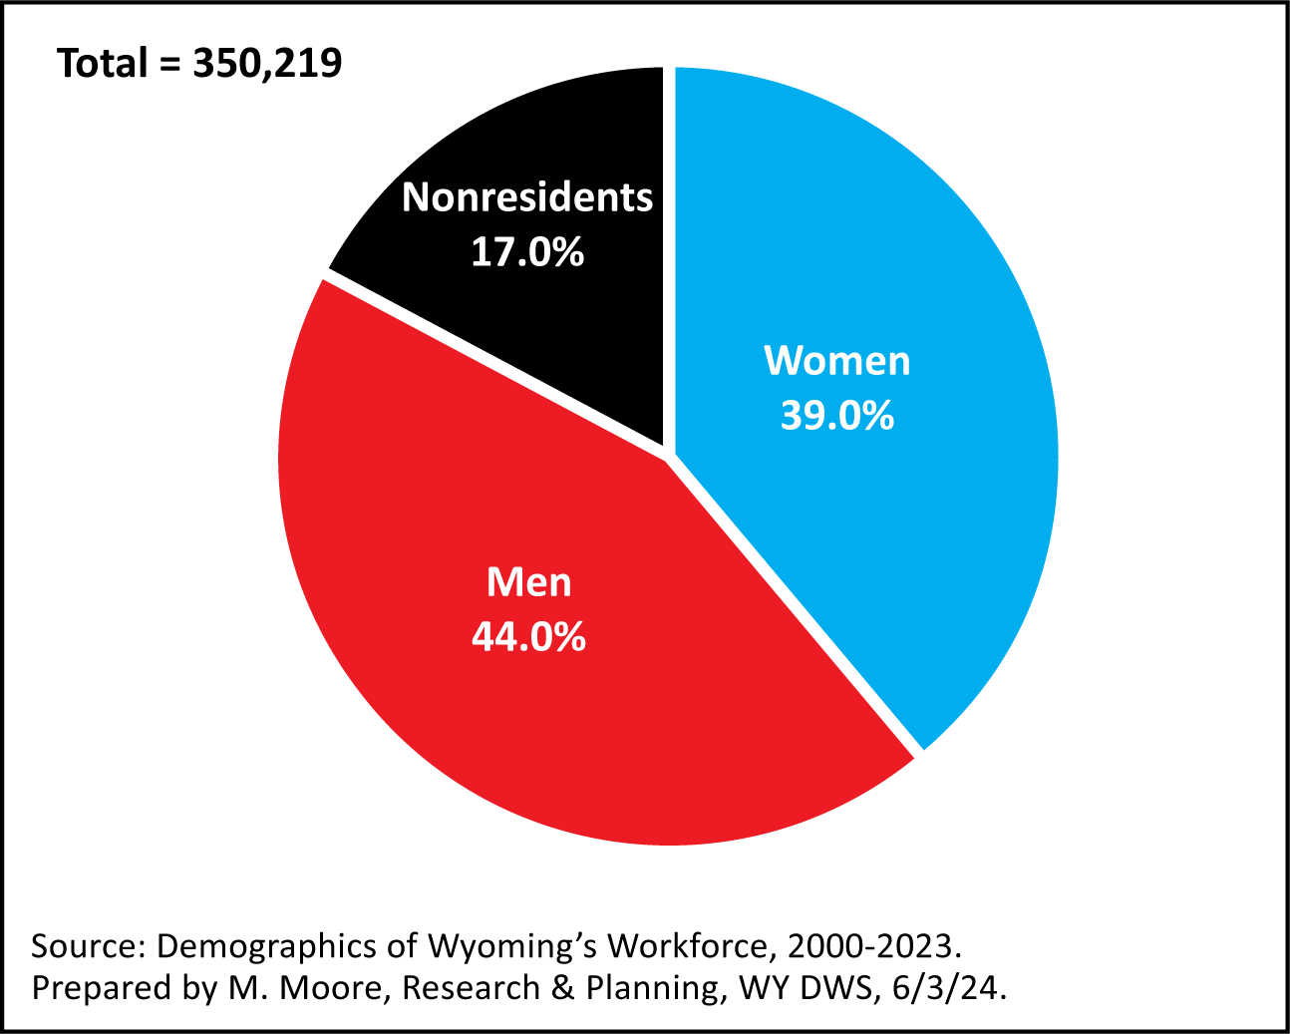
Getting to Know Wyoming’s Workforce
Demographics of the Workforce
Persons Working in Wyoming at Any Time During the Year, 2023
Notes:
In 2023, there were 350,219 individuals working in Wyoming at any time during the year. Again, this could mean they worked for one day, or all four quarters.
Each individual is only counted once.
Resident males made up 44.0% of all persons working, while resident females made up 39.0%.
The remaining 17.0% were nonresidents, or individuals for whom demographic data are not available.
That’s roughly 60,000 nonresidents working in Wyoming in 2023.

Slide 19
Getting to Know Wyoming’s Workforce
Demographics of the Workforce
Nonresidents
Demographic data not available
Commute to Wyoming from another state or country
Could be individuals who moved to Wyoming but haven’t obtained a driver’s license
12% to 17% of all individuals working in Wyoming any given year
Notes:
It’s important to understand what the term nonresidents means.
Nonresidents are typically individuals who commute to Wyoming from another state or country for work.
They may be from Colorado, Florida, Canada or Mexico. We currently do not have a way to identify them.
Nonresidents also may be individuals who moved to Wyoming for work in 2023 but had not established residency by the end of the year.
Wyoming has historically relied heavily on a nonresident workforce, especially for industries such as construction and leisure & hospitality.
During any given year dating back to 2000, nonresidents typically account for 12% to 17% of all individuals working in Wyoming.
The number of nonresidents in Wyoming’s workforce has steadily increased over the last several years.

Slide 20
Getting to Know Wyoming’s Workforce
Demographics of the Workforce
Decline of Resident Workers
Younger workers leaving the state
50% of high school seniors not found working in Wyoming 5 years after graduation
Older workers retiring or exiting the workforce
Individuals ages 55+ made up one-third of Wyoming population in 2023
Commuting to other states
Not captured in wage records
Notes:
Over the last several years Wyoming has seen a decline in the number of residents working in the state. There are several possible reasons why.
We know that younger workers continue to leave the state. Our research has shown that about half of all high school seniors are not found working in Wyoming five years after graduation.
Older workers are retiring or leaving the workforce. In 2023, individuals 55 and older made up about one-third of the state’s population, slightly higher than the national average.
Wyoming residents could be commuting to neighboring states like Colorado, Idaho, and Utah for work.
Wyoming residents may be working in jobs that don’t show up in wage records, such as gig-type jobs or selling goods online.
Or they could be teleworking for an employer outside of Wyoming.

Slide 21
Getting to Know Wyoming’s Workforce
Demographics of the Workforce
Individuals Working in Wyoming at Any Time During the Year by Generation, 2023
 |  |  | Working in Wyoming
Generation | Birth Years | Ages in 2023 | N | %
Baby Boomers | 1946-1964 | 59-77 | 46,175 | 13.2
Generation X | 1965-1980 | 43-58 | 81,067 | 23.1
Millennials | 1981-1996 | 27-42 | 97,997 | 28.0
Generation Z | 1997-2012 | 11-26 | 63,467 | 18.1
Other |  |  | 1,957 | 0.6
Nonresidents |  |  | 59,556 | 17.0
Total |  |  | 350,219 | 100.0
Source: Demographics of Wyoming's Workforce, 2000-2023.
Prepared by M. Moore, Research & Planning, WY DWS, 9/6/24.
Notes:
This table shows the number of people working in Wyoming at any time during in 2023 by their generation, and is similar to the population table I showed you earlier.
In 2023, millennials made up the largest segment of people working in Wyoming, with nearly 98,000, or 28.0%.
Millennials are those born from 1981 to 1996.
In 2023, they were between the ages of 27 and 42.

Slide 22
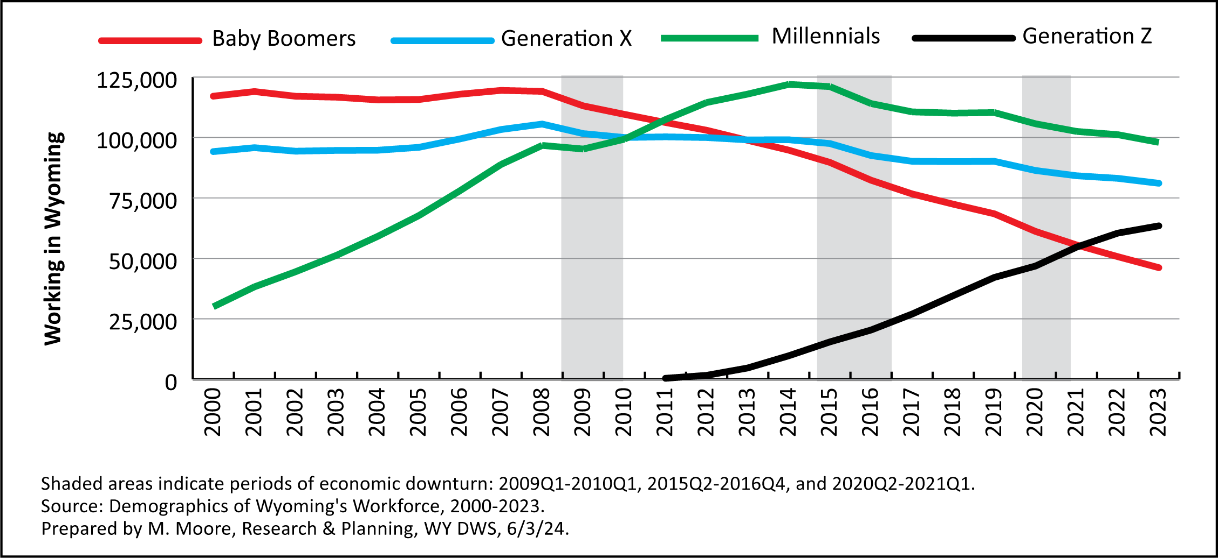
Getting to Know Wyoming’s Workforce
Demographics of the Workforce
Notes:
This figure shows the number of Wyoming residents working in the state by generation from 2000 to 2023.
There are some interesting trends to notice. Nonresidents are not included in this graph.
The green line represents millennials. The number of millennials, which has been the largest segment of the workforce since 2012, has consistently declined since the 2015-2016 economic downturn.
The red line represents baby boomers. We can see how the number of baby boomers working in Wyoming has pretty rapidly declined since 2008 as they’ve gotten older.
The blue line represents generation X, which has also declined in recent years.
The black lines represents generation z, our youngest workers. 2022 and 2023 marked this first two years when generation z made up a larger proportion of those working than baby boomers.

Slide 23
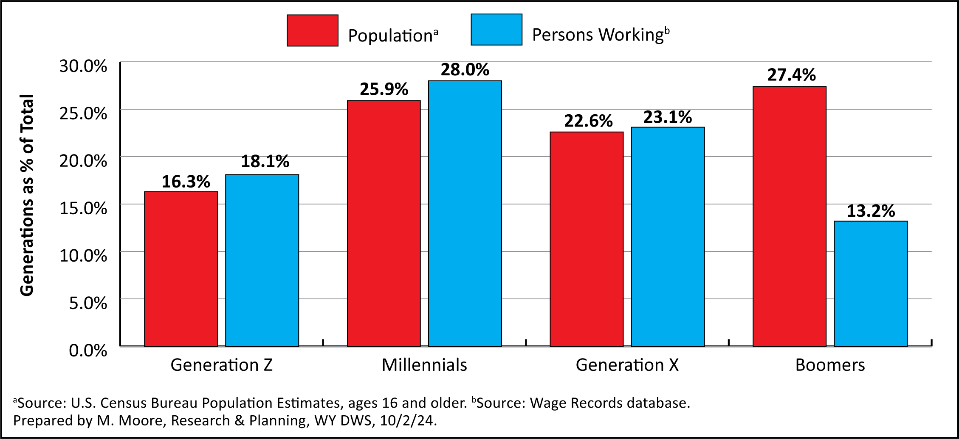
Getting to Know Wyoming’s Workforce
Population and Persons Working by Generation, 2023
Notes:
This figure shows each generation as a percent of the population and the number of persons working at any time during the year.
For the number of population estimates, I only used individuals 16 and older, so that it would be somewhat comparable to data for persons working.
For example, millennials made up 25.9% of Wyoming’s population ages 16 and older and 28.0% of all persons working.
In addition, baby boomers made up 27.4% of the population and 13.2% of those working.
This is kind of what we would expect to see, as baby boomers have moved into retirement and make up a larger percentage of the population than of those working.

Slide 24
Getting to Know Wyoming’s Workforce
American Community Survey 5-Year Estimates for Wyoming, 2022
Notes:
I’ll finish up with some data from the American Community Survey (ACS) for Wyoming
The ACS is a product of the U.S. Census Bureau
I’ll be using 5-year estimates for 2022, which are the most reliable estimates
This is just a sample of the type of data available. I’ll post an Excel file online that will have all sorts of different data, many of which won’t be covered in this presentation

Slide 25
Getting to Know Wyoming’s Workforce
Educational Attainment in Wyoming, 2022
Table: Number and Percent of Population Age 25 or Older by Education Attainment in Wyoming, 2022
Education | N | %
Less than 9th grade | 7,876 | 2.0
9th to 12th grade, no diploma | 16,894 | 4.3
At least a high school diploma | 367,219 | 93.7
High school graduate (includes equivalency) | 109,746 | 28.0
Some college, no degree | 98,169 | 25.0
Associates degree | 45,671 | 11.7
Bachelors degree | 71,118 | 18.1
Graduate or professional degree | 42,515 | 10.8
Total | 391,989 | 100.0
Source: American Community Survey 5-Year Estimates, U.S. Census Bureau.
Prepared by L. Knapp, Research & Planning, WY DWS, 9/20/24.
Notes:
The ACS provides us with educational attainment data, looking at the highest level of completed education.
In 2022, at least 93.7% of Wyoming residents had at least a high school diploma.
25.0% had some college, no degree
This also includes post-secondary non-degree awards, such as a commercial driver’s license or other certificate
11.7% had an associate’s degree
18.1% had a bachelor’s degree
And 10.8% had a graduate or professional degree

Slide 26
Getting to Know Wyoming’s Workforce
Poverty in Wyoming, 2022
11.0% age 16+ below 100% poverty level
Poverty for individual: $13,590
Poverty for family of 4: $27,750
14.6% unemployment rate of those in poverty
Source: American Community Survey 5-year estimates.
Notes:
Data from the ACS show that in 2022, about 1 in 10 (11.0%) of those ages 16+ in Wyoming lived below 100% of the poverty level.
In Wyoming in 2022, 100% poverty for an individual was $13,590.
For a family of 4, it was $27,750.
The unemployment rate of those living below the 100% poverty threshold was 14.6%
In contrast, the statewide average annual unemployment rate was 3.4% in 2022, and 2.9% in 2023.

Slide 27
Getting to Know Wyoming’s Workforce
Disability in Wyoming, 2022
16.6% of those age 16+ had a disability
76,000 people
67.5% of those with disability not in the labor force
Source: American Community Survey 5-year estimates.
Notes:
Data from the ACS show that in 2022, 16.6% of those ages 16+ in Wyoming had some sort of disability.
That is more than 76,000 individuals.
Among those 76,000, approximately two-thirds (67.5%) were not in the labor force, meaning they were either not working, or looking and available for work.
In contrast, 28.2% of individuals 16+ without a disability were not in the labor force.

Slide 28
Getting to Know Wyoming’s Workforce
Veterans in Wyoming, 2022
Nearly 42,000 veterans in Wyoming in 2022
9 out of 10 were men
Nearly half were age 65+
96.7% had at least a high school diploma
1 in 4 had at least a bachelor’s degree
4.4% unemployment rate
Source: American Community Survey 5-year estimates.
Notes:
In 2022, nearly 42,000 veterans were living in Wyoming
Approximately 9 out of 10 (89.8%) were men
Nearly half (49.6%) were ages 65 or older
96.7% of all veterans had a least a high school diploma, greater than the overall average of 93.7% for Wyoming
1 in 4 (24.8%) had at least a bachelor’s degree, about the same as the overall average of 25.0%
The unemployment rate for veterans in 2022 was 4.4%, higher than the overall rate of 3.4%

Slide 29
Getting to Know Wyoming’s Workforce
Non-English Speakers in Wyoming, 2022
20,216 didn’t speak English or didn’t speak English well (4.4%)
68.0% spoke Spanish
55.1% had no high school diploma
12.1% had a bachelor’s degree or higher
Source: American Community Survey 5-year estimates.
Notes:
In 2022, more than 20,000 individuals ages 16+ living in Wyoming didn’t speak English or didn’t speak English well
Of non-English speakers, more than two-thirds (68.0%) spoke Spanish
More than half of non-English speakers (55.1%) ages 16+ did not have a high school diploma or equivalent
Only 12.1% had a bachelor’s degree or higher

Slide 30
Getting to Know Wyoming’s Workforce
Contact Us
Michael Moore, Research Supervisor
(307) 473-3814
Michael.Moore@wyo.gov
https://doe.state.wy.us/LMI
Notes:
With that I will go ahead and wrap up the presentation.
Thank you for inviting me to speak here today.
I know I threw a lot of numbers at you, so if there is something in particular you would like to know more about, feel free to call or email me. Our website URL is on this slide, and you can find everything we produce there, including a copy of this presentation.
Thanks again.

