Slide 1
Inside the 2025 Wyoming Workforce Annual Report
Presented to the Wyoming Workforce Development Council by Michael Moore, R&P Research Supervisor, Thursday, September 4, 2025
Notes:
Good afternoon, my name is Michael Moore and I am the research supervisor for R&P.
Thank you for giving me the time today to talk to you a little bit about R&P’s 2025 Wyoming Workforce Annual Report.
This report is an excellent resource and something to go back to if you need to quickly find answers to labor market information questions that may arise.

Slide 2
2025 Wyoming Workforce Annual Report
About Research & Planning
OUR ORGANIZATION:
R&P is an exclusively statistical entity within DWS.
WHAT WE DO:
R&P collects, analyzes, and publishes timely and
accurate labor market information (LMI)
meeting established statistical standards.
OUR CUSTOMERS:
LMI makes the labor market more efficient by
providing the public and the public’s
representatives with the basis for
informed decision making.
Notes:
Just a little bit about Research & Planning to get us started.
R&P is an exclusively statistical entity within DWS.
We collect, analyze and publish timely labor market information (LMI) data.
We provide this information to the public, legislators, educators, training providers, the media, and more.

Slide 3
2025 Wyoming Workforce Annual Report
2025 Wyoming Workforce Annual Report
https://doe.state.wy.us/annual_report.htm
Annual publication
In conjunction with Wyoming Workforce Development Council
Overview of all R&P’s work
Notes:
Each year we publish a Wyoming Workforce Annual Report in conjunction with the Wyoming Workforce Development Council.
The 2025 issue was just published in June.
This is a great overview of all the work R&P does during the year.
This publication is available online at the URL on this slide, and there’s also a link at the top of our main page.
This presentation will serve as an overview to the annual report. There are a few images in this presentation that were taken from other presentations or publications that did not appear in the annual report.

Slide 4
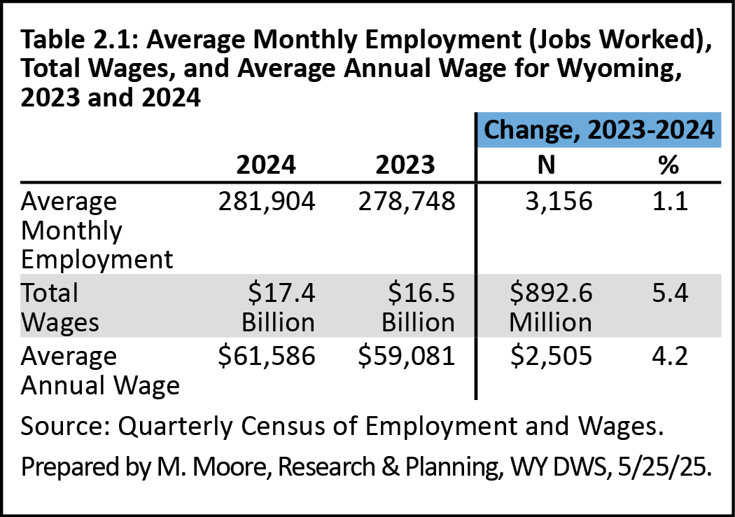
2025 Wyoming Workforce Annual Report
Chapter 2: Quarterly Census of Employment and Wages
Notes:
Chapter 2 looks at annual employment and wages using data from the Quarterly Census of Employment and Wages, or QCEW.
The data in this chapter show that from 2023-2024:
Wyoming added more than 3,100 jobs (a 1.1% increase)
Total wages increased by $892.6 million, a 5.4% increase
The state’s average annual wage was $61,586, up 4.2%

Slide 5
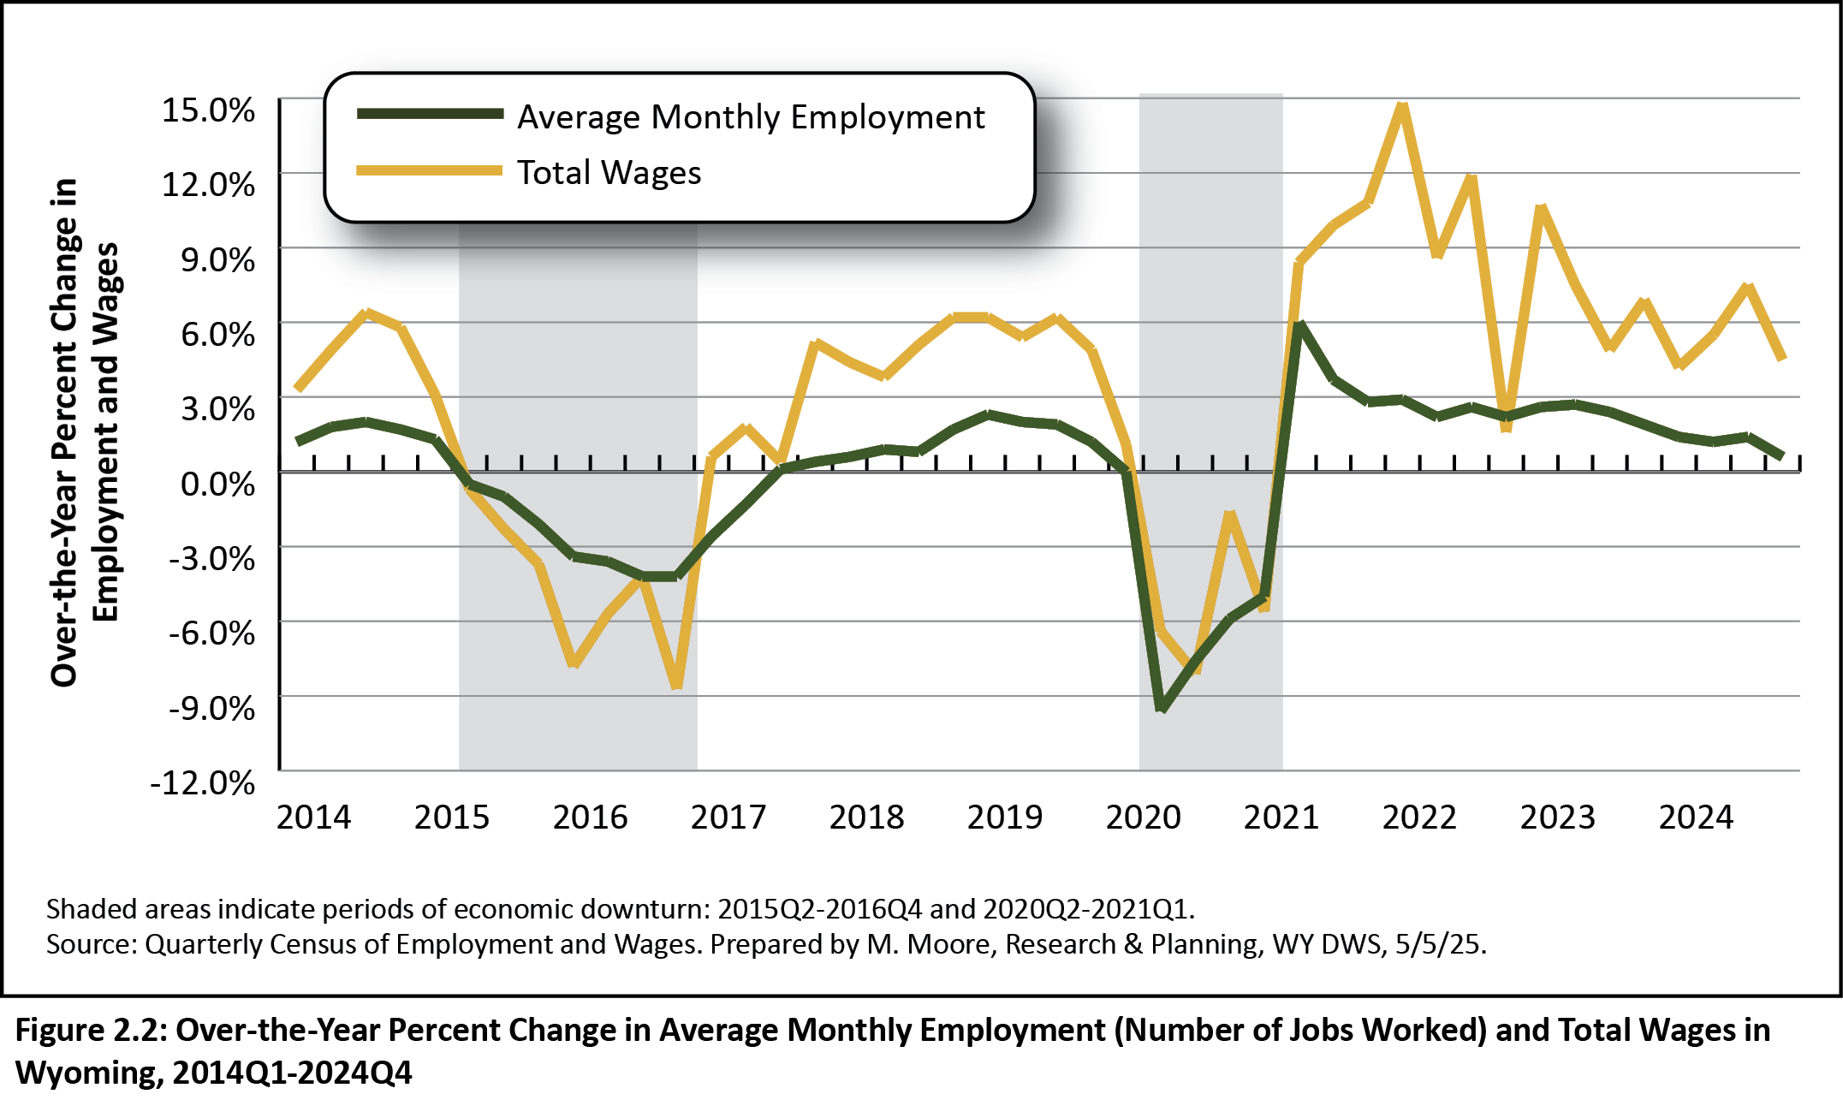
2025 Wyoming Workforce Annual Report
Chapter 2: Quarterly Census of Employment and Wages
Over-the-Year % Change in Employment and Wages, 2014Q1-2024Q4
Notes:
I’ll be talking about periods of economic downturn during this presentation, and this graphic will help you visualize what I’m talking about.
The shaded boxes represent periods of economic downturn: 2015Q2 to 2016Q4 and 2020Q2-2021Q1.
We define an economic downturn as at least two consecutive quarters of over-the-year decline in average monthly employment and total wages, based on data from the QCEW.
This figure shows over-the-year percent changes in employment and total wages from 2014Q1 to 2024Q4.
The green line represents over-the-year change in annual employment.
You can see how the downturn in 2015 and 2016 was more prolonged.
In the 2020 downturn, which is associated with the pandemic and declining energy prices, we saw a sharp drop in employment at the start, but it didn’t last as long.
You can see how growth has slowed in the most recent years since the pandemic, but is still positive.

Slide 6
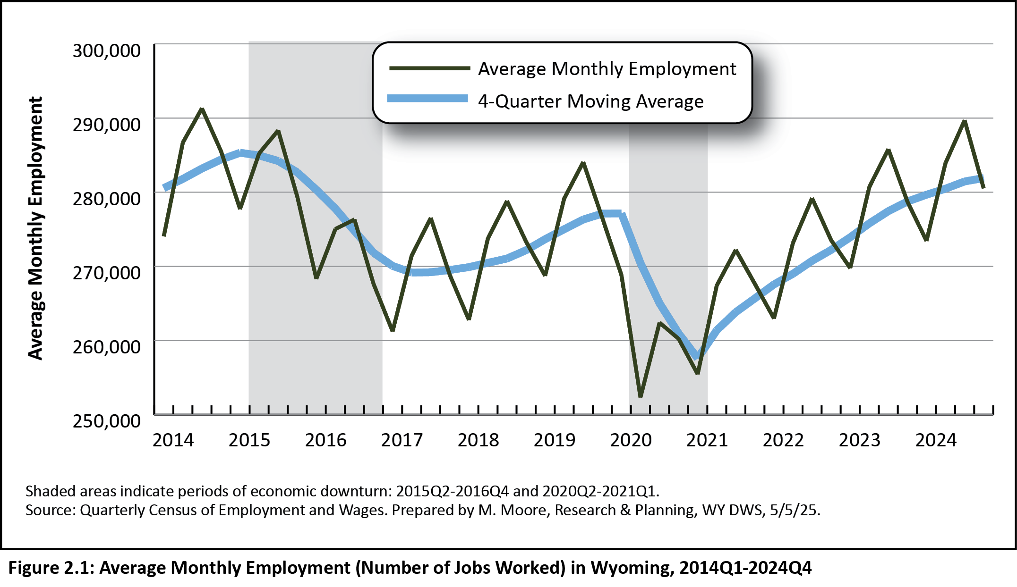
2025 Wyoming Workforce Annual Report
Chapter 2: Quarterly Census of Employment and Wages
Wyoming Employment, 2014Q1-2024Q4
Notes:
This figure shows Wyoming’s average monthly employment from first quarter 2014 to fourth quarter 2024.
The thin green line represents average monthly employment, so you can see how employment changes from one quarter to the next.
Employment increases from first to second quarter, then peaks during third quarter, which is July, August, and September. We then see a decrease in jobs from third to fourth quarter as many of those seasonal summer jobs go away.
The blue line is a four-quarter moving average, which allows us to more easily identify trends over time.
You can see in this figure how employment has grown consistently since the end of the most recent downturn, but it did take us a while to get back to pre-Covid employment levels.

Slide 7
2025 Wyoming Workforce Annual Report
Chapter 2: Quarterly Census of Employment and Wages
Job Growth by Industry
Construction (1,281, or 5.7%)
Health care & social assistance (411, or 1.6%)
Professional & business services (368, or 1.7%)
Mining, Including Oil & Gas (1,036 jobs, or -6.1%)
Notes:
QCEW data provide us with job growth by industry
The greatest over-the-year job growth was seen in industries like:
Construction, with 1,281 new jobs, or 5.7%
Health care & social assistance, 411 jobs, or 1.6%
And professional & business services with 368 jobs, or 1.7%
However, it is worth pointing that that Wyoming’s mining sector lost more than 1,000 jobs, or -6.1%.
Some of that change in mining is due to some recent non-economic code changes, but we also did see substantial job losses.

Slide 8
2025 Wyoming Workforce Annual Report
Chapter 2: Quarterly Census of Employment and Wages
Highest Wages by Industry
Total: $61,586
Mining, Including Oil & Gas ($106,695)
Federal government ($88,949)
Professional & business services ($85,412)
Financial activities ($84,915)
Notes:
Data from the QCEW show us which industries had the highest annual wages in 2024.
The overall average annual wage in Wyoming was $61,586.
Mining (including oil & gas) had the highest wage with $106,695, followed by
Federal government with $88,949
Professional & business services with $85,412,
And financial activities with $84,915

Slide 9
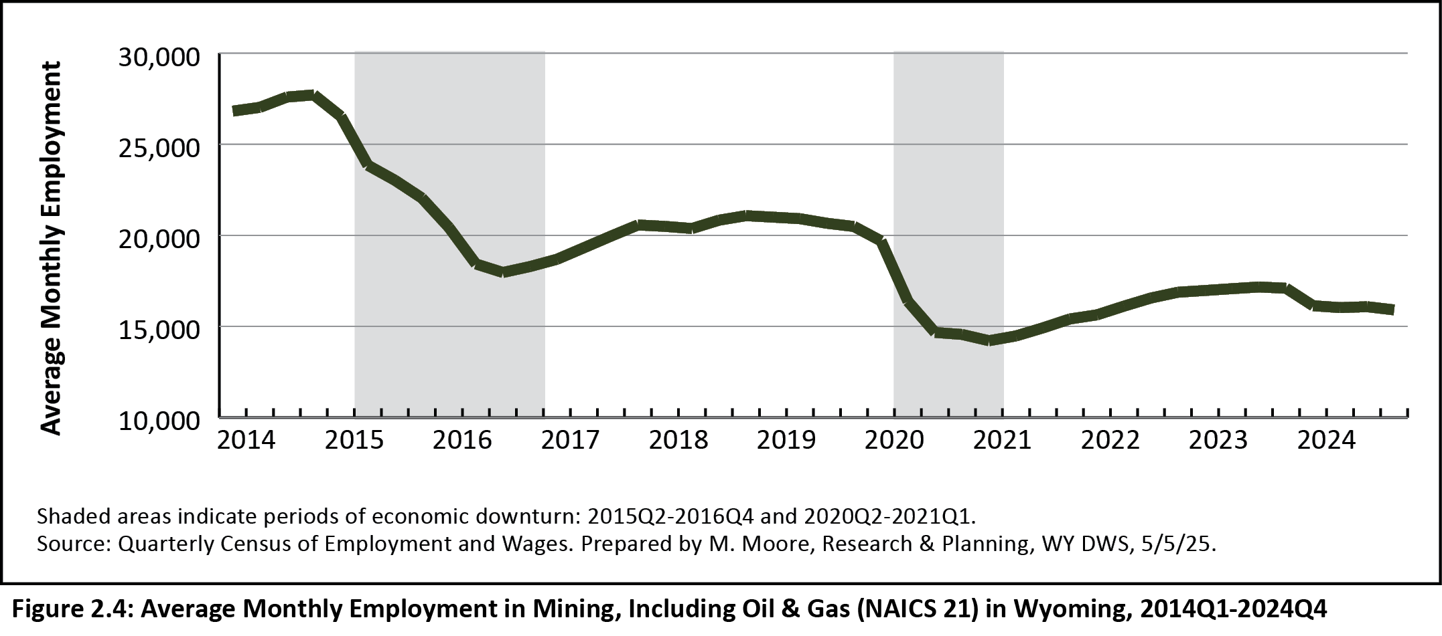
2025 Wyoming Workforce Annual Report
Chapter 2: Quarterly Census of Employment and Wages
Average Monthly Employment in Mining in WY, 2014Q1-2024Q4
Notes:
This figure shows average monthly employment in mining in Wyoming for 2014Q1 to 2024Q4.
You can see how employment in mining drops drastically during periods of economic downturn, which are often preceded by declining energy prices and demand.
As I said before, mining lost more than 1,000 jobs from 2023 to 2024.
Part of those job losses were due to some jobs being reclassified to a different ownership, while the others were actual job losses.

Slide 10
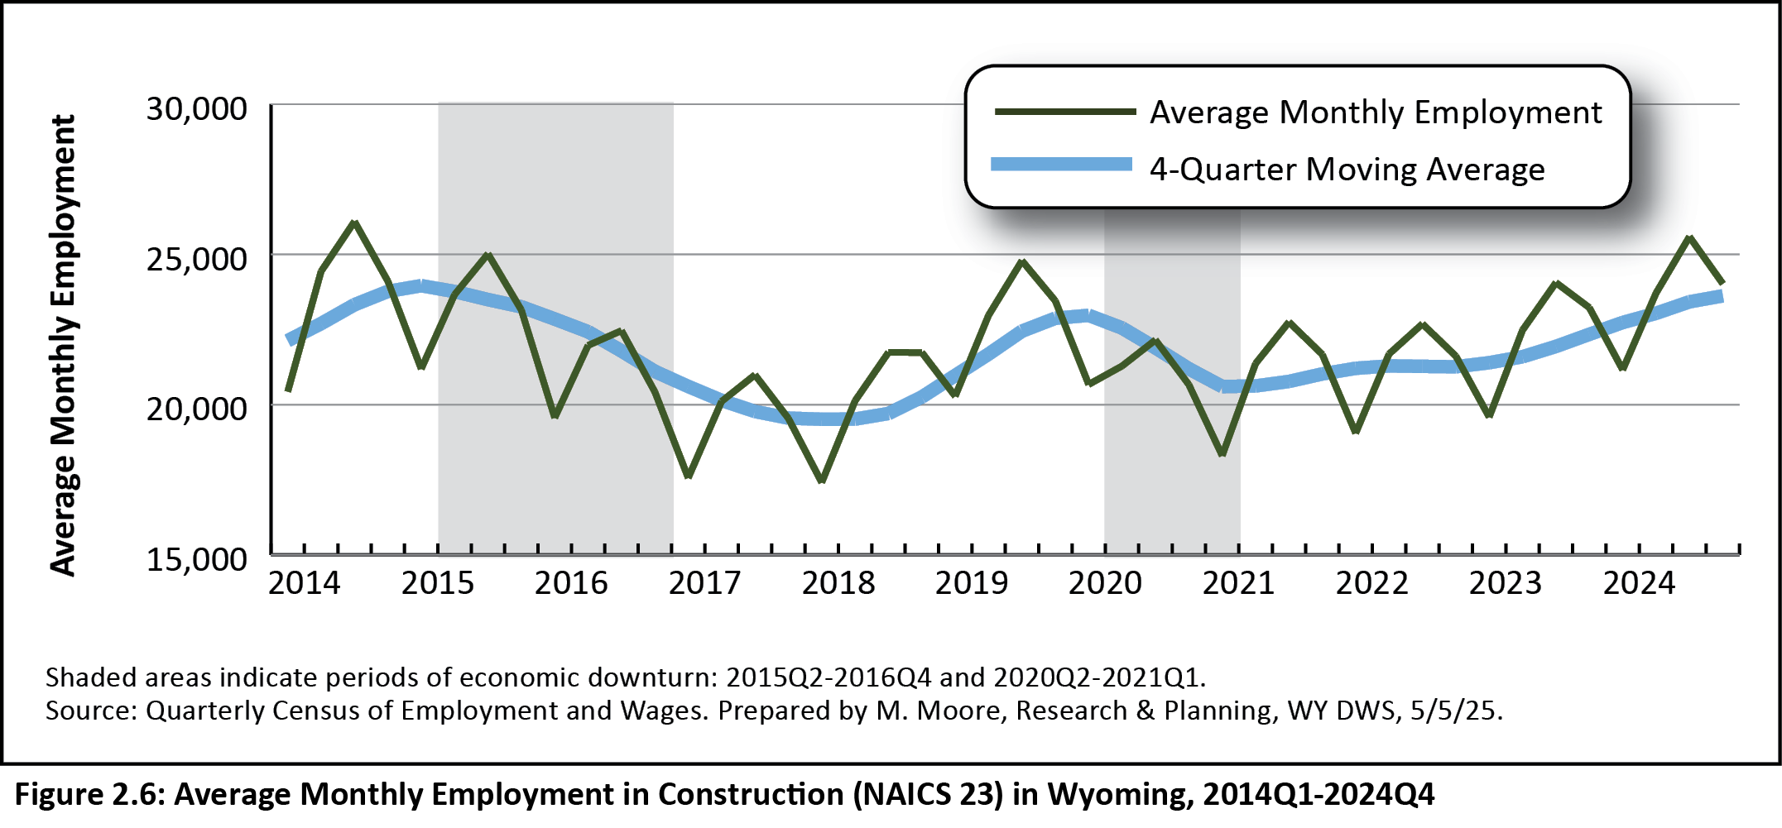
2025 Wyoming Workforce Annual Report
Chapter 2: Quarterly Census of Employment and Wages
Average Monthly Employment in Construction in WY, 2014Q1-2024Q4
Notes:
This figure shows employment in Wyoming’s construction sector from 2014Q1 to 2024Q4.
Once again the thin green line is average monthly employment, while the blue line is a four-quarter moving average.
You can see the consistent growth in construction employment since the end of the pandemic, particularly in 2023 and 2024.
In the last several quarters, construction has driven Wyoming job growth.

Slide 11
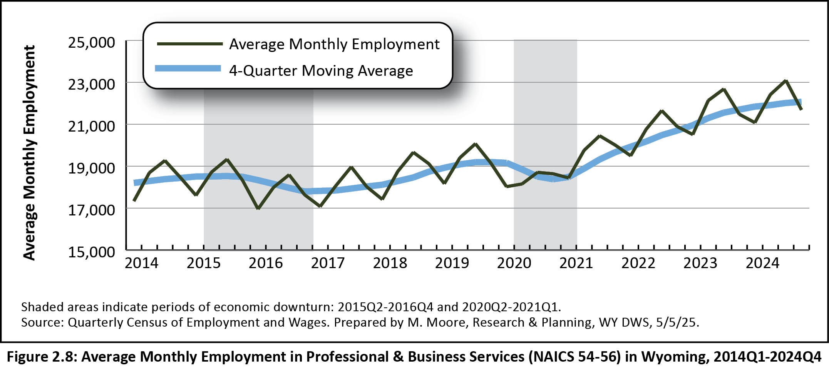
2025 Wyoming Workforce Annual Report
Chapter 2: Quarterly Census of Employment and Wages
Average Monthly Employment in Professional & Business Services in WY, 2014Q1-2024Q4
Notes:
Another industry that has seen substantial job growth is professional & business services.
You can see here just how much employment in this industry increased since the pandemic.
These are the largest employment numbers we have ever seen in this sector.

Slide 12
2025 Wyoming Workforce Annual Report
Chapter 2: Quarterly Census of Employment and Wages
What is Professional & Business Services?
Supersector made up of three sectors:
Professional & technical services
Management of companies & enterprises
Administrative & waste services
Notes:
So what exactly is professional & business services? While some industry titles are self-explanatory, like mining, construction, or health care, this one is a little different.
Professional & business services is a supersector made up of three sectors:
Professional & technical services
Management of companies & enterprises
Administrative & waste services
So what does all that mean? This industry supersector includes businesses involved in things like temporary employment staffing, computer systems designs, legal services, architectural & engineering services, and a whole lot more.

Slide 13
2025 Wyoming Workforce Annual Report
Chapter 2: Quarterly Census of Employment and Wages
Employment Growth by County, 2023-2024
Laramie County (718, or 1.5%)
Natrona County (555, or 1.4)
Teton County (377, or 1.6%)
Albany County (355, or 2.1%)
Sheridan County (292, or 2.1%)
Notes:
The QCEW provides us with employment and wage data by county.
The counties with the greatest job gains from 2023 to 2024 were:
Laramie County, with 718 (1.5%)
Natrona, with 555 (1.4%)
Teton, with 377 (1.6%)
Albany, with 355 (2.1%)
And Sheridan, with 292 (2.1%)

Slide 14
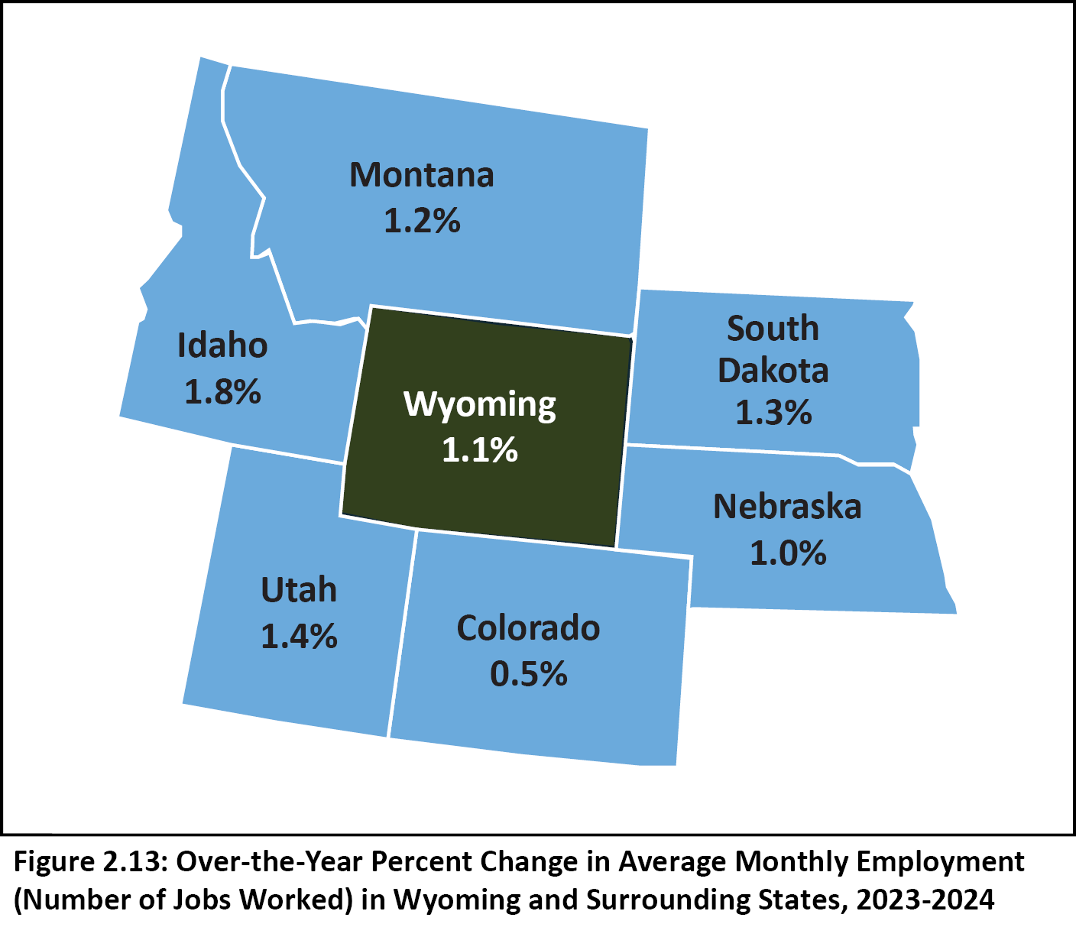
2025 Wyoming Workforce Annual Report
Chapter 2: Quarterly Census of Employment and Wages
Job Growth in Surrounding States
Notes:
The QCEW allows us to compare job growth in Wyoming and surrounding states.
As I mentioned, Wyoming’s average monthly employment increased by 1.1% from 2023 to 2024.
That really wasn’t a whole lot different from most of our surrounding states.
Idaho had a the greatest increase in employment at 1.8%, while Colorado had the smallest at 0.5%.

Slide 15
2025 Wyoming Workforce Annual Report
Chapter 3: Population Estimates
Wyoming 2024 Population: 587,618
From 2023 to 2024, 0.4% increase (1,898)
Surpassed 2019 population (578,759) by 1.5% (8,859)
From 2014 to 2024, 0.9% increase (5,087)
Notes:
We’ll move on to Chapter 3, which looks at population estimates from the U.S. Census Bureau
Wyoming’s population in 2024 was 587,618

Slide 16
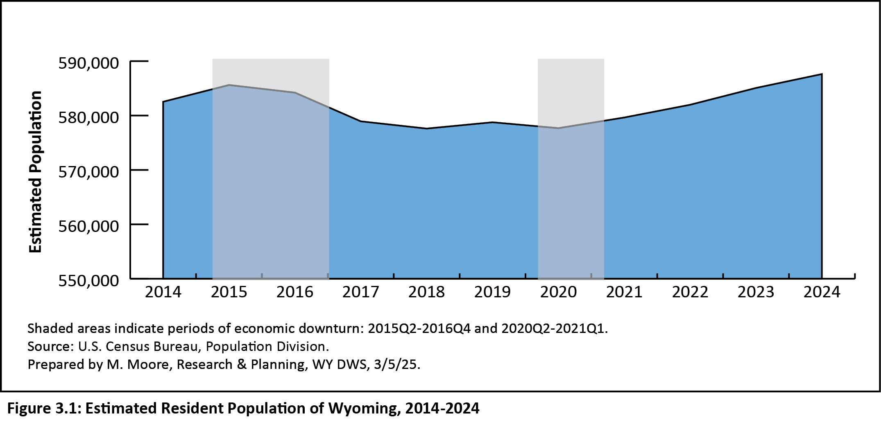
2025 Wyoming Workforce Annual Report
Chapter 3: Population Estimates
Wyoming 2024 Population: 587,618 Estimated Resident Population of Wyoming, 2014-2024
Notes:
You can see in this graph how Wyoming’s population has increased since the pandemic.
Again, these shaded areas represent those economic downturns I was talking about earlier.

Slide 17
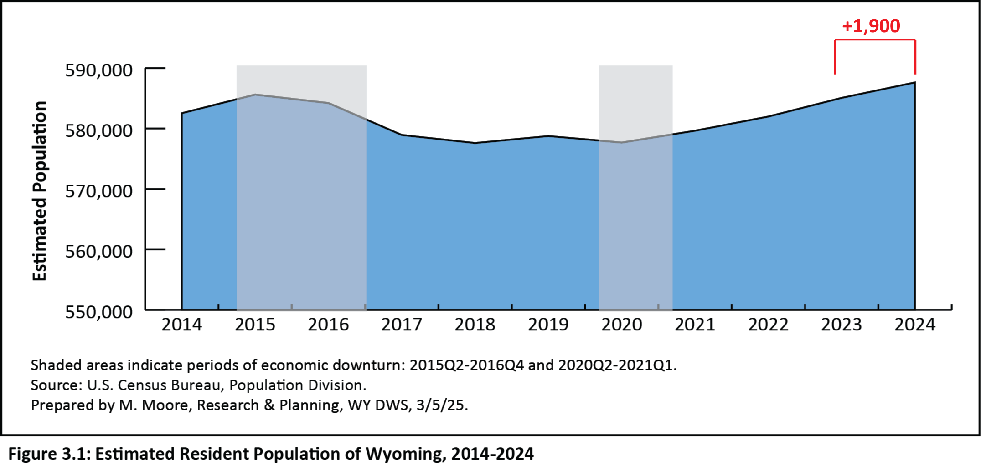
2025 Wyoming Workforce Annual Report
Chapter 3: Population Estimates
Wyoming 2024 Population: 587,618 Estimated Resident Population of Wyoming, 2014-2024
Notes:
The population was up about 1,900 people (0.4%) compared to 2023

Slide 18
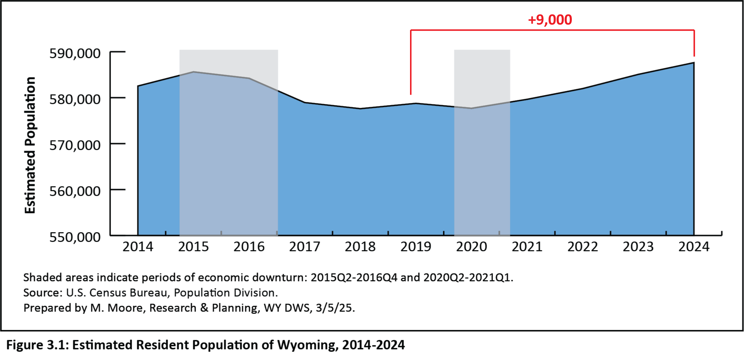
2025 Wyoming Workforce Annual Report
Chapter 3: Population Estimates
Wyoming 2024 Population: 587,618 Estimated Resident Population of Wyoming, 2014-2024
Notes:
Population was up about 1.5% or almost 9,000 compared to pre-pandemic level of 2019, which was 578,759

Slide 19

2025 Wyoming Workforce Annual Report
Chapter 3: Population Estimates
Wyoming 2024 Population: 587,618 Estimated Resident Population of Wyoming, 2014-2024
Notes:
And finally, from 2014 to 2024, Wyoming’s population increased by 5,087 people, or 0.9%

Slide 20
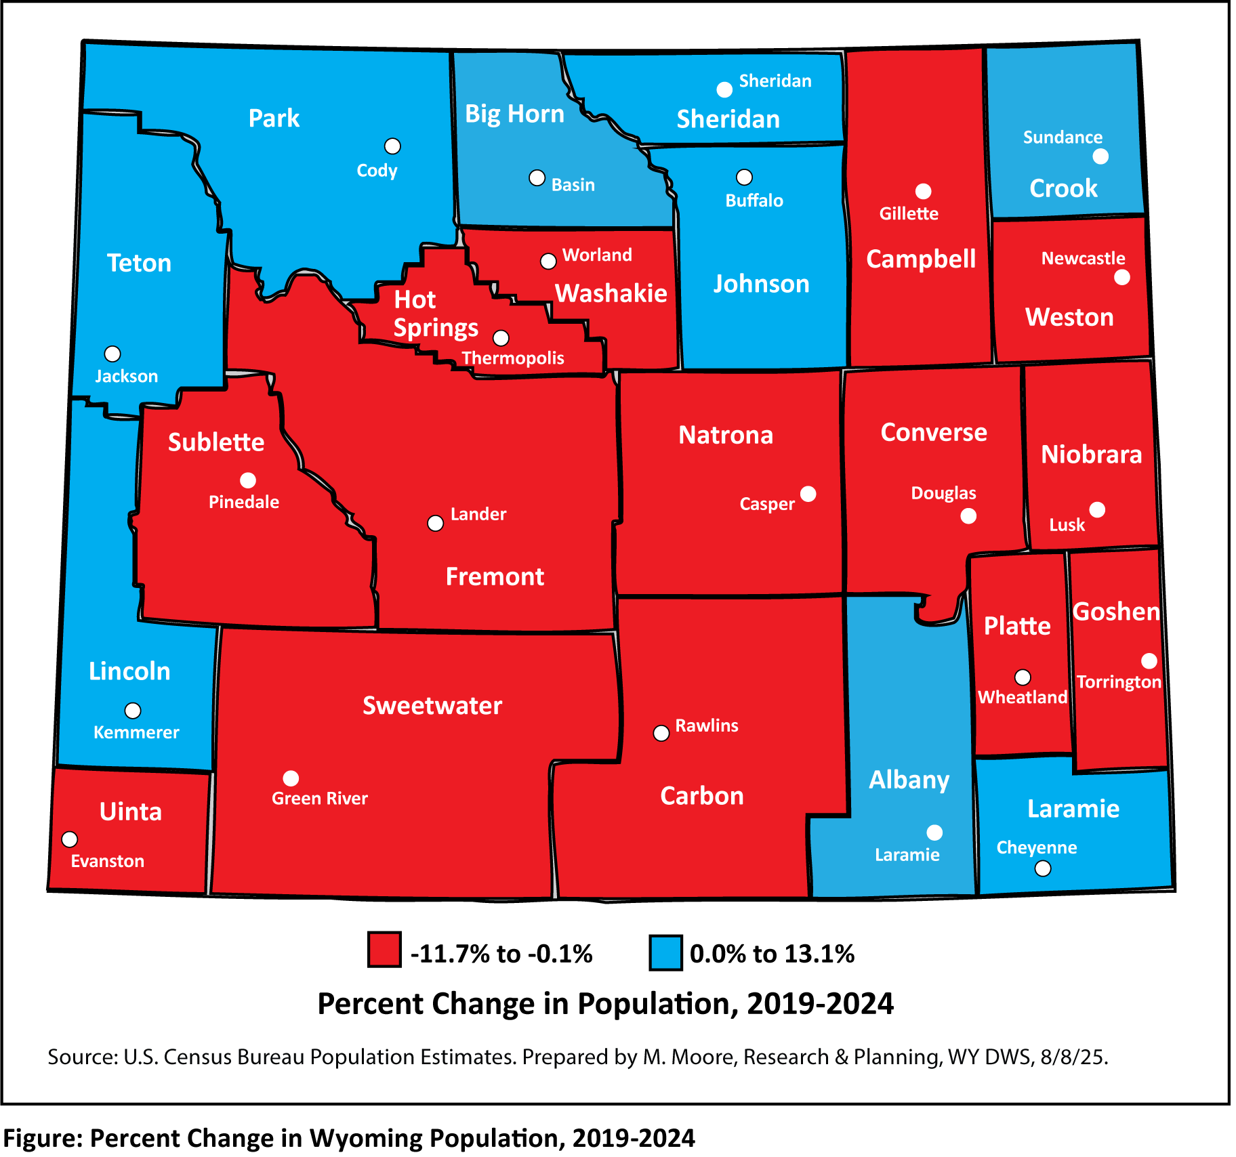
2025 Wyoming Workforce Annual Report
Chapter 3: Population Estimates
Notes:
This figure from Chapter 3 shows population change from 2019 to 2024
The blue counties saw increases in population, while the red counties saw population decreases.
There were 14 counties with population decreases, with the greatest percentages seen in Sublette with -11.7% and Carbon with -10.2%.
The greatest percentage increases were seen in Lincoln with 13.1% and Sheridan with 10.5%.

Slide 21
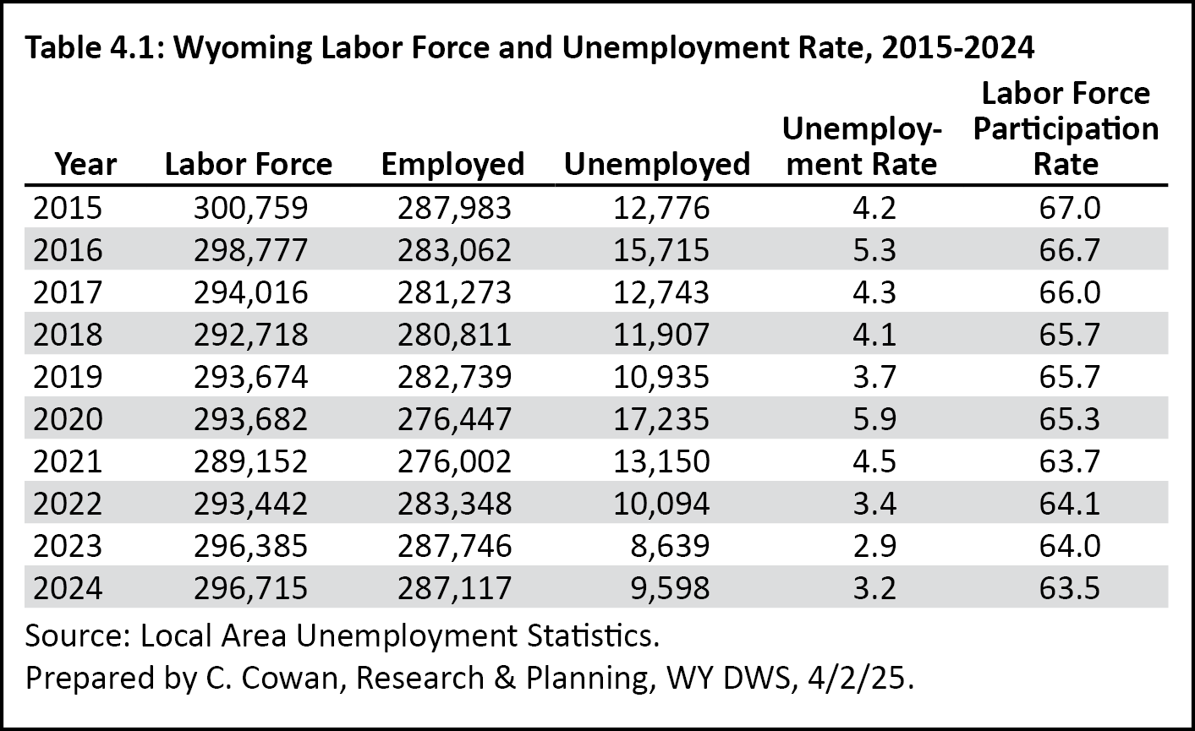
2025 Wyoming Workforce Annual Report
Chapter 4: Local Area Unemployment Statistics
Notes:
Chapter 4 focuses on data from the Local Area Unemployment Statistics program, or LAUS. LAUS data include the labor force, number of employed, number of unemployed, and the unemployment rate
We can see here that the total labor force increased from 296,385 in 2023 to 296,715 in 2024.
Since 2021 we’ve seen pretty consistent increases in the workforce and the number of individuals employed.
The number of unemployed was 8,639 in 2023, the lowest amount since 2007. The number of unemployed went up to 9,598 in 2024, which was still lower than at any point in the last 10 years.
The unemployment rate increased from 2.9% to 3.2%.
So to sum this up, we’ve seen recent increases in the labor force and the number of employed individuals, which are both higher than pre-pandemic levels from 2018 and 2019.
In case you’re wondering, Wyoming’s most recent seasonally adjusted unemployment rate was 3.3% for June 2025.

Slide 22
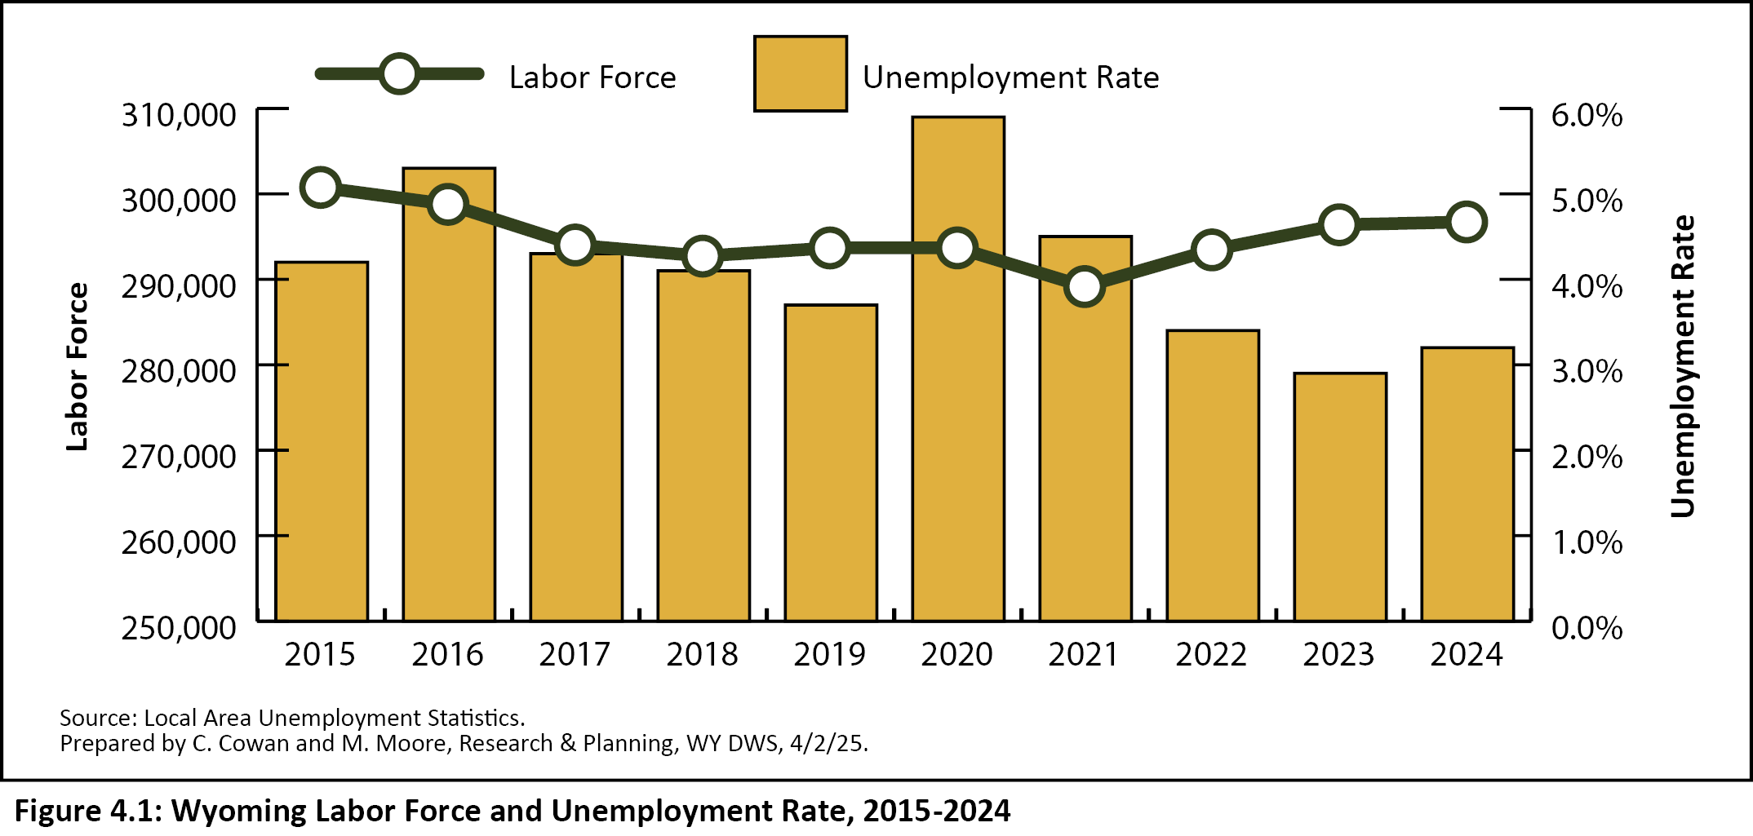
2025 Wyoming Workforce Annual Report
Chapter 4: Local Area Unemployment Statistics
Wyoming Labor Force and Unemployment Rate, 2015-2024
Notes:
This figure from Chapter 4 provides a visualization of the data I just talked about.
The black line represents the labor force, and you can see how it has increased since 2021.
The yellow bars represent the unemployment rate, and you can see the slight increase from 2023 to 2024.
You can see that in 2020 during the pandemic, we had an unemployment rate of almost 6%.

Slide 23
2025 Wyoming Workforce Annual Report
Chapter 5: Unemployment Insurance Claims
Notes:
Chapter 5 looks at annual Unemployment Insurance claims data, such as the number of UI benefit recipients and the total amount of benefits paid
In 2024 Wyoming had 10,972 UI benefit recipients. That was up over the year by 512, or 5.9%.
The average exhaustion rate was 18.1%, up slightly compared to 17.2% in 2023.
The average number of weeks claimed in 2024 was 10.3, unchanged from the prior year.
Finally, Wyoming UI paid out $51.7 million in benefit expenses in 2024, up by $6.5 million, or 14.4%.

Slide 24
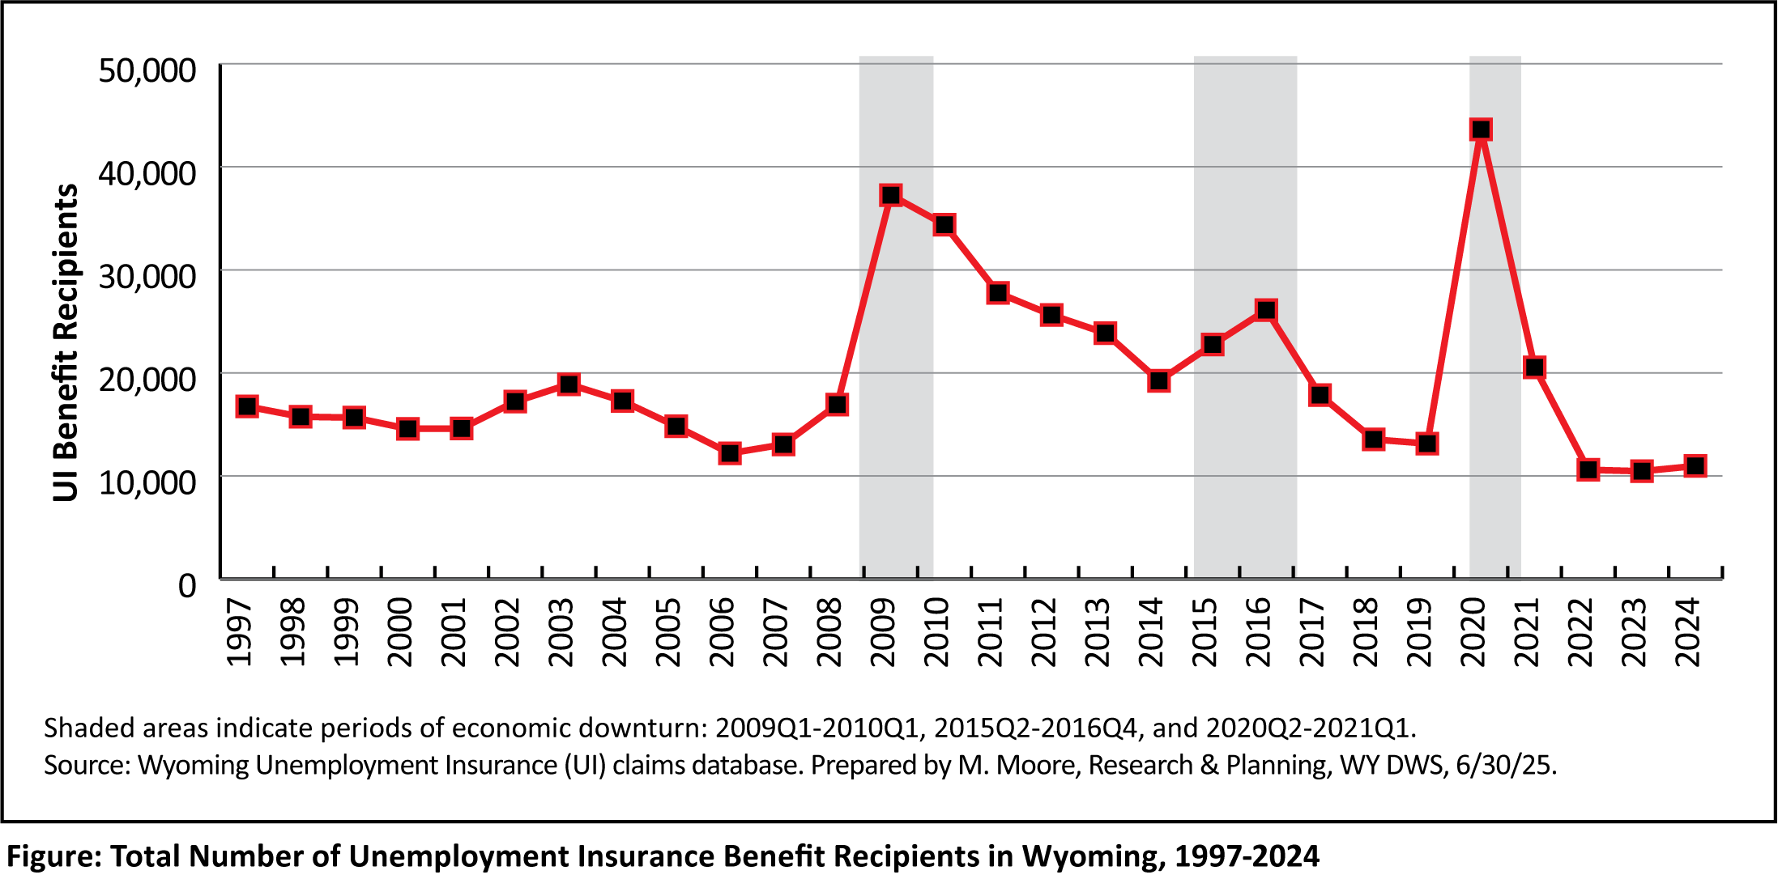
2025 Wyoming Workforce Annual Report
Chapter 5: Unemployment Insurance Claims
UI Benefit Recipients in Wyoming, 1997-2024
Notes:
This figure shows the total number of UI benefit recipients in Wyoming for each year from 1997 to 2024.
Once again, the shaded boxes show economic downturns. This one goes back a bit further, so you can also see the 2009-10 downturn, which occurred during the national Great Recession.
You can see how the number of UI benefit recipients spiked during each economic downturn as jobs were lost.
In 2020, Wyoming had 43,630 individuals receiving UI benefits, which marked the largest number of UI benefit recipients dating back to at least 1997.
You can see that from 2022 to 2024, Wyoming had historically low numbers of UI benefit recipients.

Slide 25
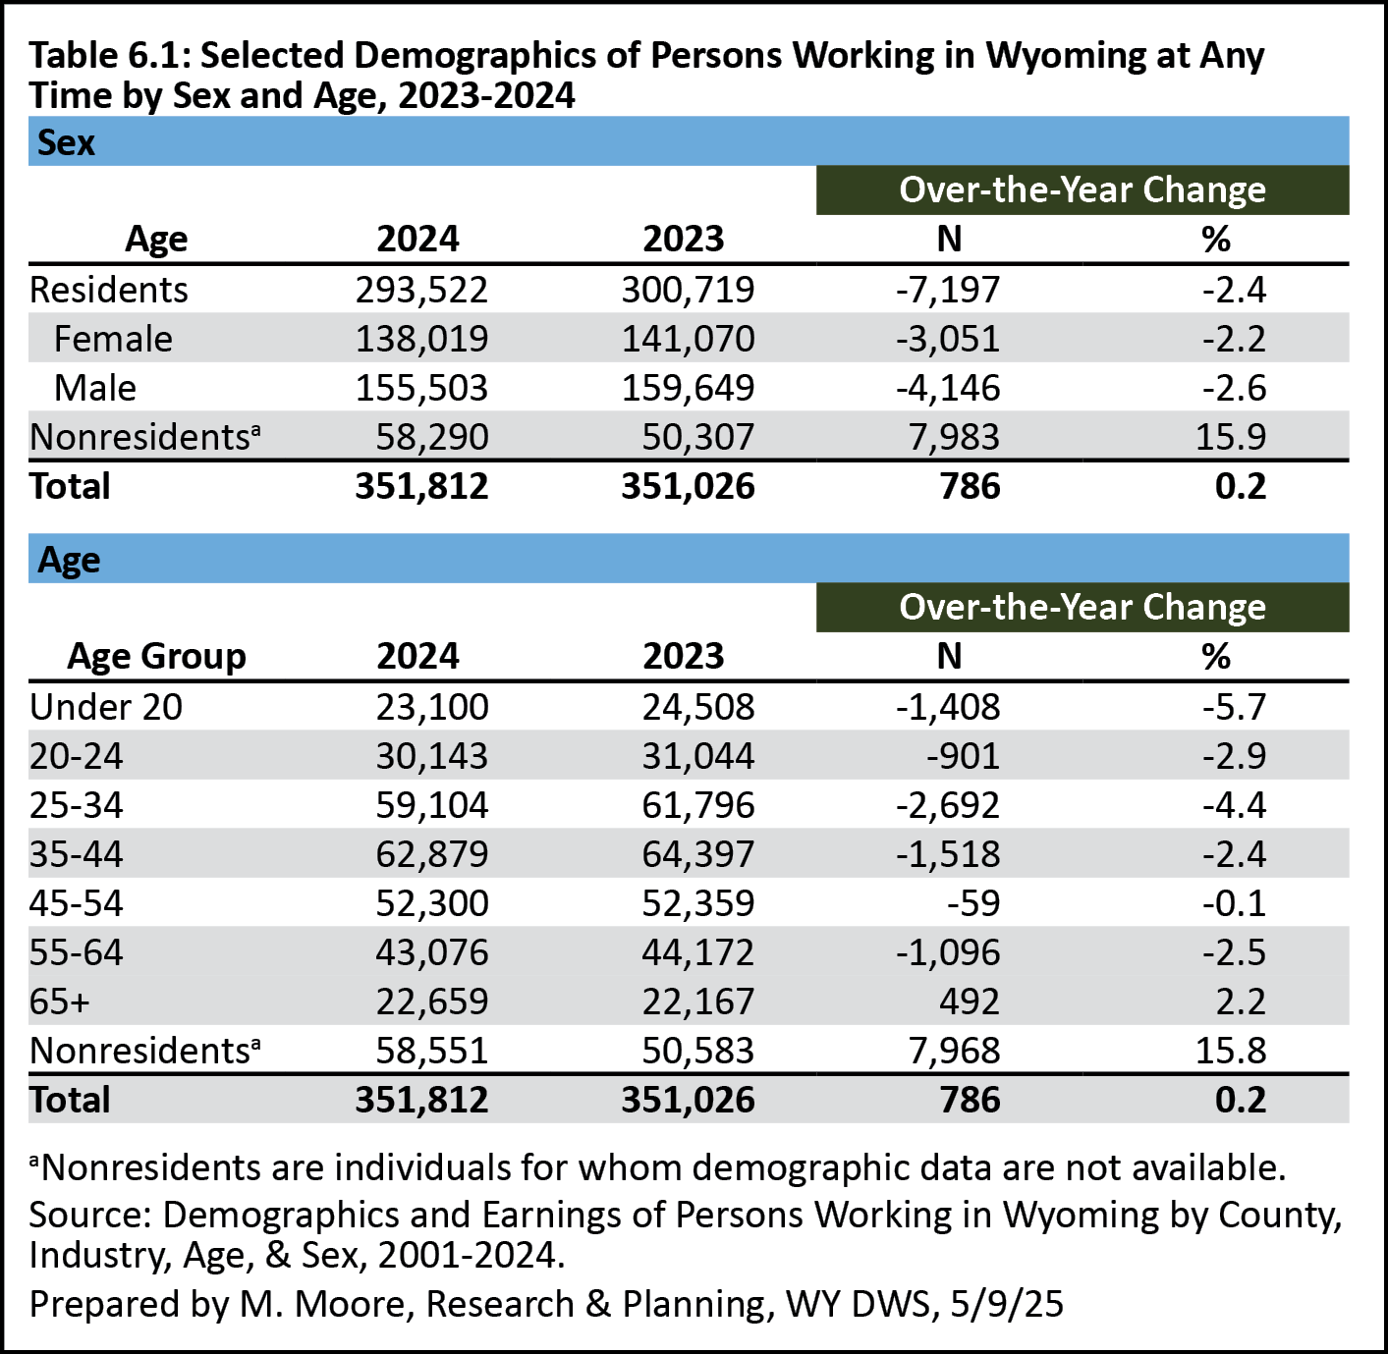
2025 Wyoming Workforce Annual Report
Chapter 6: Demographics of the Workforce
Notes:
Chapter 6 looks at demographics of Wyoming’s workforce, which was accomplished by linking data from several of our administrative databases
These numbers represent individuals working in Wyoming at any time during the year, whether that’s one day or all four quarters
In 2024, there were 351,812 unique individuals working in Wyoming, up slightly (786 individuals) compared to 2023.
In 2024, 44.2% of the people working in Wyoming were males and 39.2% were females.
The remaining 16.6% were nonresidents, which refers to individuals for whom data aren’t available.

Slide 26
2025 Wyoming Workforce Annual Report
Chapter 6: Demographics in Wyoming
Nonresidents in Wyoming
Individuals for whom demographic data are not available
Commute to work in WY for another state or country
Temporary, seasonal jobs
Often in construction and leisure & hospitality
Moved to Wyoming but have not obtained a Wyoming driver’s license
Notes:
It’s important to understand what we mean when we talk about nonresidents.
Nonresidents are often people who commute to Wyoming from other states or countries for temporary jobs in industries such as construction and leisure & hospitality.
For example, a person who comes to Wyoming from Colorado for a construction job in the summer would be considered a nonresident.
Nonresidents also may be individuals who moved to Wyoming but haven’t yet obtained a Wyoming driver’s license.

Slide 27
2025 Wyoming Workforce Annual Report
Chapter 6: Demographics in Wyoming
Nonresidents in Wyoming
Work jobs in seasonal industries
One-third of workers in:
Construction (34.2%)
Leisure & hospitality (32.6%)
Notes:
Again, nonresidents often work jobs in seasonal industries like construction and leisure & hospitality.
In 2024, nonresidents accounted for about one-third of all individuals working in construction and leisure & hospitality.

Slide 28
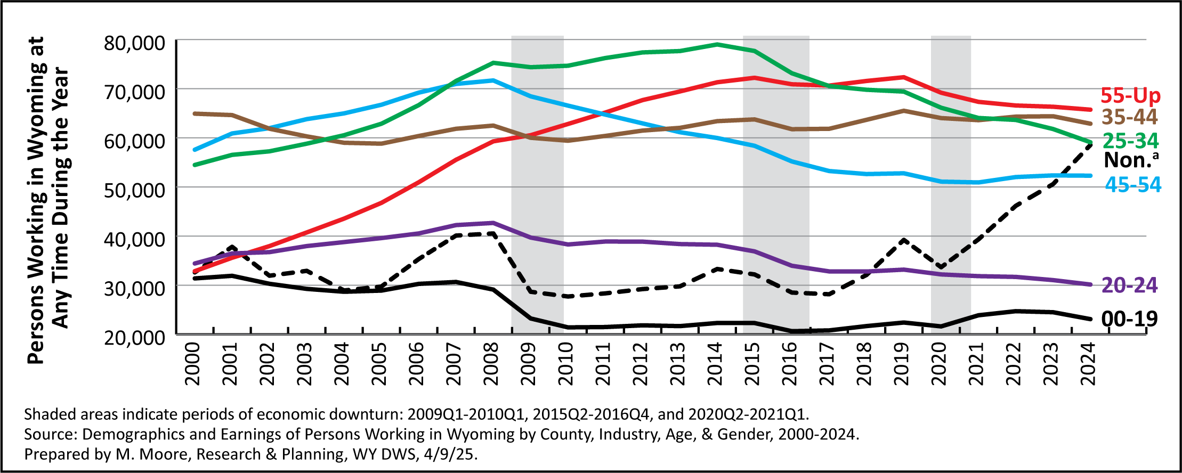
2025 Wyoming Workforce Annual Report
Chapter 7: Demographics of the Workforce
Persons Working in Wyoming by Age, 2000-2024
Notes:
Figure 7.2 on page 42 of the annual report shows the change in the number of people working in Wyoming from 2000 to 2024 by age.
We can see downward trends for most of these age groups over the last several years.

Slide 29
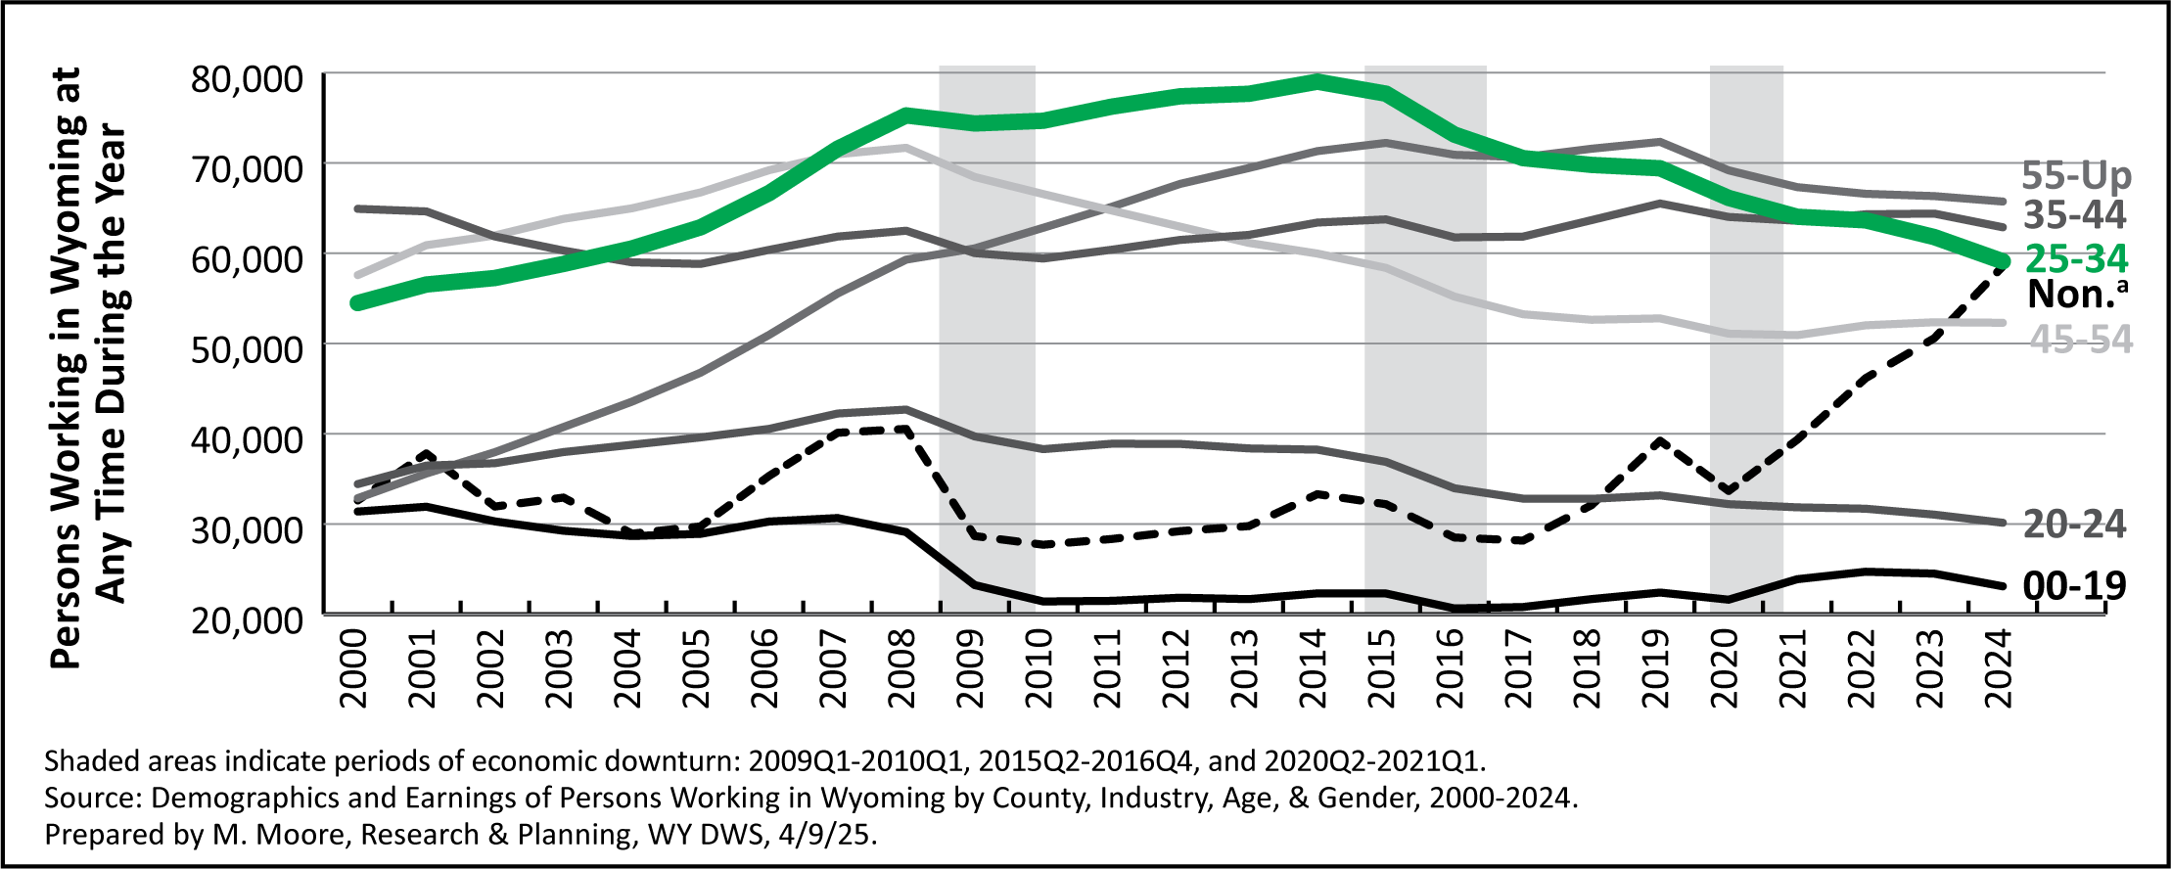
2025 Wyoming Workforce Annual Report
Chapter 7: Demographics of the Workforce
Persons Working in Wyoming by Age, 2000-2024
Notes:
If we focus in on just the green line, we can see a pretty drastic drop in the number of 25-34 year olds working in Wyoming since 2014.
This is consistent with studies, including some of ours, that have shown a substantial decline in younger workers in Wyoming over the last 10 years.
You can see how this age group accounted for the largest share of Wyoming’s workforce from 2007 until about 2016, and has declined since then.

Slide 30
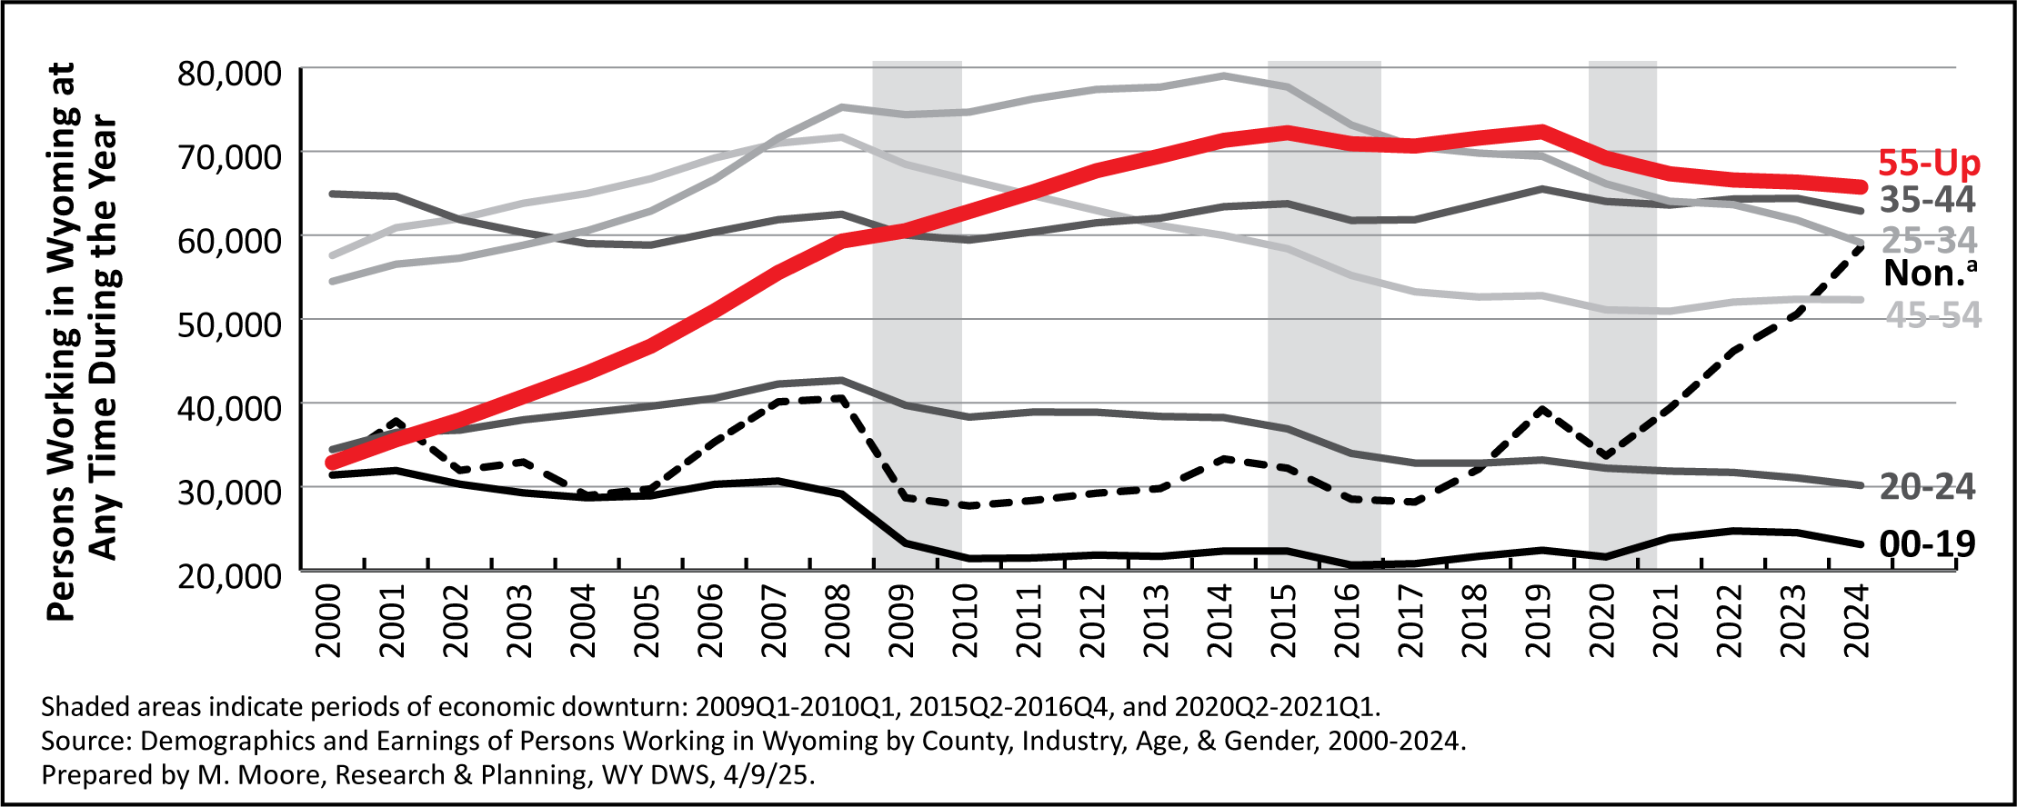
2025 Wyoming Workforce Annual Report
Chapter 7: Demographics of the Workforce
Persons Working in Wyoming by Age, 2000-2024
Notes:
Since about 2018, individuals ages 55 and older have made up the greatest proportion of Wyoming’s workforce.
You can see this in the red line in this graph.
You can see consistent growth in this age from 2000 to 2015, as more and more baby boomers moved into this age range.
We can see a consistent decline in this age group since 2019. This is likely due to a variety of factors, including older workers retiring, leaving the workforce, or moving out of state.

Slide 31
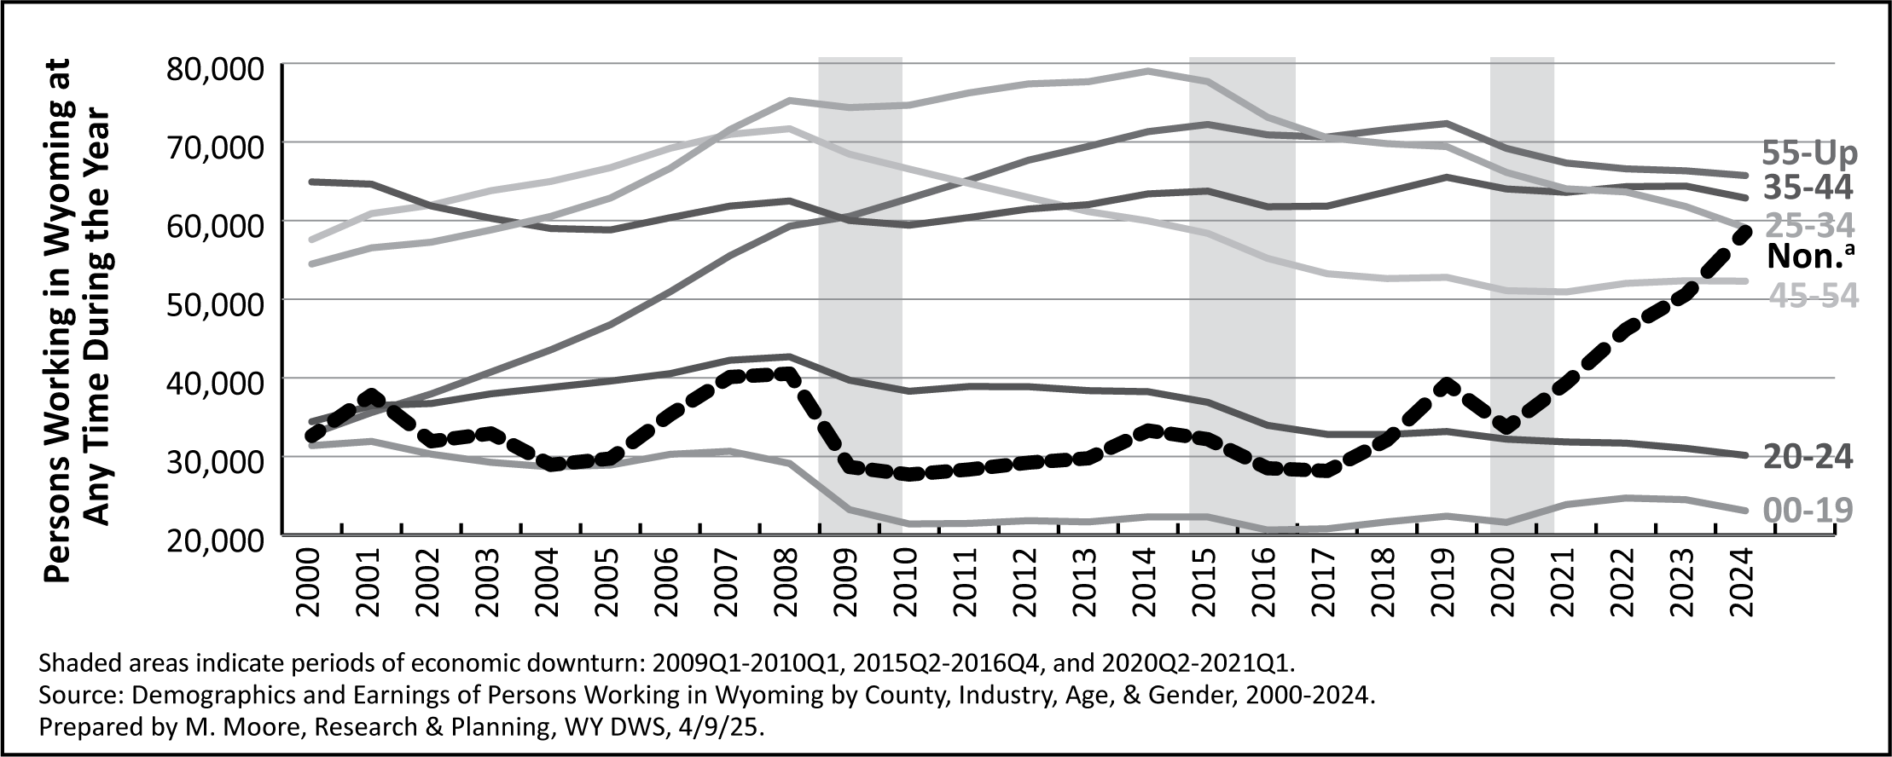
2025 Wyoming Workforce Annual Report
Chapter 7: Demographics of the Workforce
Persons Working in Wyoming by Age, 2000-2024
Notes:
Finally we’ll look at nonresidents, represented by the dark dotted line.
We can see a substantial increase in nonresidents working in Wyoming each year since 2020.
There are a variety of factors at work here.
One, because of the large number of younger workers leaving the state, Wyoming employers may have turned to more out-of-state workers to fill jobs.
Two, some of these are individuals who have moved to Wyoming but haven’t obtained a Wyoming driver’s license.
As we obtain new data the next few years, I think we will have more information on some of these nonresidents, and will move them into other age groups.

Slide 32
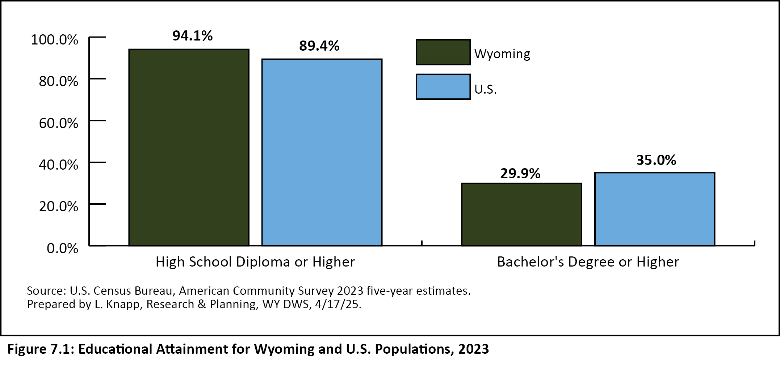
2025 Wyoming Workforce Annual Report
Chapter 7: Educational Attainment
Notes:
Chapter 7 looks at educational attainment in Wyoming and the U.S. by using data from the Census Bureau’s American Community Survey.
For example, in 2023, Wyoming had a greater percentage of individuals with a high school diploma or higher compared to the U.S.: 94.1% vs. 89.4%
However, Wyoming trailed the national average when it came to individuals with a bachelor’s degree or higher, 29.9% to 35.0%%.
In other words, we have a greater percentage of the population with a high school diploma, but a smaller percentage with a bachelor’s degree or higher

Slide 33
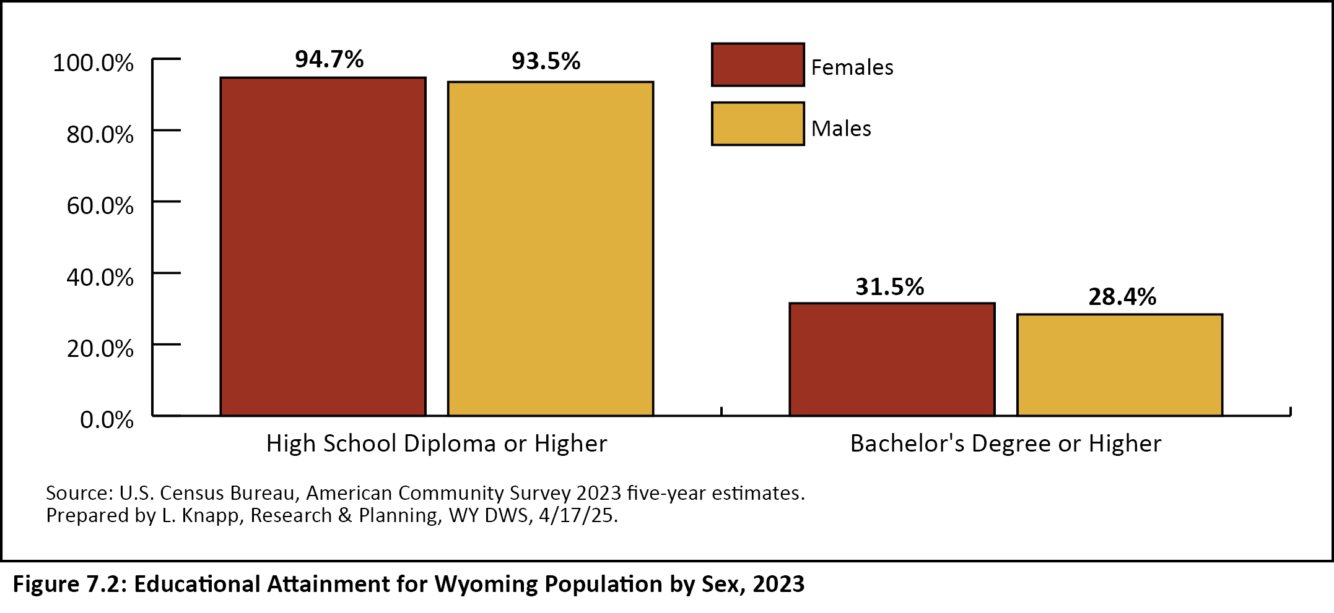
2025 Wyoming Workforce Annual Report
Chapter 7: Educational Attainment
Notes:
Chapter 7 also looks at the difference in educational attainment between males and females in Wyoming.
In 2023, females were more likely to have a high school diploma or higher, 94.7% to 93.5%.
In addition, females were more likely to have a bachelor’s degree or higher, 31.5% to 28.4%.

Slide 34
2025 Wyoming Workforce Annual Report
Chapter 8: Long-Term Employment Projections
Industry Projections
2022-2032
35,000 new jobs
Leisure & hospitality – 6,200 new jobs
Health care & social assistance – 4,600 new jobs
Construction – 4,000 new jobs
Notes:
Chapter 8 looks at long-term industry and occupational projections for 2022 to 2032.
These projections show Wyoming adding 35,000 new jobs over that 10-year period.
Beginning with industry projections, leisure & hospitality is projected to add the greatest number of jobs with 6,200.
Health care & social assistance is projected to add 4,600 new jobs.
And construction is projected to add 4,000 new jobs.

Slide 35
2025 Wyoming Workforce Annual Report
Chapter 8: Long-Term Employment Projections
Occupational Projections
Types of openings:
Growth (new jobs)
Exits
Transfers
Total
Notes:
Chapter 8 also discusses R&P’s most recent long-term occupational projections.
Occupational projections provide us with even more detail, as we’re able to look at projected openings due not just to new jobs (or growth), but also:
Exits, or people leaving Wyoming’s workforce. These could be people retiring, moving, or leaving the workforce to go back to school or to care for a family member.
And transfers, or people changing occupations. These include people getting a promotion, or changing careers.
Total openings refers to the sum of openings due to growth, exits, and transfers. In occupational projections, growth is just a small part of the total projected openings.
Occupational projections also provide the level of education, experience, and on-the-job training typically required to enter that occupation.

Slide 36
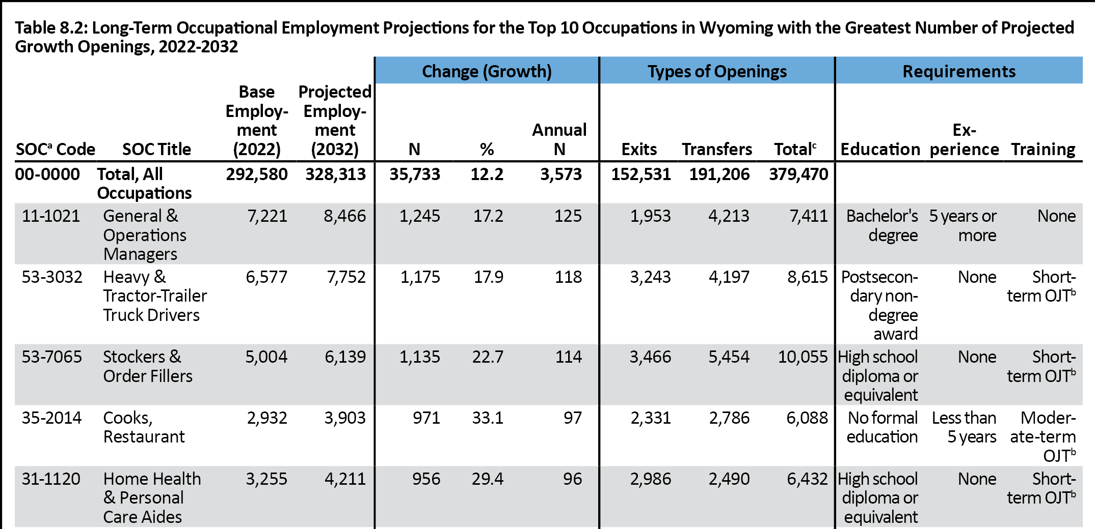
2025 Wyoming Workforce Annual Report
Chapter 8: Long-Term Employment Projections
Occupational Projections
Notes:
Table 8.2 on page 48 of the annual report shows the top 10 occupations with the greatest number of total projected openings.
This table is an excerpt of Table 8.2 and shows the top 5.

Slide 37
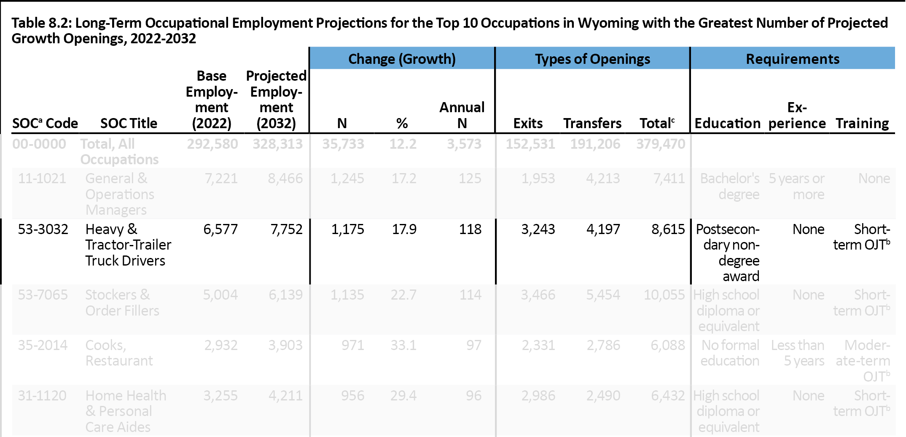
2025 Wyoming Workforce Annual Report
Chapter 8: Long-Term Employment Projections
Occupational Projections
Notes:
Looking, for example, at heavy-tractor trailer truck drivers (which is highlighted in this slide), we see that:
Projections show this occupation growing from 6,577 in 2022 to 7,752 in 2032 – that’s 1,175 new jobs.
In addition, we’re projected to see 3,243 openings due to exits, and 4,197 openings due to transfers, for 8,615 total projected openings.
This is an occupation that typically requires a postsecondary non-degree award (or a certificate), no experience, and short-term on-the-job training.

Slide 38
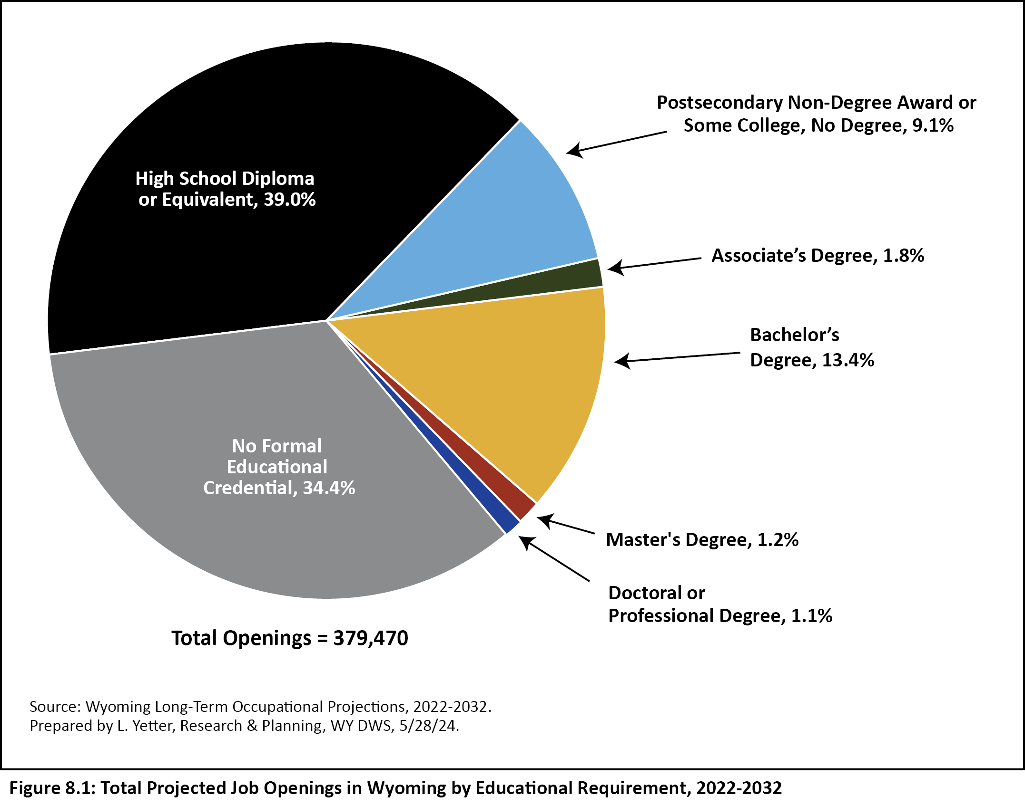
2025 Wyoming Workforce Annual Report
Chapter 8: Long Employment Projections
Occupational Projections: Educational Requirements
Notes:
Overall, as shown in Figure 8.1 on page 49, our long-term occupational projections show 379,470 total job openings in Wyoming from 2022 to 2032.
You can see the vast majority of these require a high school diploma or equivalent (39.0%) or no formal education (34.3%). Together, those two groups make up nearly three-fourths of all projected job openings.
Occupations requiring a bachelor’s degree make up 13.4% of the total, and jobs requiring a postsecondary non-degree award or some college, no degree, make up 9.1%.

Slide 39
2025 Wyoming Workforce Annual Report
Chapter 9: STEM Occupations
STEM Occupations in Wyoming
18,156 STEM jobs in Wyoming
6.2% of all jobs
Higher wages
Almost all require postsecondary education
Notes:
Chapter 9 looks at STEM occupations in Wyoming, based on data from the Occupational Employment and Wage Statistics program, or OEWS, and our long-term occupational projections.
STEM stands for science, technology, engineering, and mathematics.
The U.S. Bureau of Labor Statistics has identified more than 100 STEM occupations. Wyoming data were available for about 80 of those.
In 2022, there were 18,156 STEM jobs in Wyoming, making up 6.2% of all jobs.
STEM jobs tend to have higher wages than many other jobs, and almost all require some sort of postsecondary education.

Slide 40
2025 Wyoming Workforce Annual Report
Chapter 9: STEM Occupations
STEM Occupations in WY and the U.S.
10-year growth rate:
WY: 15.3%
U.S.: 9.8%
Lower-paying jobs in WY than in U.S or many surrounding states
Notes:
Projections data indicate that Wyoming will outpace the U.S. in STEM job growth from 2022-2032.
Wyoming STEM jobs are projected to grow at a rate of 15.3%, compared to 9.8% for the U.S.
However, it’s important to remember that despite this accelerated growth, there are still a relatively low number of STEM jobs in Wyoming.
In addition, OEWS data show that STEM jobs in Wyoming tend to be lower paying than in the U.S. or many surrounding states.

Slide 41
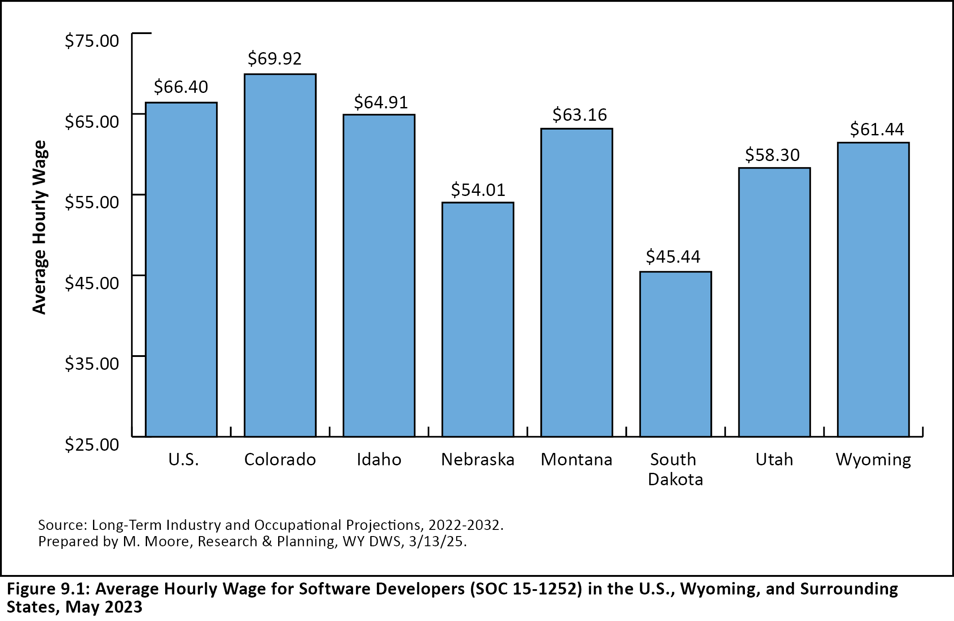
2025 Wyoming Workforce Annual Report
Chapter 9: STEM Occupations
STEM Occupations in WY and the U.S.
Notes:
As an example, Figure 9.1 on page 55 of the annual report shows average hourly wages for software developers in the U.S., Wyoming, and surrounding states.
The average hourly wage for software developers in Wyoming was $61.44 in May 2023.
This is higher than in states like Nebraska and South Dakota, but lower than the national average of $66.40 and the average wage of $69.92 in Colorado.

Slide 42
2025 Wyoming Workforce Annual Report
Chapter 10: Benefits Survey
Benefits
Collects information on types of benefits offered
65.3% offered health insurance
37.0% offered paid sick leave
69.5% offered access to a retirement plan
Notes:
Chapter 10 looks at data from our annual benefits survey.
We collect data on benefits on a quarterly basis, and publish a report on the findings each year.
This report looks at the number of employers offering benefits, and the number of employees offered benefits.
This includes benefits such as medical insurance, paid leave, a retirement plan, etc.
We have very detailed information available at levels like employer size, industry, and sub-state region, and for full- and part-time jobs.
Our survey shows that about two-thirds of Wyoming employees were offered health insurance and a retirement plan.
A smaller percentage (37%) were offered paid sick leave.

Slide 43
2025 Wyoming Workforce Annual Report
Chapter 11: Occupational Employment and Wage Statistics
About OEWS
Employment estimates
Hourly wage
Annual wage
By industry, state, and sub-state region
Notes:
Chapter 11 looks at data from our Occupational Employment and Wage Statistics program, or OEWS.
These data are updated in March and September, and published twice each year.
The OEWS program gives us data on employment estimates by occupation, hourly wage, annual wage, and more.
This information is available at the industry, state, and sub-state region levels.

Slide 44
2025 Wyoming Workforce Annual Report
Chapter 11: Occupational Employment and Wage Statistics
Health Care Occupations, 2013-2023
Total, all occupations: -5,160, or -1.9%
Home health & personal care aides: +1,010, or 45.4%
Medical & health services managers: +320, or 46.4%
Nurse practitioners: +250, or 113.6%
Notes:
For this particular chapter, one of our statisticians looked at OEWS data for health care occupations.
She looked at how employment changed in health care occupations in Wyoming from 2013 to 2023.
Overall during that time, Wyoming lost over 5,000 jobs, or 1.9% of its total employment.
But many health care occupations saw substantial growth.
Home health & personal care aides increased by more than 1,000, or 45.4%
Medical & health services managers increased by 320, or 46.4%
And nurse practitioners increased by 250, or 113.6%

Slide 45
2025 Wyoming Workforce Annual Report
Chapter 12: Census of Fatal Occupational Injuries
Occupational Fatalities
45 in 2023, up from 34 in 2022
Two-thirds were transportation incidents
17 in natural resources & mining
Notes:
Chapter 12 looks at data from the Census of Fatal Occupational Injuries, or CFOI.
In 2023, Wyoming had 45 workplace fatalities, up from 34 in 2022.
Two-thirds of those were in transportation incidents.
At the industry level, 17 were in natural resources & mining

Slide 46
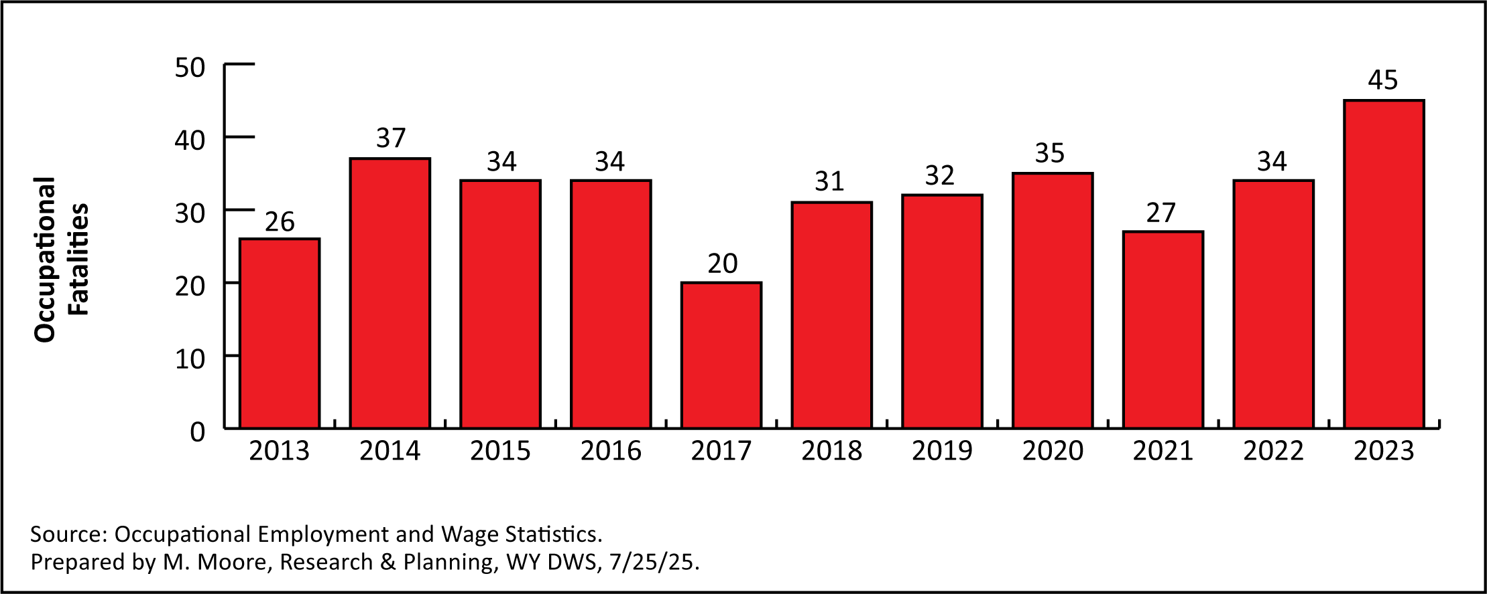
2025 Wyoming Workforce Annual Report
Chapter 12: Census of Fatal Occupational Injuries
Occupational Fatalities Number of Occupational Fatalities in WY, 2013-2023
Notes:
This figure shows the number of occupational fatalities in Wyoming from 2013 to 2023.
You can see that the 45 we had in 2023 was the highest at any time during this period.
In 2017, workplace fatalities dropped to 20.

Slide 47
2025 Wyoming Workforce Annual Report
Chapter 13: Survey of Occupational Injuries and Illnesses
Occupational Injuries
Number of workplace injuries: 2,600
Incidence rate in WY (private industry): 2.7
Incidence rate in U.S. (private industry): 2.4
Notes:
Chapter 13 also focuses on occupational safety and health, with data from the Survey of Occupational Injuries and Illnesses
The SOII is published annually, and collects information only on workplace injuries that result in days away from work.
For example, just a bandaid for a paper cut is not counted as an occupational injury.
The SOII gives us information on the number of incidents, types of incidence, and the incidence rate, or number of incidents per 100 full-time workers.
There were 2,600 workplace injuries that resulted in days away from work in 2023.
The incidence rate for Wyoming private industry was 2.7, while the incidence rate for U.S. private industry was 2.4

Slide 48
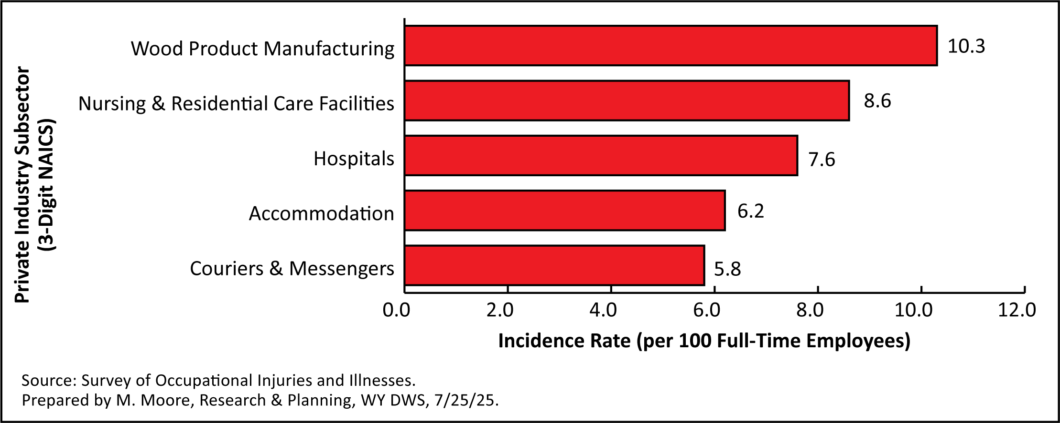
2025 Wyoming Workforce Annual Report
Chapter 13: Survey of Occupational Injuries and Illnesses
Occupational Injuries
Private Industry Subsectors with Highest Incidence Rates in WY, 2023
Notes:
This graphic shows the five industry subsectors with the highest incidence rates in Wyoming in 2023.
Wood product manufacturing had an incidence rate of 10.3, and nursing & residential care facilities had a rate of 8.6.
As a reminder, Wyoming’s overall incidence rate for private industry in 2023 was 2.7.

Slide 49

2025 Wyoming Workforce Annual Report
Contact Us
Michael Moore, Research Supervisor
(307) 473-3814
Michael.Moore@wyo.gov
444 W. Collins Drive
Suite 3100
Casper, WY 82601
https://doe.state.wy.us/LMI
Notes:
With that I will go ahead and wrap up the presentation.
Thank you for inviting me to speak here today and for looking over the annual report.
If you have any questions or need any assistance finding particular data, please feel free to reach out to me. My phone number and email address are provided on this slide, along with our physical address and website.

